Slide 1
Welcome!
Critical Conversations for Healthy Communities

Slide 2
Welcome!
Thank you for coming!
Introductions
Lay of the land
Insert photos of facilitators or something pretty here!
Notes:
Welcome and thank your participants for coming.
Introduce yourself and the other facilitators.
Provide a lay-of-the-land, including where restrooms are located, refreshments, etc.

Slide 3
Purpose for the Day
Explore the breadth of health issues in our community
Determine the resources currently in our community
Discuss needed resources
Brainstorm Extension’s role in improving community health
Notes:
Our goal for today is to talk with key stakeholders in our community – YOU! – to learn more about where our community stands and where we need to focus our efforts.
We will spend our time today working through a great deal. We have an ambitious agenda that includes:
Exploring the breadth of health issues in our community
Determining the resources currently in our community
Discussing needed resources
Brainstorming Extension’s role in improving community health

Slide 4
Who’s in the room?
Do introductory activity of your choice. An example could include:
Name, where you’re from, why you’re here
If you have a large group, you could ask them to introduce themselves to their tablemates
Notes:
But before we get into the heart of why we are here, I’d like to take this time to learn who is in the room.

Slide 5
Why Extension?
Notes:
Now that we’ve learned who is in the room, I want to take the opportunity to tell you why K-State Research and Extension is leading this effort (or collaborating on this effort with another agency/organization).
K-State Research and Extension has identified five grand challenges that we focus our work around. These grand challenges were identified locally with input from a variety of individuals and groups across the state. One of them is the grand challenge of Health. The others include: water, global food systems, developing tomorrow’s leaders, and community vitality.
When we talk about health, though, we do so with immense breadth. Health is so much more than physical activity and nutrition – though those two things are incredibly important! K-State Research and Extension is also interested in larger issues, such as the social determinants of health – things like poverty and injustice. We’re also passionate about environmental health, social health, and mental health. We are dedicated to improving health in all areas, so therefore we approach health from a broad perspective.
So, what does this look like? Some of the work we are already doing in our area/county related to health is ______.

Slide 6
Why focus on Health?
We live in a time when we no longer expect that American children will live a longer life than their parents.
- Centers for Disease Control and Prevention
Notes:
Now I’d like to start to reflect on why we’re here and what has led us to having these conversations.
First and foremost, this staggering statistic from the CDC emphasizes exactly why we need to be here having these conversations. We are currently living in a time when we can no longer expect that our children will live a life longer than our own. Now, this is the first time that this has ever happened – ever! And that alone is a scary fact. Because of the choices we’re making and the environments in which we are living, we are left with this defeating trend.

Slide 7
What influences our health outcomes?
25% = genes and health behaviors
75% = other things
Poverty, inequities among races and ethnicities, access to health care, education, etc.
Social Determinants of Health
- Centers for Disease Control and Prevention
Notes:
So, what is leading us to this trend of decreased life expectancy? It’s a combination of things – and although you might expect what the combination of factors is, you may be surprised at how much of an influence those factors have.
According to the Centers for Disease Control and Prevention, genes and health behaviors together account for about 25% of population health. People generally believe that their health behaviors might account for a larger percentage of their overall health outcomes, but’s that is simply not the case.
The remaining 75% can be attributed to the social environment, physical environment, and health services/medical care, and the like. Things like access to safe and quality housing, affordable and healthy foods, and quality health care and education all fit into the category of “social determinants of health”. These are big issues, and it will require big steps to improve them.
Many of these population health disparities are also due to poverty and inequities among racial and ethnic groups. The impact of these factors are especially hard-felt by Kansans living in rural and frontier regions that are challenged by geographic and social isolation, and lack of access to consistent health care services and professionals.
Lack of access to health care services and professionals is complicated by distance to health care services, high rates of poverty, and unique health conditions associated with working in agriculture. Rural communities also confront out-migration of young people leaving for education and employment, while elderly citizens age in-place, families living in poverty remain, and new immigrants migrate to the area in pursuit of jobs and social mobility.
So, 75% of our health outcomes are due to this big-picture issues. And in order to improve our health outlook, it is going to require some big-picture ideas.

Slide 8
Kansas Statistics
Between 2013 and 2015 opioid addiction increased by 28% and heroin deaths by 71%. Both continue to rise.
Farmers now have higher suicide rates than veterans – both are too high.
Obesity is 31% in all age groups over age 10.
Nearly 20% of our children are food insecure.
More than 12% of our population is in poverty.
And the list goes on…
Notes:
In Kansas, we have some grim statistics. And some of these that I will read to you only begin to paint the picture of our health issues. These are the tip-of-the-iceberg, and we have many strides that need to be made to create a healthier Kansas.
[read slide statistics]

Slide 9
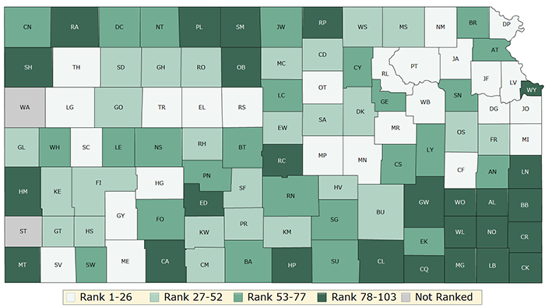
Kansas County Health Rankings
Notes:
But even within our state, the statistics fluctuate a great deal. This is a photo of the 2018 County Health Rankings that are published each year by the University of Wisconsin Population Health Institute and the Robert Wood Johnson Foundation.
The darker regions of the map rank the lowest in Kansas. These rankings are based on a variety of health indicators, including health behaviors, access to clinical care, social and economic factors, and the physical environment. There are many health inequities across our state, and you can see that the southeast region, for example, is hit especially hard.

Slide 10
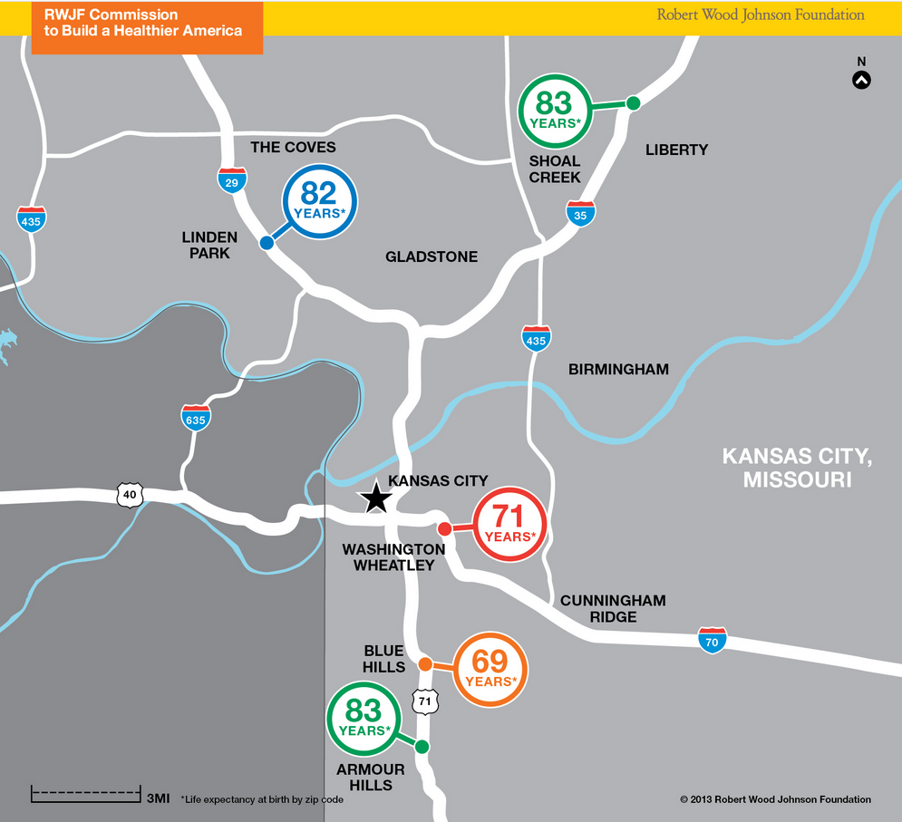
Life Expectancy by Zip Code
Notes:
But the data doesn’t only vary by county – it can also vary within our counties by only a matter of miles. The Robert Wood Johnson Foundation has developed maps of some of the large cities in the United States that show how life expectancy is influenced by where people live – even within small geographical areas.
This is a map of Kansas City, Missouri. Look at the difference in average life expectancy of the two circles toward the bottom of the picture. In the Armour Hills region on highway 71, it is 83 years. Yet, only a few miles up highway 71 in the Blue Hills region, it is 69 years.
That is remarkable and highlights how powerful the environment in which you live truly is.

Slide 11
Extension’s Current Role
Insert some examples of programs/initiatives you are engaging in to improve health in your area
Notes:
So, what is K-State Research and Extension doing about our state’s health challenges? We’re doing a lot! Some ideas of what we’re currently doing in this area are:

Slide 12
Extension’s Future Role
Contribute to the development of healthier communities
Foster collaborations that improve community health
Help alleviate poverty
Help communities prepare for emergencies
Help youth access services to prevent and manage bullying, anxiety, drug use, and other stressors
Help adults understand health care and insurance
Insert some examples of things you think you could do in your community in the future
Notes:
And our role can and should continue to grow into the future. K-State Research and Extension administration feels that we can have influence in some of these areas: [read list from slide – I have included some examples, but feel free to tailor this to what you can think you can do in your county/district]

Slide 13
Extension’s Current and Future Role
“Increase the number of Americans who are healthy at all stages of life.”
Notes:
The list of the previous slide can all be summed up by saying that we are dedicated to “increasing the number of Americans who are healthy at every stage of life.” That is what we are truly passionate about at K-State Research and Extension, and that’s what we intend to do.

Slide 14
But it will take all of us…
Social services
Faith organizations
Businesses
Community members
Youth
Community leaders
Others…
Notes:
But, we can’t do it alone. It is going to take all of us in our community to make a difference. And that is why we are here today – to begin the discussion of what our needs are, where we currently stand, and what we need to do to move forward.

Slide 15
World Café
Notes:
Today we are going to be engaging in a “world café” – a model of facilitating conversation. You are going to begin by discussing the first question with your current group, then we’re going to switch it up. Please select one person in your current group to be the note-taker. That individual will stay at your table once the time is up. The rest of you will move to a new group with new people. The goal is to mix up the groups so that you are hearing diverse opinions and strategies during every question that we discuss today.
So, to recap. We’re going to discuss the first question. One person will be your note-taker. That person will stay at the table when it is time to switch. The rest of you will move around to different tables. Then, we’ll discuss the next question. And then we’ll repeat the process. Sound good?

Slide 16
World Café
Question 1
What are the biggest health concerns in our community today? How do we know this?

Slide 17
World Café
Question 1
What are the biggest health concerns in our community today? How do we know this?
Question 2
What resources does our community currently have to address these needs?

Slide 18
World Café
Question 3
What resources, programs, and initiatives does our community need to help address our biggest health concerns?
Question 2
Who else do we need to bring to the table to discuss the resources, programs, and PSE initiatives we need to address the biggest health concerns in our community? Who needs to be on board to implement these strategies?

Slide 19
World Café
Question 3
What resources, programs, and initiatives does our community need to help address our biggest health concerns?
Question 4
What educational and outreach initiatives can K-State Research and Extension provide to help our community move forward in improving health?

Slide 20
So Now What?
What will you do in the next 30 days to help our community become healthier?
Notes:
Ask participants to answer this question on their evaluation sheet (in addition to the other questions asked).

Slide 21
High-Fives!
What was your high-five moment of the day?
Insert fun picture of you high-fiving someone!
Notes:
At each site, have a few groups share their “high-five” moments of the day. Maybe they thought of a new partnership or initiative, maybe they felt inspired, whatever it is, have some folks shout it out.
Be sure to take notes during this section – as you can incorporate their statements into your evaluation measures. You might also submit notable “high five” moments as a Success Story in PEARS.

Slide 22
Final Things…
Thank you for coming!
Submit your evaluation
Insert your personal contact info/office contact info here with your county/district logo

