Slide 1



Program Update
August 30, 2018
Gayle Price
Extension Specialist
Neeley Carlson, Director
Workforce Development
Notes:
Introduction
Gayle and Neeley
Recognition of Cody Crawford- KRHA
Karen Blakeslee- Support with the Food Safety- ServSafe Website.
Handouts
Overview of ServSafe Manager Training Tools
Sample Agenda for 8 Hour Video Based Manager Training
KSRE- Making a Difference Report- 2017

Slide 2
Objectives:
Review levels of ServSafe training.
Review and understand ServSafe certification protocol.
Understand the value of the KSRE/KRHA program partnership.
Review and update on ServSafe training resources.
Learn about ServSafe Manager registration/support from KRHA.

Slide 3
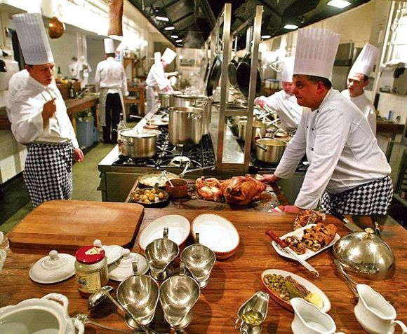

Why
The ServSafe Food Safety training
program is widely recognized and
respected in the foodservice industry.
Notes:
The ServSafe® program is developed by the National Restaurant Association with the help of foodservice industry experts who face the same risks you do every day..
K-State Research and Extension (KSRE) Family and Consumer Sciences (FCS) professionals in partnership with the Kansas Restaurant and Hospitality Association (KRHA) provided food safety training to foodservice outlets and community organizations in Kansas.
The ServSafe® Food Safety Education program is a nationally recognized certification and training program. This program targets foodservice managers, entry-level food handlers, and community organizations who provide food to the public.

Slide 4


Why
Quality materials and exams
Accepted in all 50 States
Provides Food Safety Education
Provides Food Safety Certification
Widely supported by Cooperative Extension
Up-to-date Information
Notes:
Uses quality materials and exams created by foodservice and regulatory experts exclusively for the foodservice industry
Reinvests proceeds from programs back into the industry
Accepted in all 50 states, making it ideal for single and multi-unit operations
A single source, one-stop show for both food safety training and the certification examination
Delivers up-to-date regulatory information
Provides support from foodservice subject matter experts available to answer questions
Offers flexible online, classroom, in-unit and one-on-one training and examination options
Widely supported by Cooperative Extension system nationally.

Slide 5


Levels of ServSafe Food Safety Training
Food Handlers
Manager Certification
Notes:
Two Levels
Food Handler –Basic entry level knowledge focused on - Basic Food Safety, Personal Hygiene, Cross-Contamination & Allergens, Time and Temperature, Cleaning and Sanitation
2-3 hour training
Manager Level- The ServSafe Manager Book 7th Edition is ideal for one- or two-day classroom instruction helping students prepare to take the ServSafe Food Protection Manager Certification Exam.
It covers critical principles including: personal hygiene, cross contamination, time and temperature, receiving and storage, food safety management systems, training hourly employees, and more.
1-day (8+ hours of instruction ending with a 90 question standardized certification exam.

Slide 6

Who Can Teach ServSafe?
ServSafe Food Handler
Extension Agent
ServSafe Manager
ServSafe Certified Instructor’s
Notes:
The ServSafe Manager Certification is good for 5 years. Re-certification is needed.

Slide 7
BECOME A SERVSAFE® CERTIFIED INSTRUCTOR
As a Certified ServSafe® Instructor, you can:
Teach the ServSafe food safety manager training course.
Access online instructor resources and information.
Recommendation:
Obtain ServSafe Dual Role Certified Instructor/Registered Proctor
Instructors do not administer exams.
Proctors and those with dual role status perform tasks related to secure exam administration.
Notes:
To become a Certified ServSafe Instructor, you must:
Have a high school diploma or GED
Meet one of the following professional experience or advanced education requirements:
Professional experience-Have taught or trained for at least six months-
Are in a training role (e.g., training at a trade school, at a state restaurant association or in a corporate setting)
Have worked in a foodservice operations environment for one year
Are employed as a health inspector or equivalent by a state or local regulatory authority
Work as a Registered Sanitarian, Registered Dietician, or equivalent
Advanced education-Have earned a Bachelor of Science degree from an accredited university or college in one of these subjects:
Food Science, Food Technology, Epidemiology, Environmental Health, Public Health
DUAL ROLE (CERTIFIED INSTRUCTOR AND REGISTERED PROCTOR)
The dual role status means that you are both a Certified Instructor for the ServSafe Food Safety Manager training and a Registered Proctor for the certification exam.

Slide 8
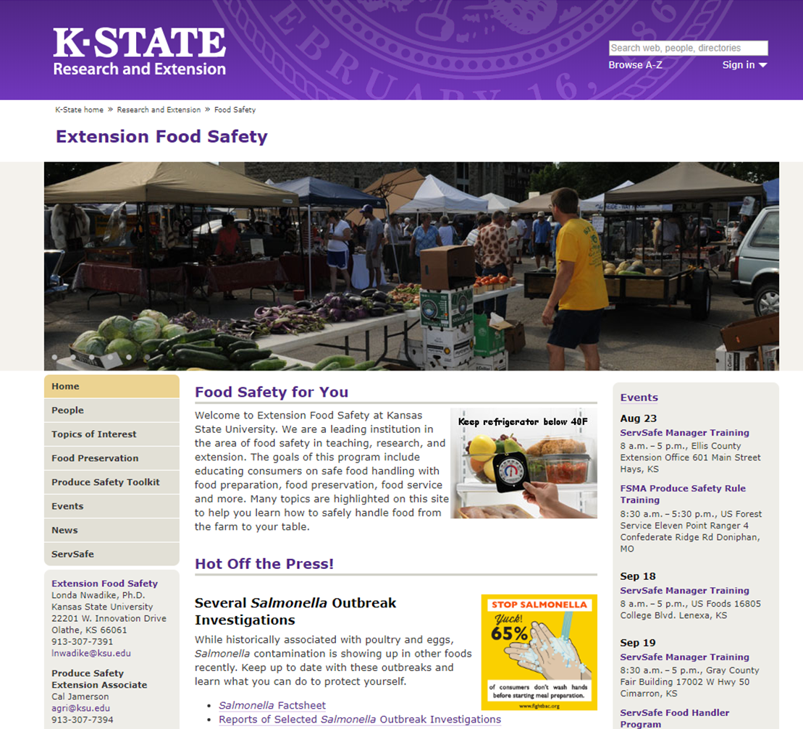
K-State Extension
ServSafe Program Website
2018 Training Schedules
Agent Resources
Price List (Pearson-Oasis)
SS Manager Resources
Professional Development Units
SS Food Handler Resources
Evaluation
Program Impact Reporting (Agent)
http://www.ksre.k-state.edu/foodsafety/servsafe/index.html
Notes:
ght the following on the Agent Resources page:
2018 Training Schedules
Agent Resources
Price List (Pearson-Oasis)
SS Manager Resources
Professional Development Units
SS Food Handler Resources
Evaluation
Program Impact Reporting (Agent)

Slide 9
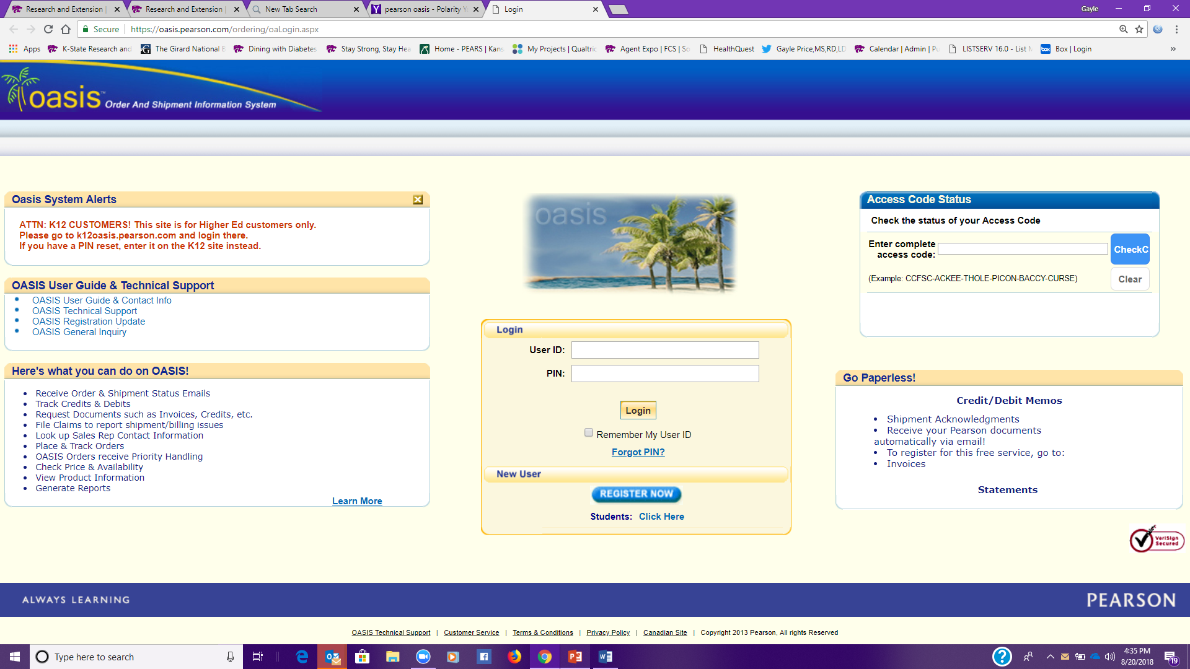
Ordering ServSafe Materials
Notes:
KSRE=Pearson Oasis Account.
Login into KSRE Food Safety- SevSafe Agent Resources Site- Document with instructions on how to access the Pearson Oasis account.
If your local unit is not currently listed please contact Gayle Price.
Current “Local Unit” List
Current Price list is also on the agent resources page.

Slide 10
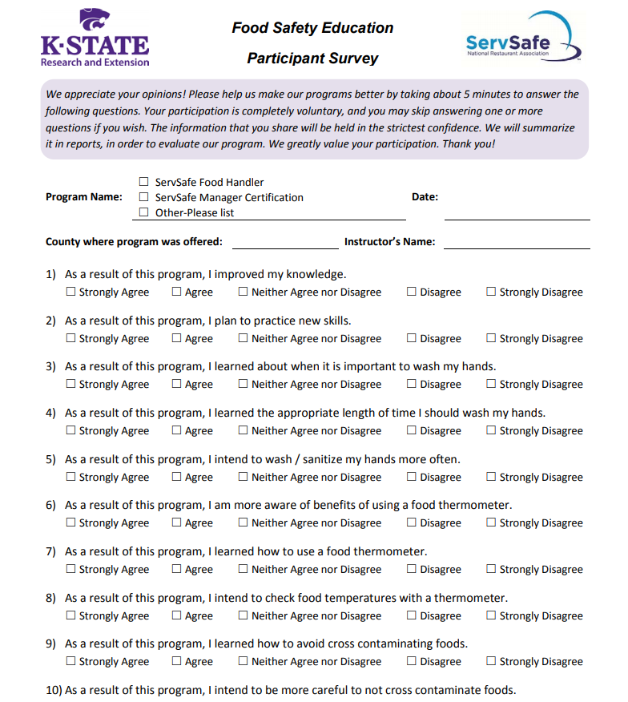

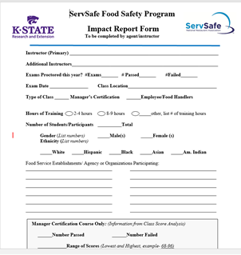
Evaluation and Reporting
Agent Summary
Notes:
Food Safety Education- Initial Feedback Survey
Use for Food Handlers and Managers Courses
Agent/Instructor Impact Summary- On Agent Resources page under evaluation
Also to encourage submission I have also created a link (Qualtrics Survey) for agents to submit instead of the “form fillable” paper form.
Either form is fine to use.

Slide 11
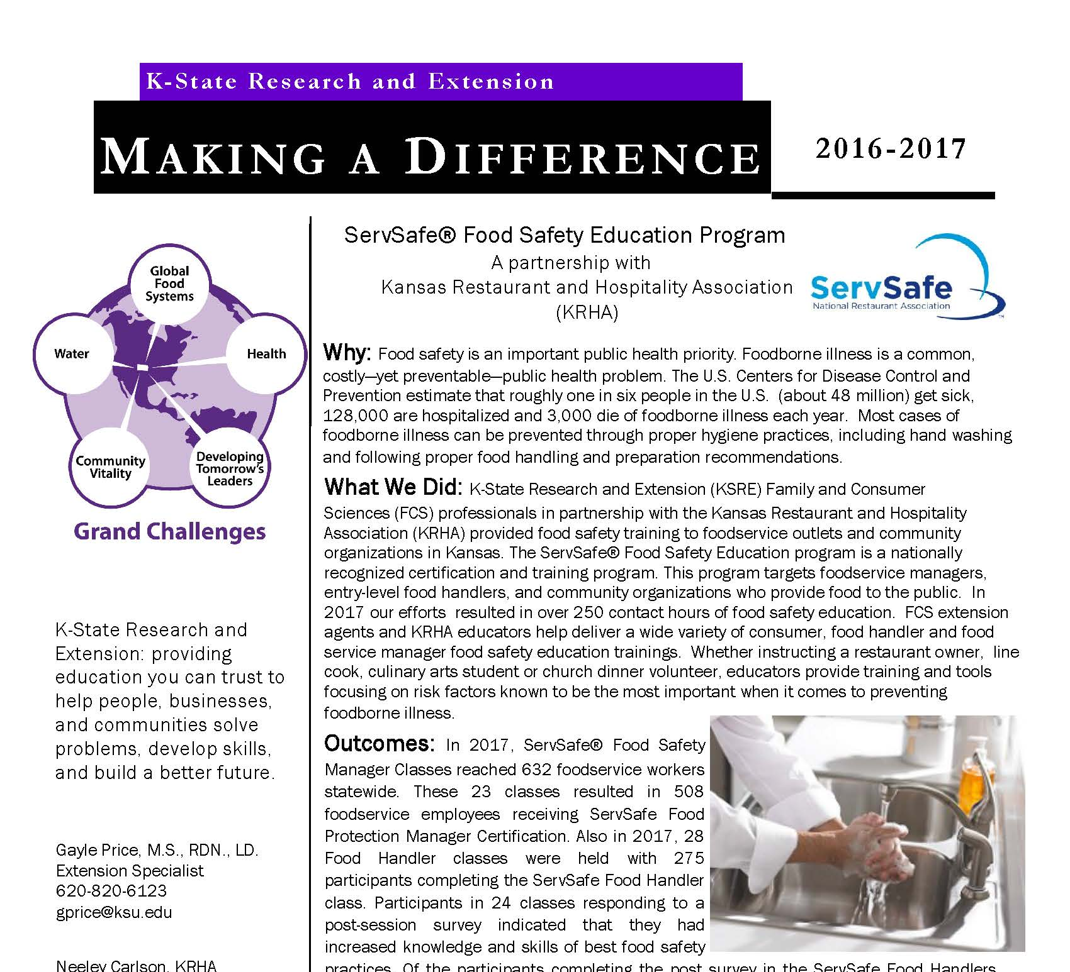


Kansas ServSafe Impact
ServSafe® Food Safety Education Program
A partnership
and
Notes:
2017 Making A Difference Report- Handout
Program Impact Reported to
KSRE Administration
Making A Difference Report
Included in the KSRE National Extension Report
KRHA- Reported to Board of Directors
Beginning in January 2019 local units providing SS Food Handlers and Manager Level Courses will be asked to send $3.00/participant to the state
to help provide training materials/marketing tools to support the work.
Charge $15.00/ participant for SS Food Handlers
Charge $120/ SS Manager Level

Slide 12
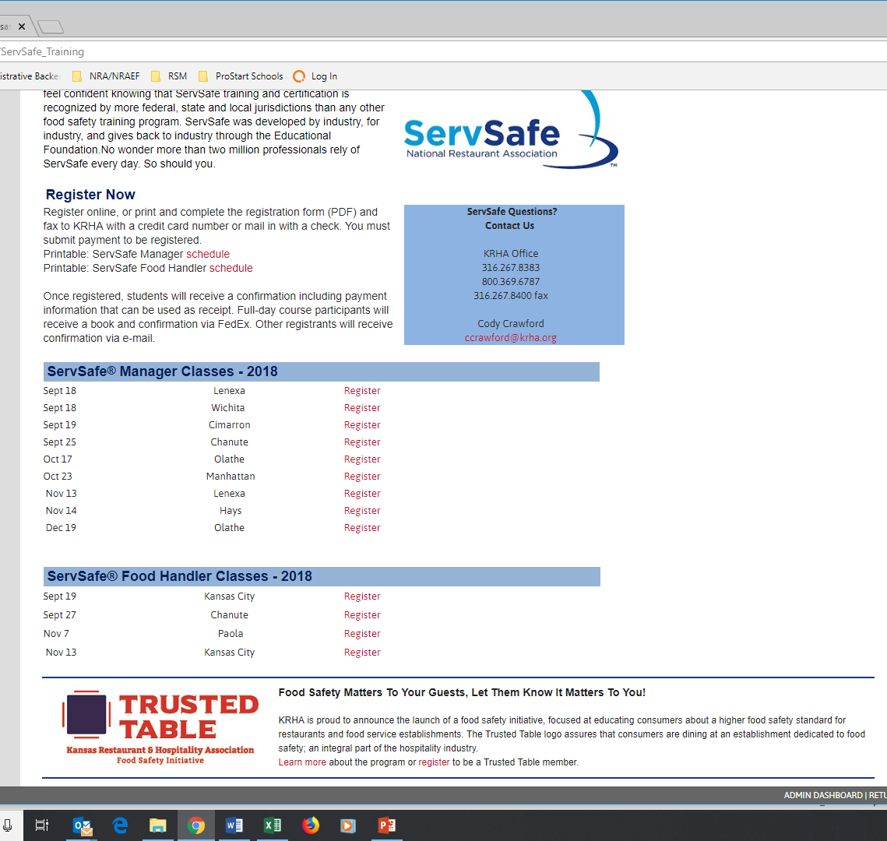

ServSafe Class Registration
Agents can submit training dates thru the online submission form.
Classes are then posted to the KRHA website.
If your extension office takes online registrations, we can redirect the link to your page.

Slide 13
Class Registration
Agents now have 2 options for managing the class registration process.
1. Agents can continue to manage the registration and class process.
2. Agents can have KRHA manage the registration process.
KRHA will take all registrations.
Minimum registration of 10 & hold shipping of books until that number is met.
KRHA (Cody) will track all registrations and can update agents upon request.
KRHA will mail out all books and diagnostic exams.
KRHA will send a class roster to the agent following the registration deadline.

Slide 14
Class Registration
KRHA will keep a portion of each registration:
  Book $70.30 or Answer Sheet $38.00
  Shipping (refer to the shipping for each type of registration above)
  Administration Fee: $5.00
  K-State portion: $29.70 with book or $32.00 with answer sheet only
The remaining funds for each registration will be sent to the host agent.
KRHA will mail exam answer sheets to agents for those that paid the registration fee for ServSafe Training/Exam (already have a book)
Agents will be responsible for ordering exams. This can be done in advance.
Agents will be responsible for sending exam results to students.

Slide 15

2017 Food Code Update
  1. Person in Charge. The person in charge (PIC) shall be a certified food protection manager who has shown proficiency of required information through passing a test that is part of an accredited program and be on-site at all times while the facility is in operation. Also, this person must be designated in writing as the PIC.
How is this a change? Previously anyone on staff could be the PIC, and while they were so designated, they did not have to be on-site or certified. Now, the PIC has to be a certified food protection manager, and has to be on site. This requirement increases responsibility and accountability, which will drive food safety. It will also mean that foodservice establishments will need to have more certified food protection managers, so that every shift will have a certified manager on site at all times.

Slide 16
2017 Food Code Update
  2. Use of Bandages, Finger Cots, or Finger Stalls. If used, an impermeable cover such as a bandage, finger cot or finger stall located on the wrist, hand or finger of a food employee working with exposed food shall be covered with a single-use glove.
What’s new? This is a stricter requirement about wound protection. The code identifies a specific physical hazard (no one wants to find a bandage in their food) and stresses the need for extra protection. This additional protection not only helps to reduce the chance of the physical hazard of a lost bandage, but also reduces the opportunity for biological hazards such as blood or pus from a wound getting into food by requiring two layers of protection.

Slide 17
2017 Food Code Update
  3. Clean-up of Vomiting and Diarrheal Events. A food establishment shall have written procedures for employees to follow when responding to vomiting or diarrheal events that involve the discharge of vomitus or fecal matter onto surfaces in the food establishment. The procedures shall address the specific actions employees must take to minimize the spread of contamination and the exposure of employees, consumers, food, and surfaces to vomitus or fecal matter.
How does this differ from prior food code recommendations? In the past, there was no requirement for written standard operating procedures (SOPs) that addressed bodily fluid clean up. This change stresses that procedures need to be written, kept at your facility, and should include procedures for actions, documentation, and training. Again, it’s a matter of accountability and responsibility. Foodservice operations must put their SOPs in writing and ensure that all employees have been trained in these tasks.

Slide 18


KRHA Food Safety Initiative
Trust the Training. Trust the Commitment.
Trusted Table is a food safety initiative, created by the Kansas Restaurant & Hospitality Association, which sets a higher food safety standard for restaurants and food service establishments. The Trusted Table logo, assures that you are dining at an establishment dedicated to food safety; an integral part of the hospitality industry.
www.trustedtable.org

Slide 19

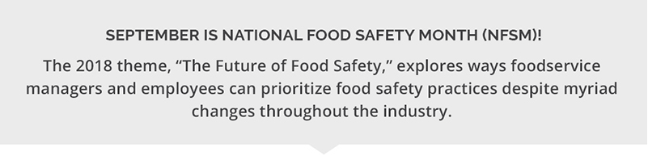

Slide 20

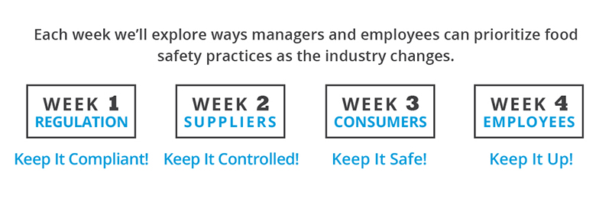

Slide 21
Questions?
Gayle Price
Extension Specialist
Neeley Carlson, Director
Workforce Development

