Slide 1
Shopping Safe at Farmers Markets
Prepared by: Londa Nwadike
Extension Consumer Food Safety Specialist
University of Missouri/ Kansas State University

Slide 2
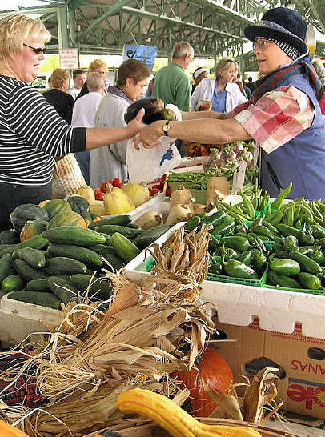
Presentation outline
Why Farmers Markets?
Who needs food safety?
Safety tips
At the market
On the way home
At home

Slide 3
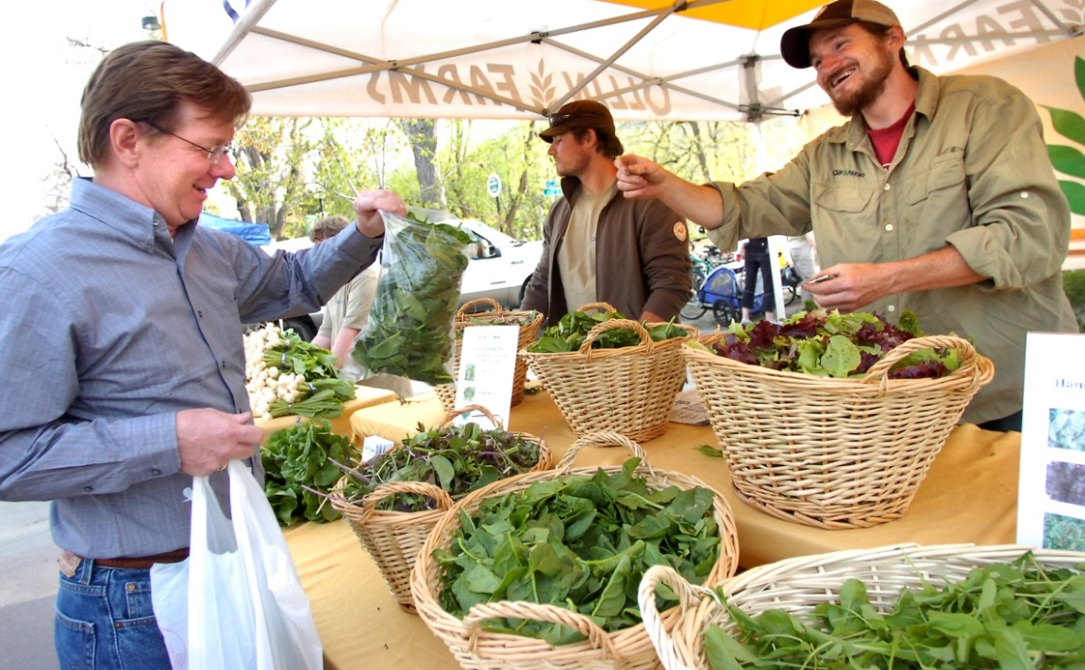
Why Farmers Markets?
Growing in popularity across US and Kansas
Purchase healthy produce and other foods
Meet and support local farmers
Enjoy shopping in a fun environment

Slide 4
Who needs food safety?
Everyone! Particularly vulnerable populations
Young
Aging populations
Pregnant women
Sick

Slide 5
Safety tips at market- Look for clues
May not have same food safety system as a store
-But can talk to producer directly
Cannot see pathogens (“germs”)- use clues
Fresh produce
Tomatoes: Avoid those with cuts or nicks
All others: clean, look fresh, above ground/floor
Cut/peeled produce
Displayed on/surrounded by ice
Should look fresh, cold
Processor needs KDA license

Slide 6
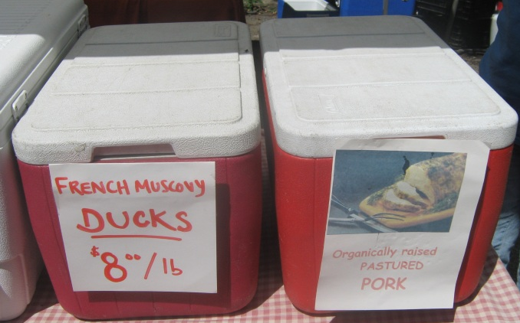
Look for clues
Note: local FM rules may be stricter
Meats, eggs, cheeses
Can touch to see if they are cold
All meat and poultry must be USDA/KDA inspected
Want to see these products in a cooler with ice
Eggs: Open carton- ensure eggs are clean, not cracked
Ensure carton is clean, can be re-used
<45F is a best practice, but requirements depend on flock size;

Slide 7
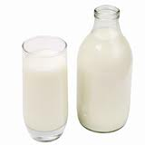
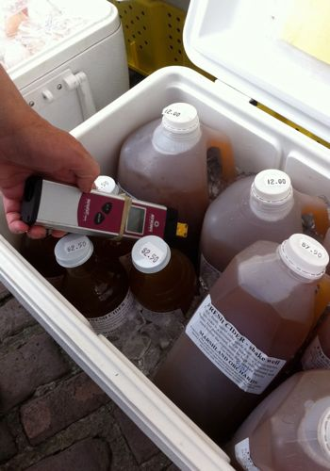
Look for clues- 2
Milk
All dairy products must be KDA inspected
Raw milk can only be sold on the farm
Juice, cider
Pasteurized is safest
Particularly for pregnant women, children, older adults, sick

Slide 8
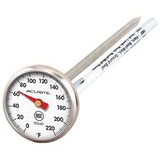
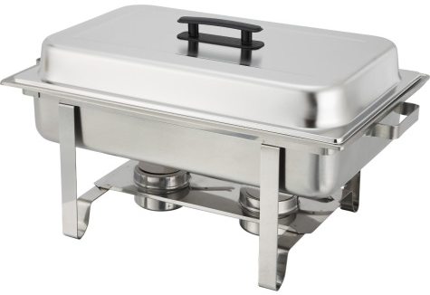
Look for clues- 3
Hot prepared foods
Would like to see vendor using thermometer
Check how vendor is keeping foods hot
Should see steam rising
# of sterno cans
Use of lids
Electric heating better
NOTE: tips are true for any festival where food is sold

Slide 9
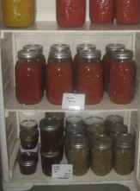
Look for clues- 4
Prepared (canned) foods
Ask vendor for specific handling instructions at home
Could require refrigeration or may be shelf-stable
Ask how food was prepared
Boiling water bath (or pressure canner) required for shelf-stable; otherwise refrigerate
Gain sense of their food safety knowledge
License required for home-canned pickles, meats, vegetables, sauerkraut

Slide 10
Look for clues- 5
Baked goods
Cookies, breads, fruit pies, dry powder mixes allowed
Samples
Servers should keep a barrier between hands and food
Gloves, tongs, tissues, utensils
Samples offered so that shoppers only touch 1 sample
Ex: toothpicks in apple slices

Slide 11
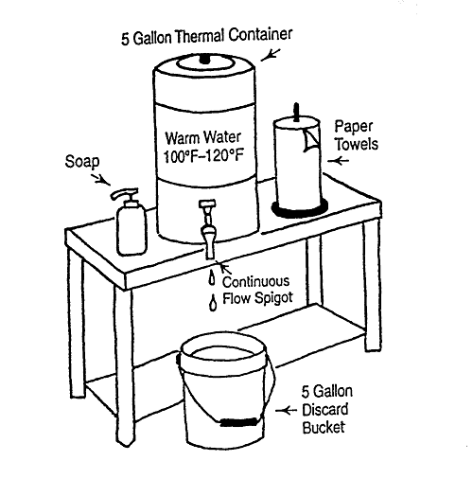
Look for clues- 6
Handwashing
Seeing vendors washing their hands
See handwashing station in booth
Needed for hot prepared foods, samples
Booth cleanliness
Surfaces of their booth, knives, other utensils
Personal hygiene
Clean clothes, hands, no wiping nose, etc.

Slide 12
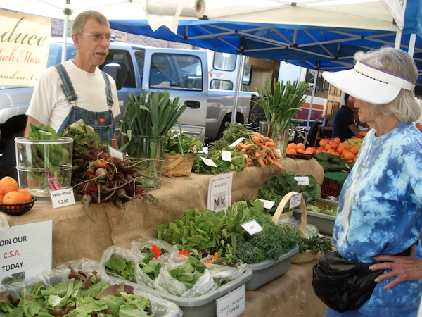
Look for clues- 7
Look for any posted food safety certifications
Training, inspections, etc
Ask vendors about their food safety practices
Water they use in irrigation, washing
Harvesting/processing/ sanitation methods
Fertilizers used
On-farm animal practices
Employee training, health
Product transportation

Slide 13
NOT necessarily a clue…
Labeling
“organic”, “local”, etc
These labels refer to things other than directly to (microbial) food safety
“No one has ever gotten sick from eating my products”
Hard to trace food borne illnesses back to foods eaten only in small quantities
Outbreaks can occur from “local” products

Slide 14
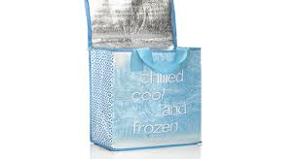
On the way home
Make market last stop before going home
Keep raw meat separate from other foods
Use cooler/ insulated bag
Especially on hot days or if >1 hour home
Store in passenger part of car, rather than trunk
Reusable bags: wash often, store dry

Slide 15
At home- 1
Same as any foods you eat
Chill: refrigerate or freeze perishables immediately
Refrigerate cut or peeled produce, meats within 2 hours
If air temperature is >90°F, within 1 hour
Pathogens (germs) love room temperature, so grow fast!

Slide 16
At home- 2
Cook: thoroughly, as with any foods
Heat kills germs
Check temperature with thermometer
Beef, pork, lamb steaks, chops, roasts: 145°F with 3 min rest
Ground beef, pork; egg dishes (quiche): 160°F
All poultry products, reheated foods: 165°F

Slide 17
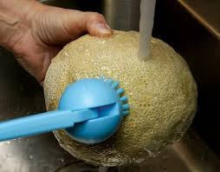
At home- 3
Clean
Always wash hands before and after handling food
Wash produce under running water
No soap or produce washes
Even if peeling the produce
Don’t transfer “dirt” from outside to inside
Wash cantaloupe, potatoes, etc with produce brush
Keep surfaces, utensils clean- before and after use

Slide 18
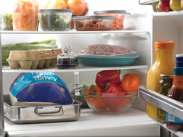
At home- 4
Separate: Keep raw, RTE foods separate
Use separate cutting boards, plates, utensils for raw meat and produce or cooked foods
Keep raw meat, eggs separate from other foods in frig
Raw items in sealed plastic bags or other containers
Keep eggs in carton and do not store in door (keep cooler)

Slide 19
Additional information
Shopping Safe at Farmers Market Fact Sheet
www.ksre.ksu.edu/bookstore/pubs/MF3136.pdf
KSRE Food Safety at Farmers Markets page:
www.ksre.ksu.edu/FoodSafety/p.aspx?tabid=39
Food Safety.gov
www.foodsafety.gov/blog/farmers_market.html

Slide 20
Contact Details
Londa Nwadike
Extension Consumer Food Safety Specialist
Kansas State University/ University of Missouri
Cell Phone: 913 313 9273 Email: lnwadike@ksu.edu
www.ksre.ksu.edu/foodsafety/

