Slide 1
Gluten and Your Gut’s Good Health
2016 FCS Lesson
K-State Research & Extension
Sandy Procter, PhD, RD/LD and Katelyn Dixon

Slide 2
Objectives:
After completing this lesson, participants will:
Know what gluten is, and its role in foods
Distinguish common and lesser-known sources of gluten in the diet
Identify potential health effects related to gluten in the diet
Understand reasons behind current gluten-free diet trends
Recognize skills needed and products available supporting gluten-free living

Slide 3
What is gluten?
the protein in wheat, rye, barley and some related grains
provides the elastic, chewy properties in breads
allows dough to stretch but not break
amount varies in flours depending on how sturdy products need to be (pasta vs. pastry, for example)

Slide 4
Why avoid gluten?
Celiac disease
Dermatitis herpetiformis
(hur-peh-tuh-FOR-mis)
Non-celiac gluten sensitivity

Slide 5
Celiac disease
Formerly called “celiac sprue”
Affects about 3 million in US
Is an autoimmune disorder
May be passed along in families
Damages villi of small intestine, decreasing absorption of nutrients
Symptoms vary from patient to patient
Treated with gluten-free diet

Slide 6
Dermatitis herpetiformis
Type of celiac
Affects person internally (gut) and outwardly (skin rash)
Diagnosed through skin biopsy, blood tests
Treated with gluten-free diet

Slide 7
Non-celiac gluten sensitivity
Called NCGS for short
May experience GI symptoms, but symptoms vary widely
No diagnostic tests at this time, so other conditions must be ruled out
Gluten-free diet is basis of treatment, but additional foods may also need to be eliminated

Slide 8
What about wheat allergy?
Differs from celiac and NCGS
Exposure brings about almost immediate symptoms
Symptoms often respiratory
May escalate to anaphylactic shock
Need to avoid wheat-containing foods (not just gluten)
Diagnosed through allergy testing

Slide 9
What is a gluten-free diet?
People with celiac disease, dermatitis herpetiformis and NCGS should follow a lifelong gluten-free diet, strictly avoiding the protein from:
Wheat
Rye
Barley

Slide 10
What is a gluten-free diet?
In 2013, the U.S. FDA published a regulation defining “gluten free”
Contains less than 20 ppm of gluten
Also covers similar claims, to decrease confusion:
No gluten
Free of gluten
Without gluten
ALL MUST MEET GLUTEN-FREE DEFINITION!

Slide 11
How does a gluten-free diet help?
Allows intestine to heal
Improves GI symptoms
May help prevent conditions possibly caused by long-term untreated celiac
lymphoma
osteoporosis

Slide 12
Gluten vs. gluten-free
Gluten-Containing Grains/Thickeners | Gluten-Free Grains/ Thickeners
Wheat | Corn
Kamut | Rice
Spelt | Tapioca (cassava)
Barley (malt, including malt extract and malt vinegar) | Amaranth
Rye | Buckwheat
Farro | Arrowroot
Oats* | Millet
Triticale (a cross between wheat and rye) | Montina
Brewer’s yeast | Lupine
Wheat starch (not processed) | Flax
 | Quinoa
 | Soy
*Technically, oats are gluten free but | Sorghum
are often contaminated during processing | Taro
 | Teff
 | Chickpea (gram flour)

Slide 13
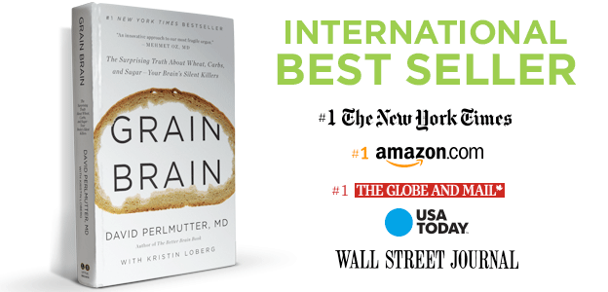
Why the gluten-free trend?
Relief from symptoms
Hope for weight loss?
Popular press increasing awareness

Slide 14
How can I tell if gluten-free is for me?
Talk with your health-care provider about your symptoms, before you exclude gluten
The diagnosis of celiac disease is based on blood tests and a biopsy of the small intestine. It’s important to test BEFORE starting a gluten-free diet.

Slide 15
Where do I start?

Slide 16
Label reading is key
Here is an ingredient panel from a Nutrition Facts label.
Is there anything here someone wishing to avoid gluten should note?

Slide 17
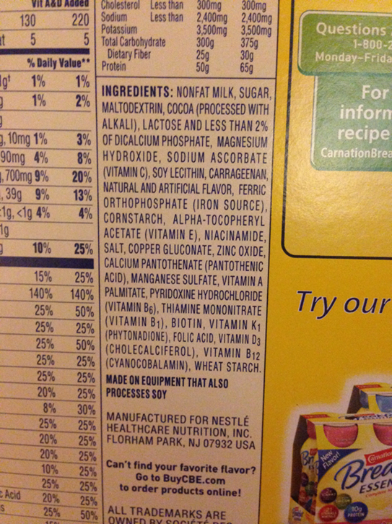
Label reading is key
Here is an ingredient panel from a Nutrition Facts label. Is there anything here someone wishing to avoid gluten should note?
Wheat starch does NOT contain gluten, so this ingredient is not an issue for a person with celiac disease or NCGS.

Slide 18
Here’s another example…
Hint: There are 2 ingredients to avoid in this food…

Slide 19
Here’s another example…
Hint: There are 2 ingredients to avoid in this food…
Whole grain wheat flour
Malted barley flour
Both contain gluten!

Slide 20
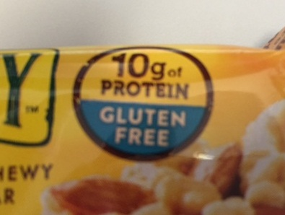
What to look for….
This symbol assures
us that this food is virtually gluten free.
Limited research since the 2013 FDA regulation shows that gluten-free foods are indeed less than 20 ppm.

Slide 21
Check labels each time you shop
– even on familiar foods and brands. Also, gluten maybe hidden in unexpected places!
Check online for gluten-free sources
Ask your pharmacist about your medications

Slide 22
How do I manage ‘gluten-free’ away from home?
Plan ahead – check restaurants for options before you arrive
Consider the possibility of cross-contact
Let your host know your diet restrictions
Offer to bring a gluten-free dish for everyone to enjoy

Slide 23
Let’s try some recipes!
Any Questions?

