Slide 1
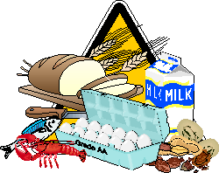
Food Allergy Facts of Life

Slide 2
K-State Research and Extension Golden Prairie Extension District #12
Amy Lorenzen
Family and Consumer Science

Slide 3
Food Allergy Basics The science behind it all
Our body has an immune system designed to protect us from germs and disease.
A food allergy is an abnormal response of our immune system to a food protein.
When the food is eaten, the immune system thinks the food is harmful and releases histamine and other chemicals to attack the “enemy.”

Slide 4
Food Allergy Basics Diagnosing a Food Allergy
Detailed medical history
Allergist will conduct skin-prick tests or blood tests or both
Only way to truly diagnose if you have a food allergy

Slide 5
Food Allergy Basics
There is no cure for food allergies
Complete and strict avoidance of the food is the only way to prevent a reaction.

Slide 6
Food Allergy Basics
8 foods cause 90% of the allergic reactions to people in the United States.
Each food has many different names.
Important to learn the different names of foods and read labels.

Slide 7
Trigger Foods
Eggs
Fish
Milk
Peanuts
Shellfish
Soy
Tree nuts (walnuts, pecans, macadamia, etc.)
Wheat

Slide 8
Food Allergy Facts
As many as 15 million Americans have a food allergy.
9 million of those are adults
6 million of those are children
Food allergies seem to be on the rise

Slide 9
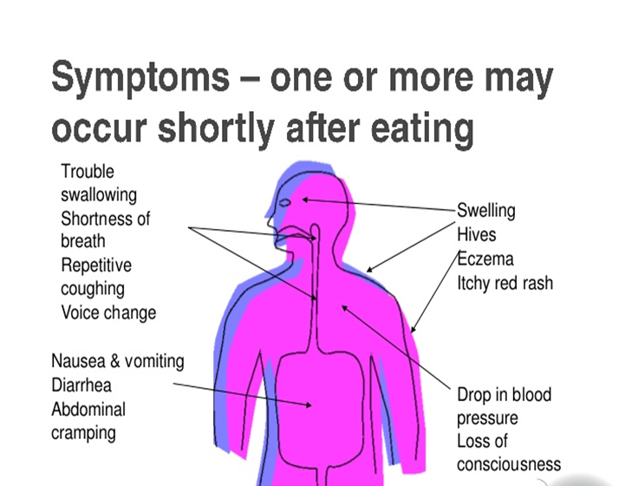
Symptoms-one or more may occur shortly after eating

Slide 10
Food Allergy Basics
Symptoms:
Trouble swallowing, shortness of breath, repetitive coughing, voice change
Nausea, vomiting, diarrhea, abdominal cramping
Swelling, hives, eczema, itchy red rash
Drop in blood pressure, loss of consciousness

Slide 11
Food Allergy Basics
Each person has a specific threshold—an amount of food that sets the allergic reaction in motion.
Tolerance level can fluctuate due to the dose, an illness or other stress in your life.
Always be aware of anaphylaxis!

Slide 12
Anaphylaxis
A SERIOUS allergic reaction that is rapid in onset and may cause death.
Becoming aware of foods that you are allergic to is vital! Read labels! Ask!
Carry a rescue device with epinephrine.
Prompt administration of epinephrine can
save your life!

Slide 13
Managing a Food Allergy
Totally avoid food allergens by:
Vigilantly reading labels and asking questions
Careful food preparation and clean up.
Always be prepared!!

Slide 14
Label Reading A Must!
Read every label every time!
Why? Companies change ingredients all the time and don’t have to let you know.
Don’t rely on “safe” lists
Allergens can be in non-food items: shampoos, soaps, detergents, skin products
medications and pet foods.

Slide 15
Soy and its many names!
Edamame
Miso
Natto
Shoyu
Soya
Soy
Soy Curd
Soy Protein
Soy Sauce
Tamari
Hydrolyzed Soy Protein
Tempeh
Textured Vegetable Protein
Tofu
Soy Milk

Slide 16
Careful Food Preparation
Wash hands, cooking utensils and food prep surfaces to avoid reactions from trace amounts of proteins left behind.
Liquid soap, bar soap or commercial wipes for hands, not antibacterial gel sanitizers.
Dishwashing detergent and hot water for cooking utensils and cutting boards.
Common household cleaners for counters tables and other surfaces.

Slide 17
Always be Prepared!
Keep medications available at all times.
Know and recognize the different names for allergens.
Know and recognize the symptoms.
Food Allergy Action Plan

Slide 18
The Three R’s
Recognize the symptoms
React quickly
Review what caused the reaction

Slide 19
Eating Out
Be vigilant about verifying ingredients and preparation methods with your server.
DO NOT be embarrassed or afraid to tell your server about your allergies.
Call ahead to find out what is on the menu if you do not know the restaurant.

Slide 20
Children’s Food Allergies
As a parent or caregiver, you must be extra aware of what your child eats or comes in contact with.
Distribute the Food Allergy Action Plan to all school personnel, from teachers to bus drivers.
Help your child understand the importance of his or her food allergy.

Slide 21
Food Intolerance
Does not involve the immune system.
Produces a slow response to food, hours or possibly days after food was eaten.
Harder to identify.
Doesn’t mean it is any less stressful or troublesome to have.
Can be any food.

Slide 22
Food Intolerance Symptoms
May be mild at first, but grow worse as time goes on.
Sensitivity to: milk, corn, wheat, eggs or some other commonly-eaten food.
Difficult to pinpoint when first started.
May not have all the symptoms.
Stress can make symptoms worse.
Can change over time.

Slide 23
Food Intolerance Symptoms
Mouth ulcers—canker sores
Nausea and indigestion
Vomiting
Heartburn
Internal gas or flatulence
Irritable bowel symptoms
Stomach pains or cramps
Diarrhea
Constipation

Slide 24
Food Intolerance Identification
Food diary
Do only with physician’s guidance
Careful avoidance of food

Slide 25
Reputable Resources
The Food Allergy and Anaphylaxis Network—foodallergy.org
Kids with Food Allergies—kidswithfoodallergies.org
The American College of Asthma and Immunology—acaai.org
National Institute of Allergy and Infectious Diseases—niaid.nih.gov

Slide 26
Questions?????

Slide 27
K-State Research and Extension Golden Prairie Extension District #12
Amy Lorenzen
Family and Consumer Science

