Slide 1

Food Safety for Farmers Market Vendors
Londa Nwadike
Extension Consumer Food Safety Specialist
Kansas State University/ University of Missouri

Slide 2
Outline
Why food safety?
Regulations for selling food at KS Farmers Markets
Produce Safety Regulations
Trainings and resources available

Slide 3
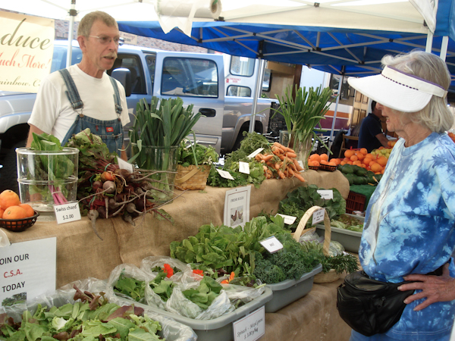
Why food safety?
Provide products as safe as possible
Assure customers that product quality and safety, and their health, is important to them
Protect markets

Slide 4
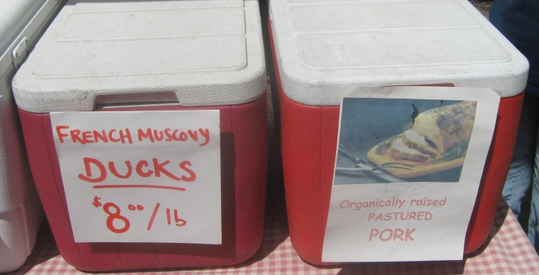
Why are there regulations?
Food borne illness outbreaks have been associated with local food
  No one wants to make their customers sick
Farmers should reduce their liability and protect their reputation as much as possible
  Liability/ reputation of entire market segment also
Create a level playing field

Slide 5
Selling meat and poultry?
Selling any other food- Kansas
FDA* FSMA
KDA
Local sales venue
USDAHACCP required
KDA
Local sales venue
Note- includes products where raw meat or poultry comprises >3% total product weight or 2% meat by cooked weight.
*HACCP currently required for juice, seafood

Slide 6
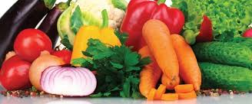
Kansas regulations
KS Dept of Ag regulates food products sales in KS
In KS, regulations are the same statewide
  MO: regulations may vary by county, city
  Sales in other states- check their regs, follow FDA/USDA regs
Individual sales venues may have stricter requirements

Slide 7
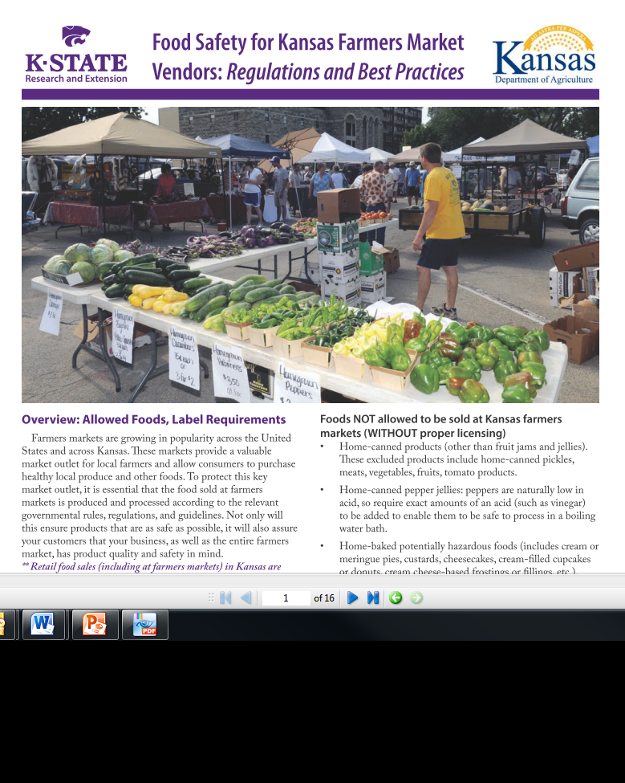
KSRE/KDA regulations publication
KS “Farmers Market” publication covers all food sold direct to consumers (D2C)
  This generally includes products sold online also
  Includes fairs, fundraisers, craft shows, etc. also
  www.ksre.ksu.edu/bookstore/Item.aspx?catId=201&pubId=17219

Slide 8
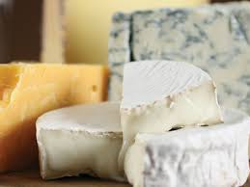
NOT allowed (WITHOUT proper licensing)- KS, D2C
Home canned pickles, meats, vegetables, sauerkraut
Home baked cream or meringue pies, custards, cheesecakes, cream-filled cupcakes, cream cheese frostings, etc. (need temp. control for safety)
Home-made dairy products (cheese, yogurt, etc.)
Uninspected meat

Slide 9
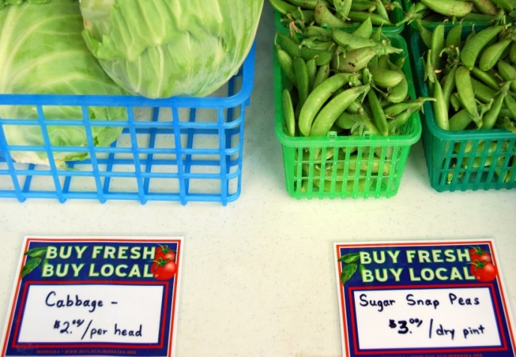
Foods allowed WITHOUT licensing-KS, D2C
(do NOT need to be labeled “homemade”- but can be)
Home baked goods (cookies, breads, cakes, etc)
Dry baking mixes
Fresh or dried uncut fruits, vegetables and herbs
Certain cut produce and cut herbs (dried or fresh)
  Cut tomatoes, melons, leafy greens require a license
Microgreens and shoots (not cut beyond normal harvesting)
Nuts (shelled or in-shell)

Slide 10
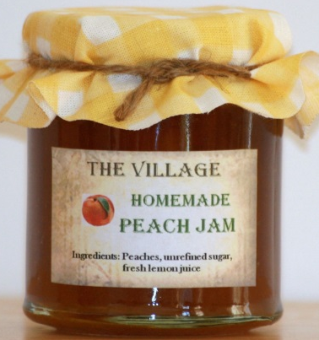
Foods allowed WITHOUT licensing- KS, D2C- 2
Honey
Eggs (food safety practices recommended, even if having <50 hens)
Poultry (<20,000 birds/year)
Home canned fruit jams and jellies
  Includes jams and jellies flavored with pepper-flavor vinegar or small amounts of pepper powder
Canned, shelf stable naturally high acid foods (canned fruits)

Slide 11
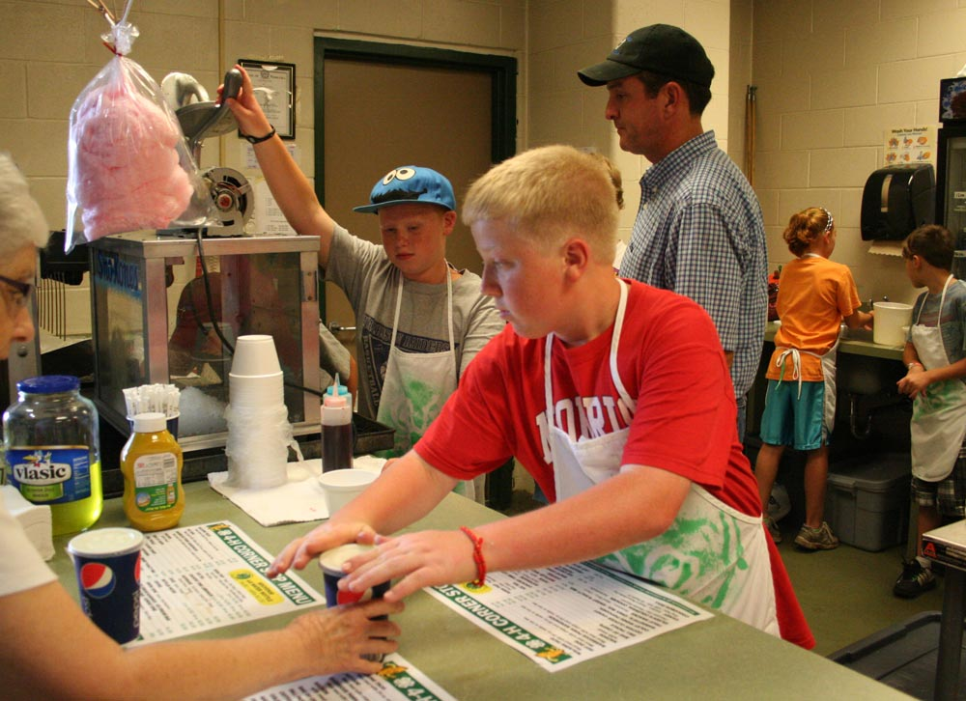
Foods allowed WITHOUT licensing- KS, D2C- 3
Cultivated mushrooms (fresh or dried)
Fish and seafood- sold whole on ice
Ready to eat foods and beverages sold <6X/year
  Must still follow sanitation and hygiene requirements
Ready to eat foods and drinks sold by community groups for fundraising purposes
  Must still follow sanitation and hygiene requirements

Slide 12

Foods allowed WITHOUT licensing- KS, D2C- 4
Non-specialized processed foods made, sold <6 days/year
  Frozen bierocks is an example
Homemade dried pasta (dry for a short time in protected environment)
Lard- no licensing if sold direct to consumer
Grain products (flour, cornmeal, popcorn)
Fruit leathers
Spices- bulk or small quantities

Slide 13
Foods allowed WITH proper licensing
(regardless of number of times/year sold)- KS
Dairy products; milk- license needed for plant and point of sale
Potentially hazardous baked products (cheesecakes, cream-filled, etc)
Raw meat (and >20,000 birds/year)
  All meat must be slaughtered under inspection
  Can be sold refrigerated or frozen

Slide 14

Foods allowed WITH proper licensing-2- KS
Ready to eat meat- KDA or USDA inspected
Fish and seafood- cleaned
Sprouts
Cut melons, cut tomatoes, cut leafy greens
  fresh or dried (cut beyond normal harvesting)
Roasted veggies (even if providing roasting service
Wild mushrooms
Naturally fermented canned foods (sauerkraut)

Slide 15
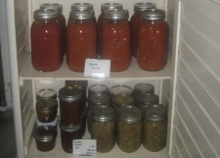
Foods allowed WITH proper licensing- 3- KS
Acidified shelf-stable canned foods (pickles, hot sauce, canned tomatoes); low acid canned foods (canned vegetables, meats, shelf stable cake/bread in a jar)
  License, recipe approval, Better Process Control School
For-profit entities selling >6 X/year (D2C): Ready to eat foods (pizza, grilled hamburgers)
Alcoholic beverages (>0.5% alcohol- beer, wine, possibly kombucha drinks)- Dept of Revenue

Slide 16

Foods allowed WITH proper licensing
Dough- refrigerated or frozen (cookie, pizza, etc)
Infused oils- garlic in oils
Animal feed/treats
  Commercial feed license (can make in home kitchen)

Slide 17
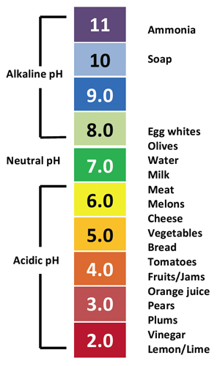
Foods that require testing first- KS
Why do we need to test some food?
  Every formulation of some products may be different
  Need to be sure food is safe
Products can be sent to Fadi
Aramouni lab or other accredited lab
www.ksre.ksu.edu/kvafl

Slide 18
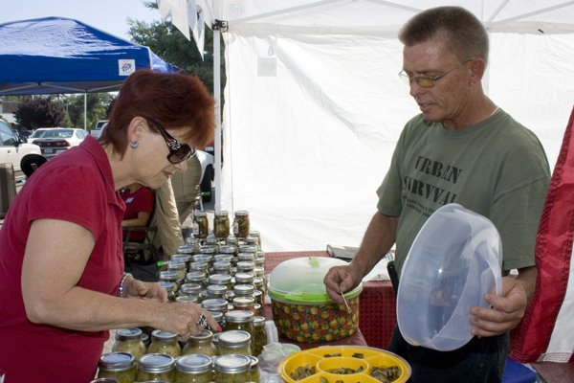
Foods that require testing first- KS
Pepper jams and jellies- water activity
Low-sugar fruit jams and jellies (shelf-stable)- pH, water activity, product formulation
Canned, shelf-stable salsa, BBQ sauce- pH
Chocolate candies- water activity
Pecan pie
Powdered sugar/milk icing
Bread with cheese on/in
Homemade mustard

Slide 19
How to get the license needed- KS?
Visit the KDA website http://agriculture.ks.gov/divisions-programs/food-safety-lodging/food-safety-egg-lodging-app-forms
or email fsl@kda.ks.gov
or call 785 296 5600

Slide 20
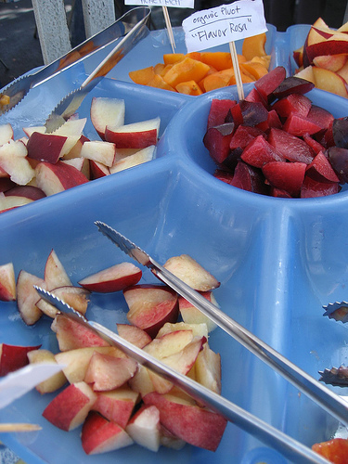
Sampling Regulations
KS Dept of Agriculture regulations
  Local markets may have stricter requirements- check with them
  Regulations may differ in other states- check with them
Best practices
  A good idea, whether required or not

Slide 21
Sampling requirements
Sample must be free and in small quantities
  Entire meal, selling- not considered a sample
Need a handwashing station*
  If any handling of product or utensils onsite
3 compartment sanitizing station*
  Unless using disposable or have enough clean utensils
Must follow sanitary procedures
Proper food storage temperatures maintained
Appropriate tools used

Slide 22
Providing Safe Samples
Wash produce before cutting and offering
No server bare hand contact with ready-to-eat food
  Use tongs, deli paper, gloves, etc.
  Still need to wash hands (with soap and water) even if wearing gloves

Slide 23
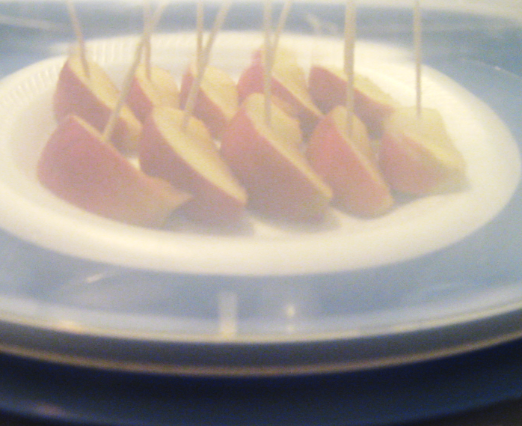
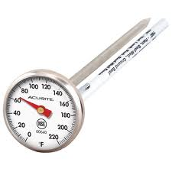
Providing Safe Samples- 2
Provide individual servings, separate from sales food
  Use toothpicks/ individual cups
  Public should not touch anyone else’s sample
Cut produce must be kept below 41F
  Hot foods >135F
  Any perishables between 41F and 135F >2 hours- discard
  Check temp hourly: thermometer

Slide 24
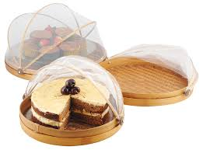
Providing Safe Samples- 3
Sampling must be done under a cover
  Tent/ umbrella as necessary
Keep insects, etc. off
  Fan, fly screen, cover
Trash receptacle nearby
www.paysonroundup.com

Slide 25
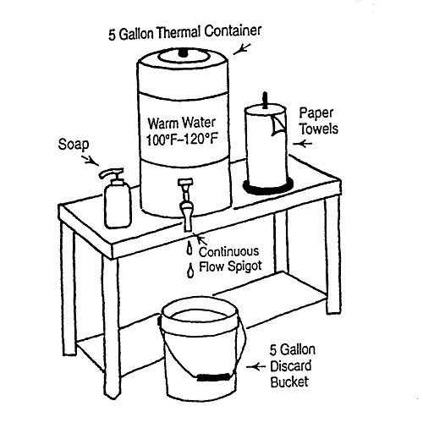
Handwashing station
Container
Clean water
Trash receptacle

Slide 26

Washing and sanitizing station
Wash Rinse Sanitize
Allow to air dry
Use potable hot water (>110 F)
Use approved sanitizer (tablets or bleach); test strips strongly recommended; soak for at least 30 seconds
Allow to air dry on clean paper towels or racks

Slide 27
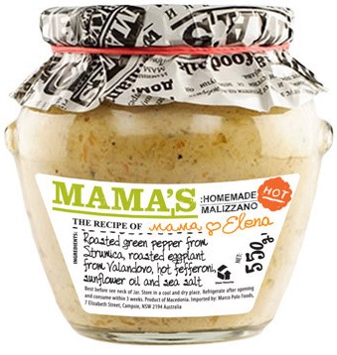
What are labeling requirements?
Common name of product
Entity responsible for product (name, address)
Product ingredients (if >1 ingredient), include allergen statement
Quantity (weight, volume, count)
Note: meat products have additional requirements

Slide 28
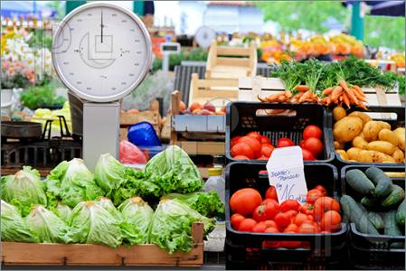
What else is needed- D2C?
Sales tax certificate- KS Dept of Revenue
Scale testing- products sold by weight must have scale tested by licensed service company once annually (KDA Weights and Measures)

Slide 29
What are GAPs and being GAP Certified?
Good Agricultural Practices
  Good practices for raising produce safely
GAPs certification
  NOT regulatory requirement; market driven
  Required by certain produce buyers, banks
  Administered by USDA or 3rd party
Notes:
You may hear people talk about needing to use Good Agricultural Practices (GAPs) or attending GAPs training. If someone says that you should use GAPs, it simply means that you should use these good practices for raising produce safely, which are the basic good practices that we will talk about later in this presentation. However, if a buyer or potential buyer tells you that you need GAPs certification, that means that you need to have a documented on-farm food safety plan and pay to have a GAPs auditor come to your farm to inspect your food safety practices. A few notes on GAPs certification: note that GAPS are NOT a governmental regulatory requirement, but are something that some buyers, such as larger grocery stores and possible schools or restaurants or distributors, will ask you to have if you want to sell to them. GAPs is market or buyer- driven, rather than regulatory. GAPs auditing is administered by USDA, or possibly by 3rd party auditors such as Primus. But again, it is NOT a regulatory requirement, even though the Ag Marketing Service within the USDA does happen to often be the group administering the audit.

Slide 30
FDA Food Safety Modernization Act- main parts
Preventive Controls for Human Food – Final rule published Sept 10, 2015
Produce Safety Rule – Final rules: Nov 13, 2015
Preventive Controls for Animal Food- Sept 2015
Foreign Supplier Verification Program
Accredited Third Party Certification
Notes:
We have previously briefly mentioned the FDA Food Safety Modernization Act. The FDA is the US Food and Drug Administration, which is part of the US Department of Health and Human Services. This is a separate entity from the USDA, United States Department of Agriculture. The Food Safety Modernization Act (FSMA) was signed into law in January of 2011. The final rule for preventative controls for human food came out in September of 2015. Produce safety final rules came out in November of 2015. Some of the other main parts of FSMA are also listed, although the list is not exhaustive.
We mentioned the produce safety rule in the general food safety presentation, but the Preventative Controls for Human Food rule is something that food processors, such as people making baked goods may be covered by and need to pay attention to. There are some exemptions which we will cover in the next slide.

Slide 31
FSMA Produce Safety Rule
Who is covered?
Sell < $25,000/ year in produce sales (on average over previous 3 years) EXEMPT
Produce is rarely consumed raw (pumpkin) EXEMPT
Produce that will be commercially processed before consumption (tomatoes sold to a canner) EXEMPT
On average (over past 3 years), have
  <$500,000 annual food sales AND
  Majority of food sold directly to “qualified end user”
  EXEMPT, but have some record-keeping requirements
Everyone else covered; NO exemption if linked to foodborne disease outbreak
Notes:
There are some exemptions to who is covered by the FSMA Produce Safety rule. However, whether you are covered by this law or not, you still have a responsibility to sell a safe product.
If on average over the past 3 years, you are selling less than $25,000 per year of produce, you would be exempt from directly meeting the requirements of the regulation. Therefore, very small farmers, or farmers just getting started who are selling less than $25,000 of produce per year would be exempt from the Produce Safety Rule. This is $25,000 of ANY produce, not just produce covered by FSMA. Note that “produce” does NOT include food grains, such as wheat.
If your produce is rarely consumed raw, such as pumpkin, those products would also be exempt from the Produce Safety Rule. If you are also raising tomatoes or cucumbers and don’t qualify for any other exemptions, your tomatoes and cucumbers would be covered by the rule though.
The next exemption is a qualified exemption. If, on average over the last three years, you have less than $500,000 of annual food sales AND the majority of your food is sold directly to a qualified end user, which is direct marketing to a consumer or to a restaurant that is in your same state or within 275 miles of your farm, you would be exempt, but you still have some recordkeeping requirements. There are a few other exemptions that are also described in the FSMA fact sheet in the resources section.
Also note that if your farm is linked to any foodborne disease outbreak, you will not be able to qualify for any of the listed exemptions. FDA will likely increase inspections of farms that have been linked to foodborne disease outbreaks.
It is also important to note that even if you do qualify for one of these exemptions, state and local food safety regulations and buyer/ sales venue requirements could become more strict now that FSMA is in place.
Educator notes: can give example that the Missouri Dept of Health is now (as of April 2016) looking closer at the sales of microgreens and may require them to have a license to be sold, due to the increased attention to produce safety. Local public health inspectors in Missouri have thrown out local microgreens sold to restaurants as they are were unsure if microgreens should require a license to be sold or not.

Slide 32
Upcoming Produce Safety Events
Introduction to Produce Safety- May 7, 5-7PM, KCMO
GAPs Food Safety Plan workshop- May 17, 9-5, Olathe
FSMA PSA grower training- May 23, 8-5, Olathe
High Tunnel bus tour- June 5, 10-4, Olathe
Other locations can be added if enough interest
SARE scholarships available for registration and travel costs

Slide 33
Voluntary registry with KDA
We encourage produce growers to self-register with KDA: agriculture.ks.gov/PSR
Online or print version
Will help KDA and KSRE understand how the produce safety rule will affect KS growers, and thus how to help farmers comply
  Many will be exempt

Slide 34
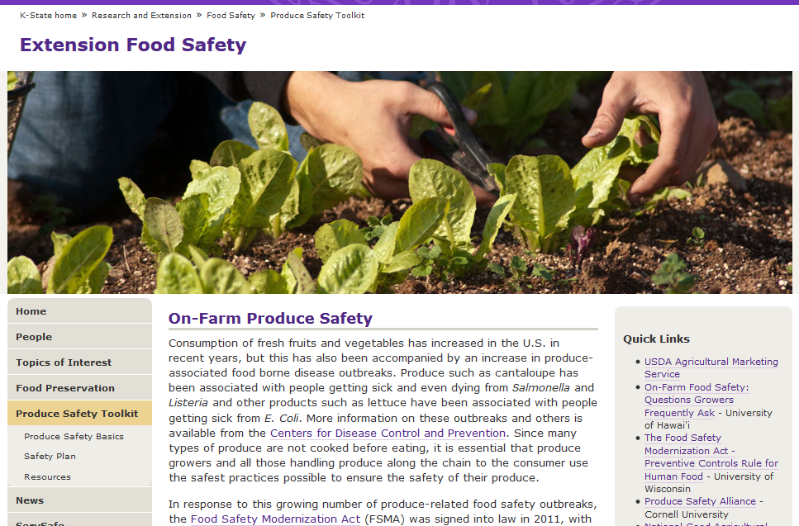
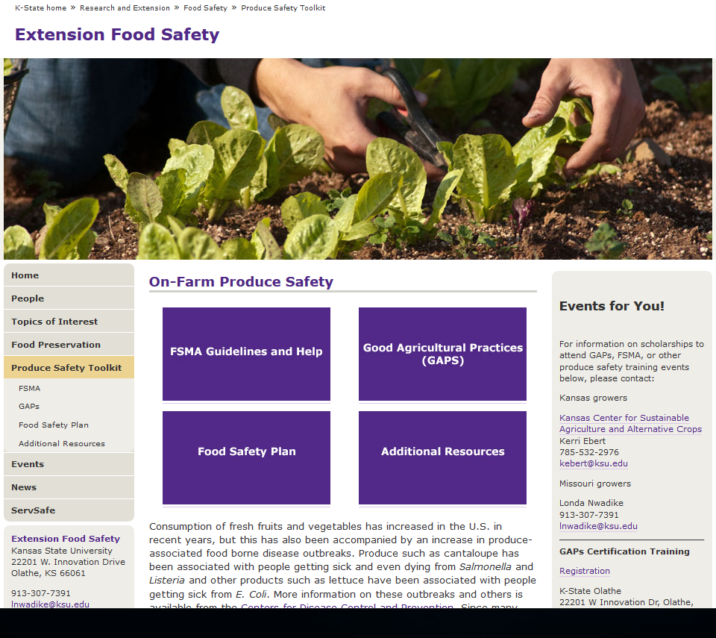
www.ksre.k-state.edu/foodsafety/produce

Slide 35
Additional information
KS Value Added Foods Lab (KVAFL- scheduled processes, product testing, nutrition facts)
  www.ksre.k-state.edu/kvafl/
Kansas Department of Ag Food Safety and Lodging
  http://agriculture.ks.gov/divisions-programs/food-safety-lodging
KSU Extension Food Safety website
  www.ksre.k-state.edu/foodsafety/

Slide 36

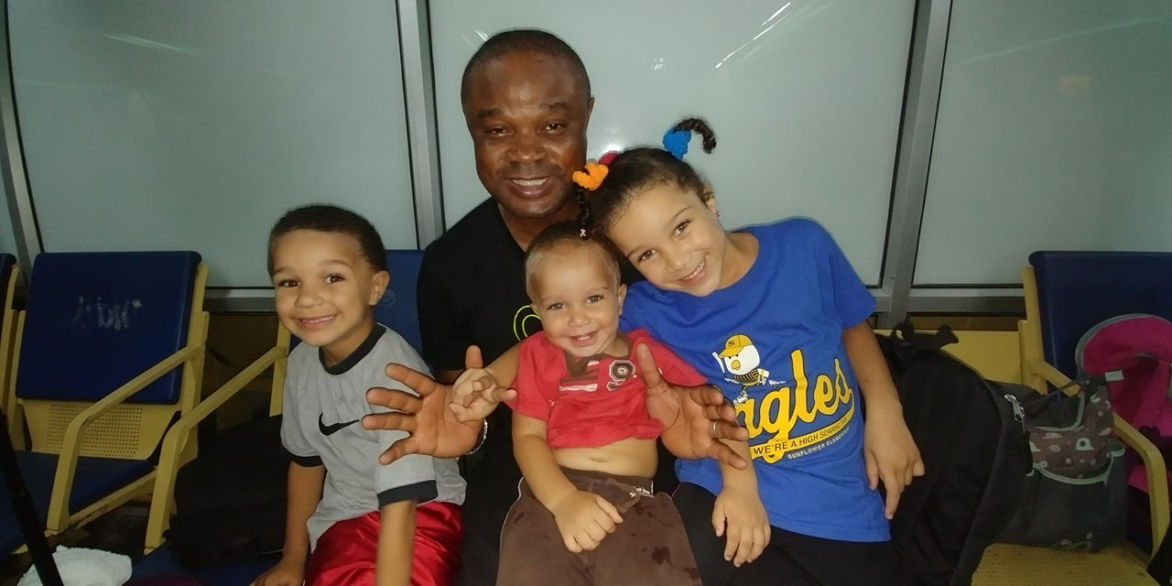
Questions?
Thank you
for your attention!

Slide 37
Contact Details
Londa Nwadike
Extension Consumer Food Safety Specialist
Kansas State University/ University of Missouri
Phone: 913 307 7391
Email: lnwadike@ksu.edu
http://www.ksre.ksu.edu/foodsafety/

