Slide 1
Donating Safe and Nutritious Food to Food Pantries and Soup Kitchens
Londa Nwadike
Extension Food Safety Specialist
University of Missouri/ Kansas State University

Slide 2
Outline
Food donations background
What can I donate?
What should I not donate?
Other food safety information

Slide 3
Community food donations
An important source of food for families trying to make ends meet
A way for neighbors to help neighbors
Instill values of caring and sharing in families and children
Bill Emerson Good Samaritan Food Donation Act- 1996
  Reduces liability if donations made in good faith

Slide 4

Reduce food waste
Donations help provide food to hungry people and also reduce food waste
30% of U.S. food supply is wasted at retail and consumer levels

Slide 5
Help food pantries control waste, too
Don’t just “clean out your cupboard” and donate foods you can no longer use
Donate safe and healthful food to help pantries avoid waste and keep customers healthy

Slide 6

Can I donate……?
NO!
Expired food (pantries can ~distribute though)
Spoiled, moldy food
Home canned or prepared foods
Opened or repackaged food
~Damaged packages, dented cans
  Flowchart on next slide

Slide 7
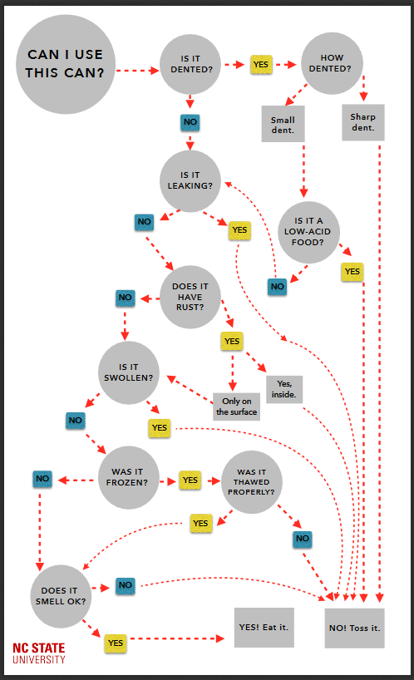

Slide 8

Can I donate……?
It depends-
Fresh fruits and vegetables
Refrigeration-required foods
Frozen foods- no large ice crystals
Meat and poultry must be from licensed processor
*Contact your food pantry to find out what they can accept

Slide 9

Can I donate……?
YES!
Non-perishable, nutritious canned and packaged foods
Monetary donations
Volunteer time

Slide 10

You can give the gift of better health by donating nutritious foods to food pantries and community food drives
Use MyPlate as the pattern for a healthy diet.

Slide 11
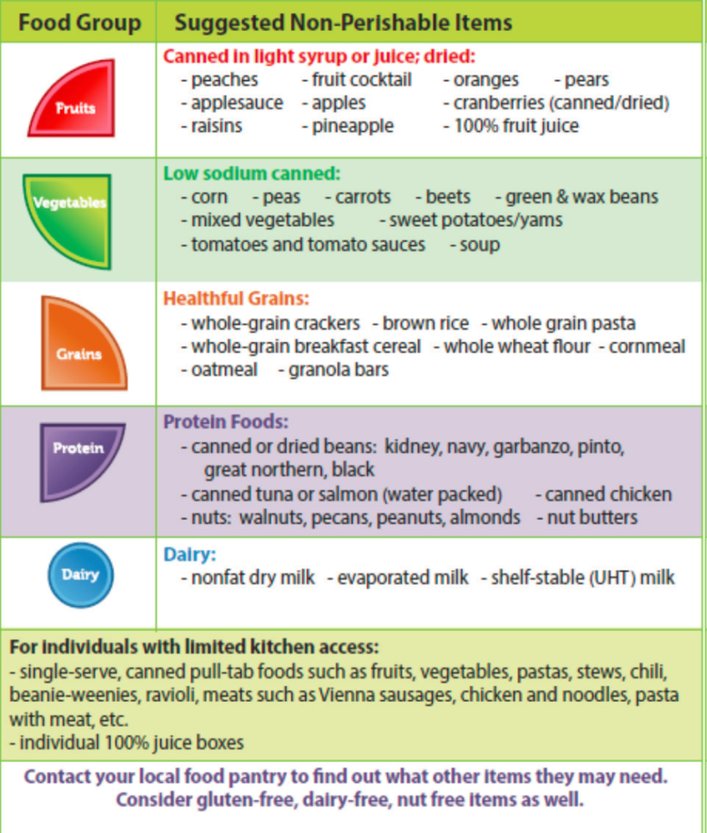
Extension food drive flyer
Gives suggestions for nutritious foods in each food group.
Flyers available through SNAP-Ed program

Slide 12
Donating to soup kitchens
No regulations currently in Kansas, but best practices:
  Only donate food prepared under license
  Food handled safely throughout
    Use practices listed in Volunteer Quantity Cooks publication
    Only donate food prepared but NOT served
    Good temperature control
    Held in food-safe containers
    Hygienic handling

Slide 13

Food pantries and the people they serve are grateful for any and all donations, but—
-- donating a variety of safe and nutritious foods will help food pantry customers have a better diet and a healthier life.
Thanks to Linda Beech for sharing her slides!!

Slide 14
Food safety trainings available
Farmers Market workshops-
  Great Bend- Feb 2
  Wichita- Feb 3
  Olathe- Feb 9
  SE KS- Feb 10
HACCP: Olathe (Oct 4-6)
FSPCA- Fadi Aramouni provides training
Produce Safety- hired Produce Safety Extension Associate, have funding for produce safety
Notes:
This is a general listing of food safety trainings that are available through MU Extension. If you are interested in any of these topics or training on other specific food safety topics, please contact your local MU Extension office or the State Food Safety Specialist to discuss more.

Slide 15
Upcoming produce safety trainings
Half day trainings
  Nov 8- Ft Scott KS
  Nov 13- Independence MO
  Nov 14- Wichita KS
  Nov 15- NW KS
  Nov 29- Olathe Hort Farm
FSMA PSA grower training
  Jan 11, St Joe MO
  March 9, Wichita, KS

Slide 16
Other new info
Food Handling Guidelines for Bake Sales
Farmer Market regulations publication
Sampling at Farmers Markets, Farm Stands, etc
Reminder- please use new home food preservation evaluation form (in PEARS)

Slide 17
More information
- Food Pantries and Food Banks- North Carolina State Univ
  https://foodsafety.ces.ncsu.edu/food-pantries-and-food-banks/
University of Wisconsin Safe Food Pantries
  http://fyi.uwex.edu/safehealthypantries/
  University of Missouri Healthy Shelves resources
  http://foodsecurity.missouri.edu/healthy-shelves/
KSU Extension Food Safety
  www.ksre.k-state.edu/foodsafety
KSU Extension Produce Safety
  www.ksre.k-state.edu/foodsafety/produce/index.html
Notes:
There are a number of different resources listed here with more information related to on-farm produce safety. University of Missouri Extension has some resources available as listed, and will have more developed in the future. The website of the Cornell Produce Safety Alliance, who are the ones organizing the training that's currently recognized by the FDA, is listed. FDA also has a good FSMA website. Then, the University of Vermont has a great website, with a number of produce safety resources that you can also take a look at for help.

Slide 18
Contact Details
Londa Nwadike
Extension Consumer Food Safety Specialist
Kansas State University/ University of Missouri
Phone: 913 307 7391
Email: lnwadike@ksu.edu
www.ksre.k-state.edu/foodsafety/

