Slide 1
PSEs & You
Environment
Systems
Policy
Hannah Boeh, MPH
Sandy Procter
Notes:
Hello! My name is Hannah Boeh. I am currently a doctoral student working with Dr. Procter on EFNEP/SNAP-Ed programs and research efforts. In this presentation “PSEs & You” we will review what PSEs are, how they fit into the socio-ecological model, our role in implementing PSEs. Additionally we will go over some examples and tips on how to accomplish adding these into your current role.

Slide 2
What is policy, systems, and environmental change?
A way of modifying the environment to make the healthy choices practical and available to all –making the healthy choice the easy choice!
Source: What is "Policy, Systems and Environmental Change'? [Pamphlet]. (2015). Oak Park, IL: Communities Putting Prevention to Work.
Notes:
Policy, Systems, and environmental change is a way of modifying the environment to make the healthy choices practical and available to all – making the healthy choice the easy choice!
Through incorporating multiple areas of change using PSEs, we can create lasting behavior change.
Let’s move on to review Policy, Systems, and Environmental changes.

Slide 3
Policy Change
Policies and laws greatly influence the daily decisions we make in our lives, including choices affecting our health.
Passing of policies, ordinances, resolutions, mandates, regulations, or laws
Government
Schools
Parks
Healthcare centers
Senior Living Centers
Example: Adding a tax on unhealthy food, passing a law allowing residents to plant community gardens in vacant lots, schools establishing a policy that prohibits junk food in schools fundraising
What can be changed?
Who can implement changes?
Example of change
Source: What is "Policy, Systems and Environmental Change'? [Pamphlet]. (2015). Oak Park, IL: Communities Putting Prevention to Work.
Notes:
Policies and laws greatly influence the daily decisions we make in our lives, including choices that affect our health.
When thinking of policy change think of passing policies, ordinances, resolutions, mandates, regulations, or laws that can make our lives healthier. These ordinances or mandates can be implemented in government, schools, parks, or healthcare centers. These are great examples of areas where policy changes can be implement however it is important to remember that these are not the only places!
One example of policy change could be adding a tax on unhealthy food or passing a law allowing residents to plant community gardens in vacant lots.
A real-life example of policy change is smoking regulations. It is becoming a trend in city’s to ban smoke in public places such as bars or restaurants. This policy influences when and where people decide to smoke.

Slide 4
Systems Change
Changing rules within an organization.
System changes work hand-in-hand with policy changes.
Changing infrastructure within an organization, school, park, worksite or health setting
Government
Schools
Parks
Healthcare centers
Senior Living Centers
Example: Creating a community plan to account for health impacts of new projects, creating a certification system for school bake sales to ensure they are in line with wellness policy
What can be changed?
Who can implement changes?
Example of change
Source: What is "Policy, Systems and Environmental Change'? [Pamphlet]. (2015). Oak Park, IL: Communities Putting Prevention to Work.
Notes:
System changes, effect the rules within an organization. These changes work hand-in-hand with policy changes. System changes involve changing the infrastructure within an organization, school, park, worksite, or health setting and are often times implemented in the same organizations as policy changes.
An example of system changes could be creating a community plan to account for health impacts of new projects or looking back at the example given in policy change of adding a tax to unhealthy foods, creating a decision-making system of where the tax income goes. Maybe it could be funneled back into healthy promotion campaigns or local food pantries.

Slide 5
Environmental Change
Change made to the physical environment.
Installing bike signage on already established bike routes, installing sidewalks, promote walking or biking
Government
Schools
Parks
Healthcare centers
Senior Living Centers
Example: Municipality undertakes a planning process to ensure better pedestrian and bicycle access to main roads and parks
What can be changed?
Who can implement changes?
Example of change
Source: What is "Policy, Systems and Environmental Change'? [Pamphlet]. (2015). Oak Park, IL: Communities Putting Prevention to Work.
Notes:
Environmental change are changes made to the physical environment. These changes could include installing bike signage on already established bike routes, installing sidewalks or promoting walking or biking paths. An example of environmental change could be a city undertaking planning to ensure better pedestrian and bicycle access to main roads and parks.
Continuing with our taxing unhealthy food example, the environmental change seen would be the increase of healthy food seen. It would be more affordable for individuals to purchase the lower cost healthy item as opposed to the higher taxed unhealthy item.

Slide 6
Example: Fresno, CA
P:
City was not zoned to allow farmers market. Policy changes amendment codes to allow markets.
System changes allowed individuals/organizations to apply to hold farmers markets in city areas.
Environment changed with new healthy food options (farmers markets) in community
S:
E:
Source: Fry, C., & Chen, L. (n.d.). PSE 101: Building Healthy Communities through Policy, System and Environmental (PSE) Change. Retrieved February 22, 2016, from http://www.changelabsolutions.org/sites/default/files/NEOP_webinar_PSE101_FINAL_20130423.pdf
Notes:
Now we are going to look at two real-life example of PSE changes in two different communities. These examples were not of my own creation, but borrowed from ChangeLab Solutions PSE 101 Webinar.
The first example is from Fresno, CA.

Slide 7
Example: Healthy Vending
P:
Require minimum % of healthy options sold in vending machines on city property
Working with existing venders to change product line in vending machines.
Healthier food accessible at city meetings, work sites and gatherings
S:
E:
Source: Fry, C., & Chen, L. (n.d.). PSE 101: Building Healthy Communities through Policy, System and Environmental (PSE) Change. Retrieved February 22, 2016, from http://www.changelabsolutions.org/sites/default/files/NEOP_webinar_PSE101_FINAL_20130423.pdf
Notes:
The second example is about healthy vending on city property.

Slide 8
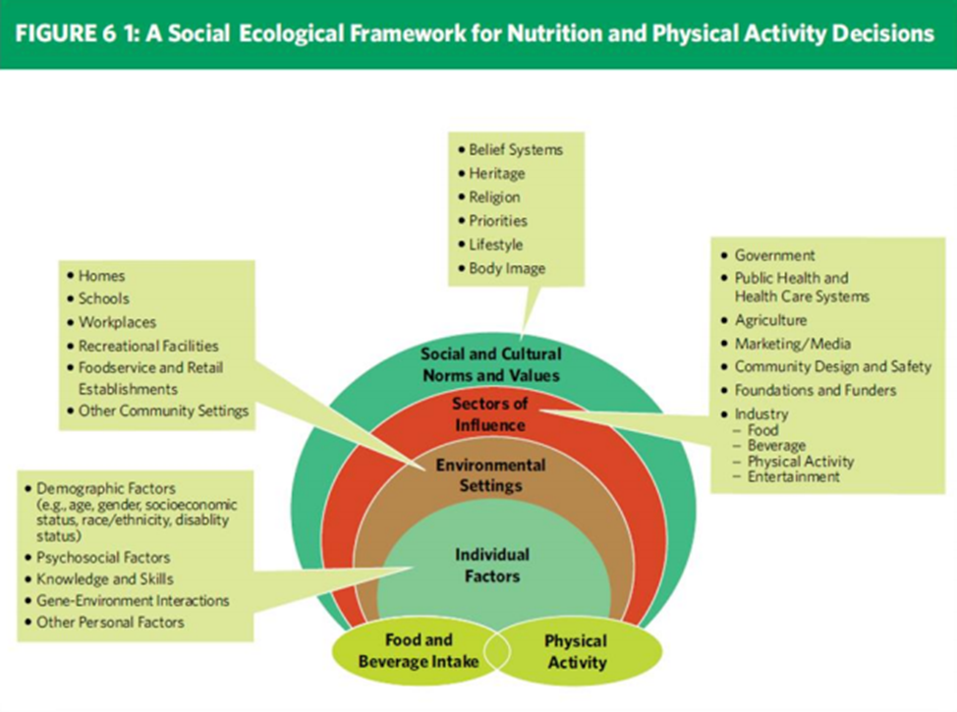
Social Ecological Model
Illustrates how all sectors of society combine to shape an individual’s food and physical activity choices and ultimately one’s calorie balance and chronic disease risk.
Source: Supplemental Nutrition Assistance Program (SNAP). (n.d.). Retrieved February 22, 2016, from http://www.fns.usda.gov/snap/nutrition-education
Notes:
The Socio-Ecological Model illustrates how all sectors of society combine to shape an individual’s food and physical activity choices and ultimately one’s calorie balance and chronic disease risk.
This model works hand-in-hand with understanding and incorporating PSEs. Additionally, there is some new language used when talking about this model that we should all be aware of.
When looking at this picture we see that there are fewer rings than previous models. What once was interpersonal, organizational, and community/policy rings are now condensed into the Environmental Settings and Sectors of Influence in the new socio-ecological model. As we go on we will be looking as each level of this model and how it can apply to PSEs.

Slide 9
Individual Factors
Factors
Age
Role
Education to improve individual food and physical activity choices.
Example
Nutrition educators teaching about MyPlate
Sex
Race
Knowledge/Skills
Source: Supplemental Nutrition Assistance Program (SNAP). (n.d.). Retrieved February 22, 2016, from http://www.fns.usda.gov/snap/nutrition-education
Notes:
At the very center of this model we see “Individual Factors.” This include age, sex, race, and knowledge and skills. These factors are unique characteristics of individuals that could affect there health behaviors. When working to improve these factors we work to educate or improve awareness of individual about nutrition and physical activity. An example of incorporating individual factors could be nutrition educators teaching about MyPlate. This would be helping individuals increase knowledge and skill associated with healthy eating.

Slide 10
Settings
Settings
Home
Role
Determine what foods are offered and what opportunities for physical activity are provided in each setting.
Example
Child care centers offering fresh fruits and vegetables as snacks and structure physical activity
Childcare
Schools
Worksites
Source: Supplemental Nutrition Assistance Program (SNAP). (n.d.). Retrieved February 22, 2016, from http://www.fns.usda.gov/snap/nutrition-education
Notes:
The second ring of this model is Environmental Settings and is commonly just referred to as “settings.” Settings are places where people live and spend the majority of their time. Some common examples of settings would be home, childcare facilities, schools, and worksites. These settings can be major determinants of our health choices. Settings can determine what foods are available and opportunities available for physical activity. One example of settings would be childcare centers offering fresh fruits and vegetables as snacks while including physical activity as part of their curriculum.
It is the goal of PSE changes to make our settings healthier, so that the healthy choice is the easiest choice. The settings described here could directly apply to each level of PSE changes.

Slide 11
Sectors
Systems
Organizations
Businesses
Role
Influence the degree to which people have access to healthy food and/or physical activity opportunities
Example
Organization supporting policy or program changes, modifying products, or creating opportunities to be physically active
Industry
Source: Supplemental Nutrition Assistance Program (SNAP). (n.d.). Retrieved February 22, 2016, from http://www.fns.usda.gov/snap/nutrition-education
Notes:
The third ring in the social ecological model is Sectors of Influence, commonly referred to as Sectors. These are the organizations, businesses, and industry that influence the degree to which people have access to healthy food and/or physical activity opportunities. Organization supporting policy or program changes, businesses creating opportunities to be physically active.
As we move to the outer rings, you can see that the focus moves away from the individual and into community or organizational/community focus.

Slide 12
Social & Cultural Norms
What are norms?
Rules that govern thoughts, beliefs, and behaviors
Role
Shared assumptions of appropriate behavior, based on societal values and reflected in laws and personal expectations.
Example
Food preference, attitudes about body weight; values placed on physical activity and health
Source: Supplemental Nutrition Assistance Program (SNAP). (n.d.). Retrieved February 22, 2016, from http://www.fns.usda.gov/snap/nutrition-education
Notes:
The most outer ring of the social ecological model is social & cultural norms. These are the rules that govern thoughts, beliefs, and behaviors. Social and Cultural norms are shared assumptions of appropriate behavior, based on societal vales and reflected in laws and personal expectations.
One example of social & cultural norms at work could be food preference, attitudes about body weight, values places on physical activity and health.

Slide 13
What is our role in implementing PSEs?
State
SNAP-Ed
Agents
EFNEP
Notes:
Our role with implementing PSEs varies depending on which program,; the role within that program and other factors such as experience or expertise.

Slide 14
EFNEP
Due to policies of EFNEP, nutrition assistant participation in PSE work will be limited, if at all.
Nutrition assistant’s primary role continues to be direct education
Working with individual factors & settings to create behavior change
EFNEP agent will address PSE opportunities in community – at “sector” and “setting” levels
Notes:
Settings: home, childcare, schools, worksites
Sectors: organizational, business, industry

Slide 15
SNAP-Ed
FNS requires two of three evidence-based approaches in every state’s SNAP-Ed plan
Individual or group-based direct nutrition education, health promotion, and intervention strategies
Community and public health approaches to improve nutrition
Local roles include mixture of direct education and community approaches
These blended approaches should create some PSE opportunities for program assistants and
agents
Notes:
Combining individual factors with settings and sectors.
Individual experience/expertise may increase your involvement in specific community efforts

Slide 16
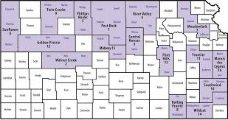
State Program
Focus is on collaborative efforts at state, regional and national levels, working with individuals and agencies to maximize PSE opportunities within Kansas.

Slide 17
Strategies for Influencing People
Informational -- include education, marketing, and media-based dissemination of information. Goal is to raise awareness or increase knowledge of an issue.
Behavioral -- may include dissemination of information, but with explicit, theory-guided focus on promoting specific behavior. Frequently involves developing cognitive and behavioral skills needed to perform, maintain behavior.
Social Support -- involve other people (family, friends, peers) as influencers of behaviors in individuals. Supportive people help make desired behavior easier to implement and sustain.
Source: Oregon State University Extension. (2015). Strategic Plan for the Extension Family and Community Healthy Program [Pamphlet]. Oregon State University.
Notes:
Now we are going to combine everything we just learned into strategies for influence. We will begin with strategies for influencing PEOPLE.
After hearing these, I’m sure all of you will realize that you all do this to some degree.
The first strategy is….informational or increasing awareness. Many people are unwilling to change until they believe it is necessary.
The next strategy is behavioral which involves the development of skills needed to perform, and maintain behavior. This could be cooking or learning how to exercise.
The final strategy for influencing people would be social support. Those closest to us are the biggest influencers of behavior. Incorporate social support and help individuals better implement and sustain change.

Slide 18
Strategies for Influencing Place
Ways we can influence setting or context where people live, learn, work, or play
Environmental strategies -- efforts to create assets promoting health and well-being. Assets may be material provisions, economic supports, positive social norms, heightened community expectations, and built or natural resources.
Systems interventions -- strategies that alter the way a program, organization, institution, or society operates in regard to a particular issue or area of concern.
Source: Oregon State University Extension. (2015). Strategic Plan for the Extension Family and Community Healthy Program [Pamphlet]. Oregon State University.
Notes:
Next we will look at strategies for influencing PLACE. Some of these strategies (wink, wink) should seem very familiar!
Environmental: create assets that promote health and well-being
Systems: changes the status-quo of a program, organization, institution, or society

Slide 19
Policy interventions -- strategies aimed at creating, implementing or amending laws, ordinances, resolutions, mandates, regulations, or rules
4. Capacity Building helps citizens, organizational leaders, community policy makers and other decision makers lead, implement, and evaluate change efforts. Helps organizations, agencies, and communities improve and develop over time.
5. Collaborative strategies involve more than a single organization. Involves working across various sectors, organizations, and agencies to create measurable, shared, and sustainable impacts.
Source: Oregon State University Extension. (2015). Strategic Plan for the Extension Family and Community Healthy Program [Pamphlet]. Oregon State University.
Notes:
Policy: changing laws, mandates or ordinances
Capacity Building: development of organizations over time making them better able to lead, implement, and evaluate change
Collaborative: bringing people together to work across different sectors and setting to create sustainable impacts.

Slide 20
Time to Practice
Scenario:
You are working with a local community group to help individuals make better health choices. Group members are interested in starting a Farmer’s Market; however, a city ordinance doesn’t allow the public to use vacant lots for sales.
How can you use your knowledge of PSEs and community experience to help this community?
(Hint: What is the P, S, E of this scenario?)

Slide 21
Possible Answer
P:
Work with the community group to create proposal to use vacant lots for Farmers Markets; present idea to city council to have ordinance amended.
System change allows community groups to hold Farmers Markets. Additionally, could create a system to allow individuals to register as sellers in local Farmer’s Market.
Healthy, fresh, local foods now available to all community members.
S:
E:

Slide 22
Time to Practice…Again
Think about your current role. How can you work to incorporate more PSE involvement or reach more “rings” of the socio-ecological model?

Slide 23
References
What is "Policy, Systems and Environmental Change'? [Pamphlet]. (2015). Oak Park, IL: Communities Putting Prevention to Work.
Fry, C., & Chen, L. (n.d.). PSE 101: Building Healthy Communities through Policy, System and Environmental (PSE) Change. Retrieved February 22, 2016, from http://www.changelabsolutions.org/sites/default/files/NEOP_webinar_PSE101_FINAL_20130423.pdf
Oregon State University Extension. (2015). Strategic Plan for the Extension Family and Community Healthy Program [Pamphlet]. Oregon State University.
Supplemental Nutrition Assistance Program (SNAP). (n.d.). Retrieved February 22, 2016, from http://www.fns.usda.gov/snap/nutrition-education

