Slide 1
Healthy Cooking Styles
2018 FCS Lesson Series
By Donna Krug, Family & Consumer Science Agent
K-State Research & Extension - Cottonwood District

Slide 2
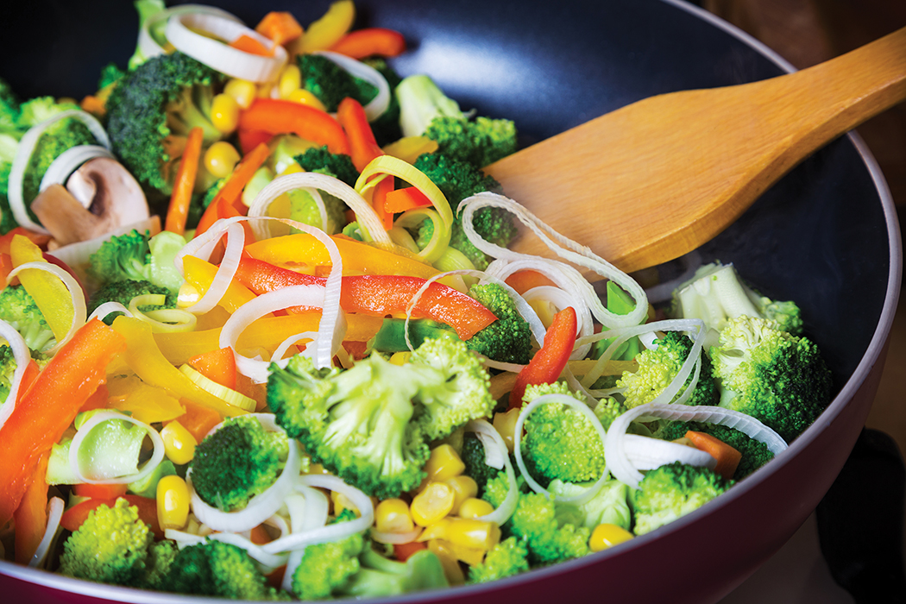
Healthy Cooking Styles

Slide 3
Cooking is an art form

Slide 4
Colorful grain dishes

Slide 5
Equipment you will need
Sharp knife and cutting board
Heavy pot with lid

Slide 6
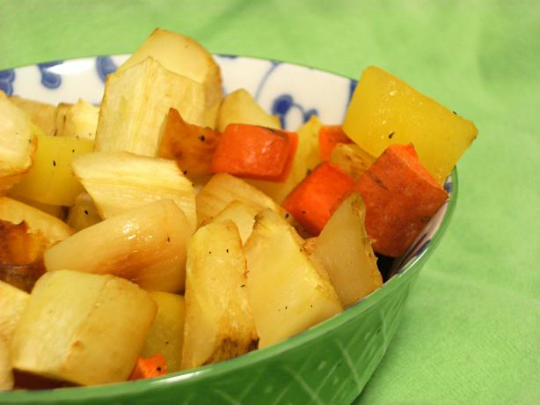
Nishime style (Slow Stewing)

Slide 7
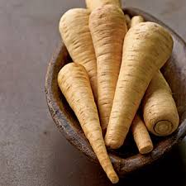
Interesting ingredients to add to nishime

Slide 8
Steaming vegetables
Use steamer basket
Bring small amount of water to boil in pan below
Cut vegetables into small pieces
Steam 3-5 minutes
Save water & add to soup stock

Slide 9
Water Saute’ Vegetables
Saute’ means “jump” or “skip”
May use oil or water
Avoid crowding too much food in pan
Cut food into small uniform pieces
Stir often or allow to brown on one side
Sauteing in oil requires higher heat
Do not overcook when sauteing!

Slide 10
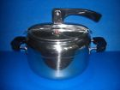
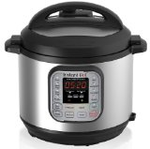
Pressure cooking
Good candidates for pressure cooking include: dry beans, soups and stews
Food cooks quickly and retains flavor and nutrients
Use less liquid since there is no evaporation

Slide 11
Boiling or Pressure-cooked grains? That is the question…

Slide 12
Boiling or Blanching
Blanching is also known as parboiling
Helps vegetables retain their shape and color

Slide 13
Create a boiled salad
Immerse vegetable in boiling water for 2-3 minutes. Then place it in cold water.
Strong flavored vegetables should be cooked last so they do not overwhelm.

Slide 14
Cutting an onion (Don’t cry!)

Slide 15
Onion Cuts
Onion Wedges
Large Dice – approximately ¾”

Slide 16
More Onion Cuts
Small Dice – approximately ¼”
Medium Dice – approximately ½”

Slide 17
Culinary Knife Cuts
Julienne or Matchstick
Battonet

Slide 18
Chiffonade cut
This cut is used when slicing leafy greens and fresh herbs.
It’s for when the dish wants lovely ribbons of green as a garnish or stirred into the recipe.

Slide 19
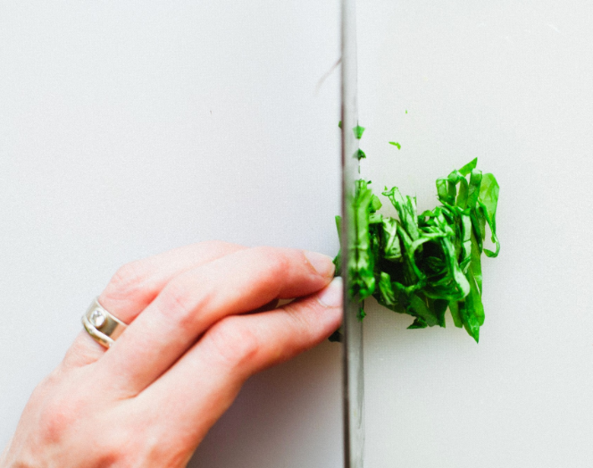
Chiffonade Cut
A knife then runs through the length of the roll creating beautiful ribbons.
Leaves of roughly the same size are stacked neatly then rolled from stem to tip.

Slide 20
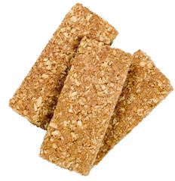
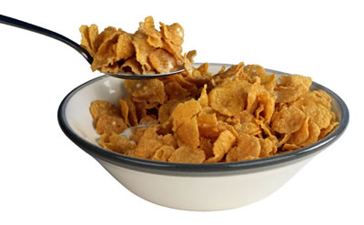
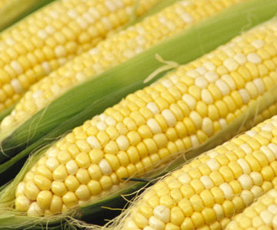
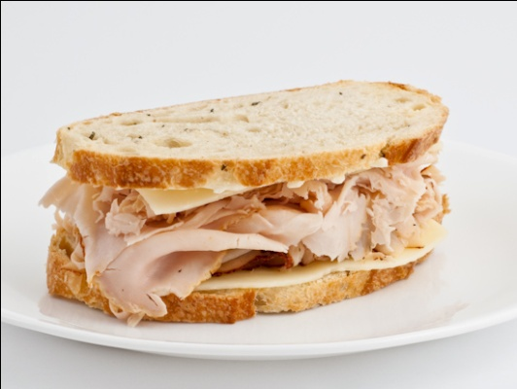
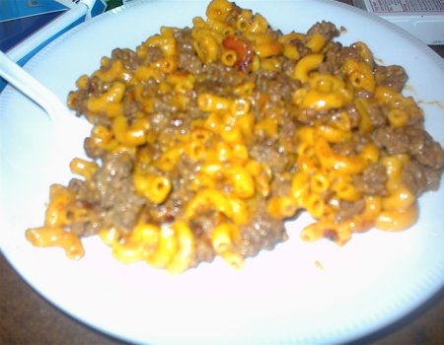
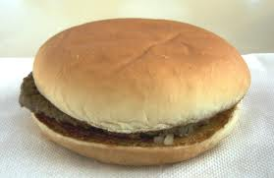
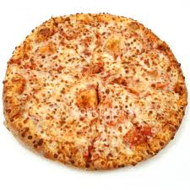
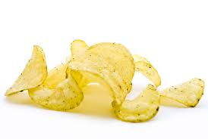
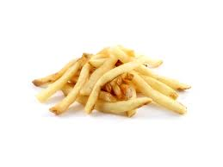
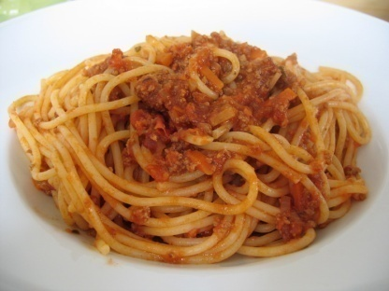
A Typical Day in Kansas

Slide 21
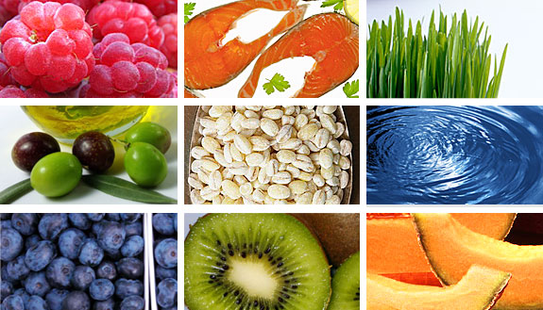
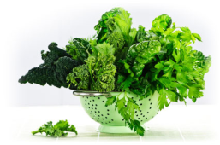
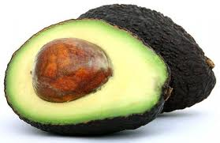
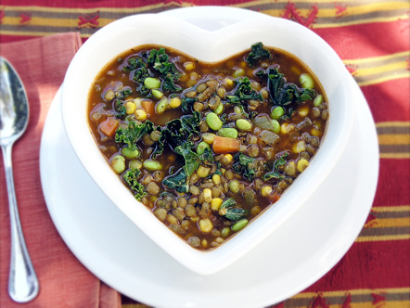
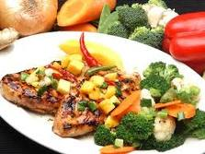
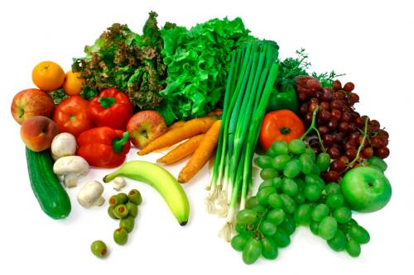
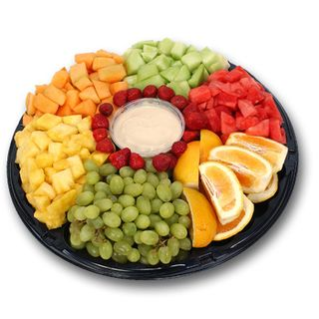
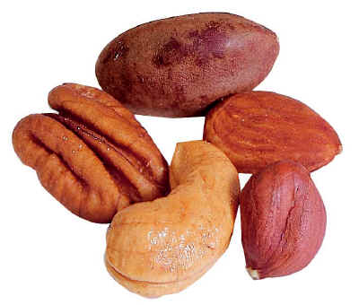
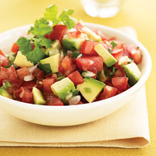
An Atypical Day in Kansas
Notes:
Wouldn’t it be nice if we could keep all sorts of fresh vegetables in our fridge’s crisper and a full fruit bowl on the kitchen table… spend all day perusing recipes and food blogs and dream of creative ways to use our healthy fruits and veggies. Instead, we need to work with what we’re more than likely going to continue eating. It’s not realistic to assume that you’re all the sudden going to decide to make several trips to the store, the farmers market, and whole foods or other

Slide 22
Have some fun with the “Healthy Cooking Styles” Fact Sheet!

Slide 23
Material adapted from “Healthy Cooking Styles” fact sheet and leader’s guide
Publications from Kansas State University are available at: www.ksre.ksu.edu
Publications are reviewed or revised annually by appropriate faculty to reflect current research and practice. Date shown is that of publication or last revision. Contents of this publication may be freely reproduced for educational purposes. All other rights reserved. In each case, credit Donna Krug, Healthy Cooking Styles, Fact Sheet and Leader’s Guide, Kansas State University, July 2017.
Kansas State University Agricultural Research Center and Cooperative Extension Service.
K-State Research and Extension is an equal opportunity provider and employer. Issued in furtherance of Cooperative Extension Work, Acts of May 8 and June 30, 1914, as amended. Kansas State University, County Extension Councils, Extension Districts, and United States Department of Agriculture Cooperating, John D. Floros, Director.
MF 3350 and MF 3351 July 2017

