Slide 1
Create your own future
: Entrepreneurship Experience

Slide 2
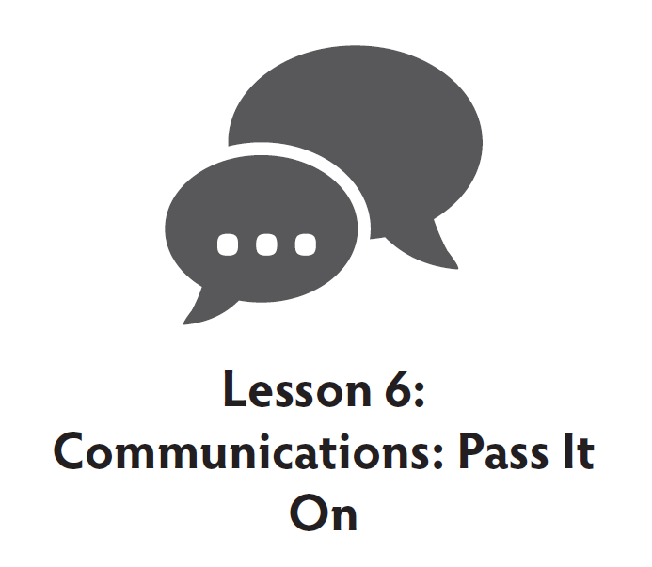
E2: Entrepreneurship Experience
Create Your Own Future
A curriculum for Extension Agents, Elementary Teachers, Volunteers, Others
For 4-H Spin Clubs, After-School Programs, 4-H Camps, Classrooms
FEATURING:

Slide 3
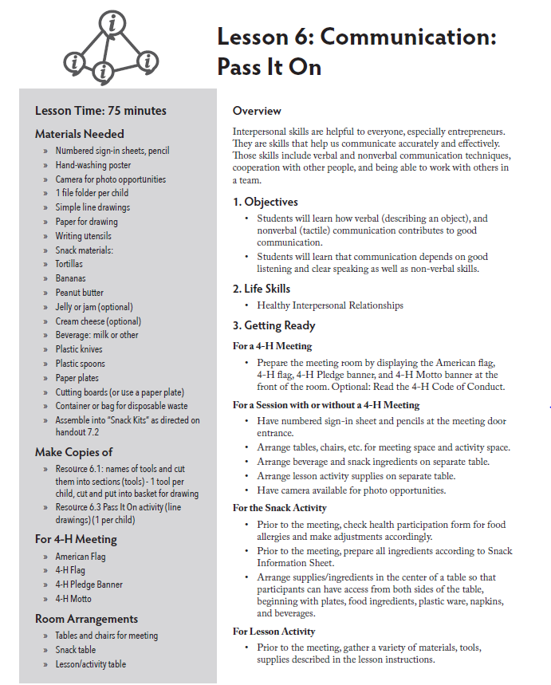
E2: Entrepreneur Experience

Slide 4
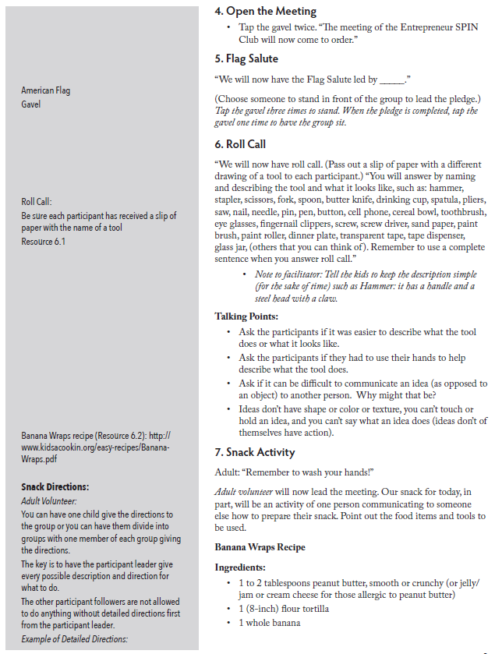
Page 2

Slide 5
Roll Call Activity
Roll Call
“We will now have roll call. (Pass out a slip of paper with a different line drawing of a tool to each participant.) “You will answer by naming and describing the tool and what it looks like such as: hammer, stapler, scissors, fork, spoon, butter knife, drinking cup, spatula, pliers, saw, nail, needle, pin, pen, button, cell phone, cereal bowl, toothbrush, eye glasses, fingernail clippers, screw, screw driver, sand paper, paint brush, paint roller, dinner plate, transparent tape, tape dispenser, glass jar, (others that you can think of.) Remember to use a complete sentence when you answer roll call.”
RESOURCE 8.1
Note to facilitator: Tell the kids to keep the description simple (for the sake of time) such as Hammer: it has a handle and a steel head with a claw.

Slide 6
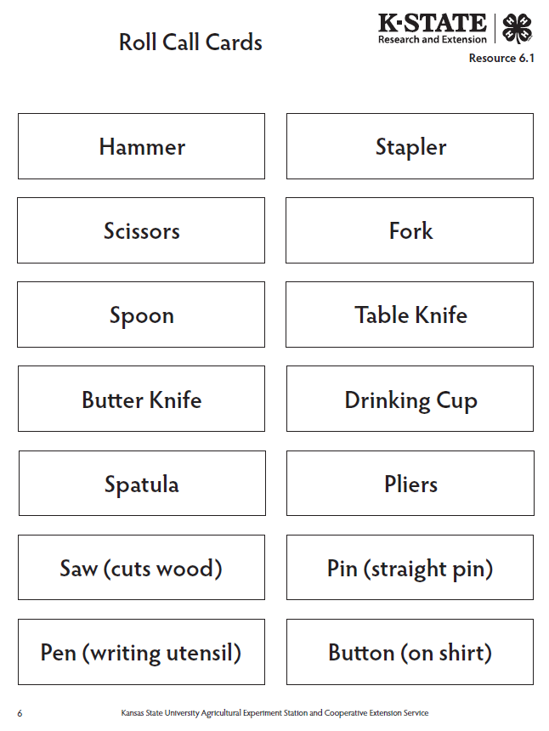
Reference Sheets

Slide 7
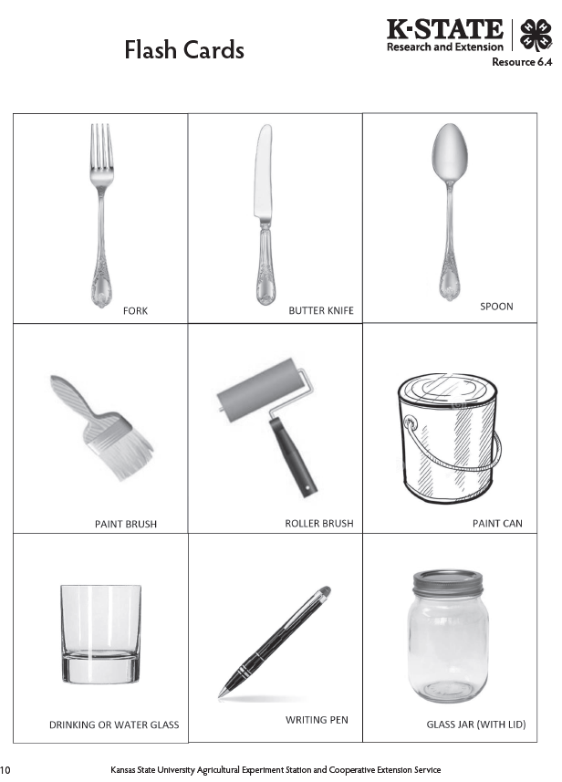

Slide 8
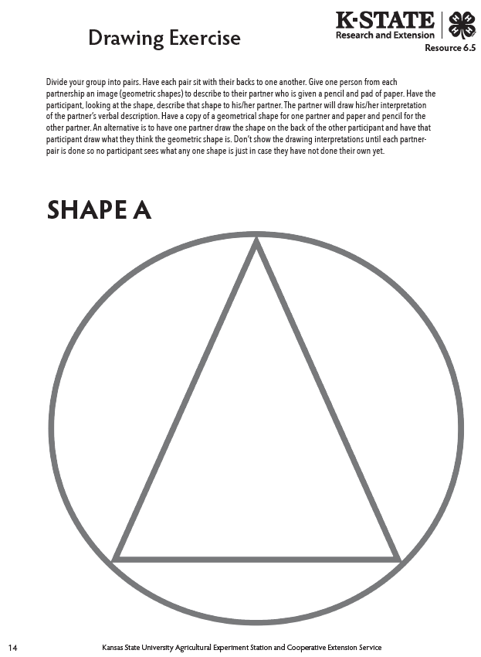

Slide 9
Talking Points
Talking Points
Ask the participants if it was easier to describe what the tool does or what it looks like.
Ask the participants if they had to use their hands to help describe what the tool does.
Ask if it can be difficult to communicate an idea (as opposed to an object) to another person. Why might that be?
Ideas don’t have shape or color or texture, you can’t touch or hold an idea, you can’t say what an idea does. (Ideas don’t of themselves have action.)

Slide 10
Snack Activity
Snack Activity
Adult: remember to wash your hands!
Adult volunteer will now lead the meeting. Our snack for today, in part, will be an activity of one person communicating to someone else how to prepare their snack. Point out the food items and tools to be used.

Slide 11
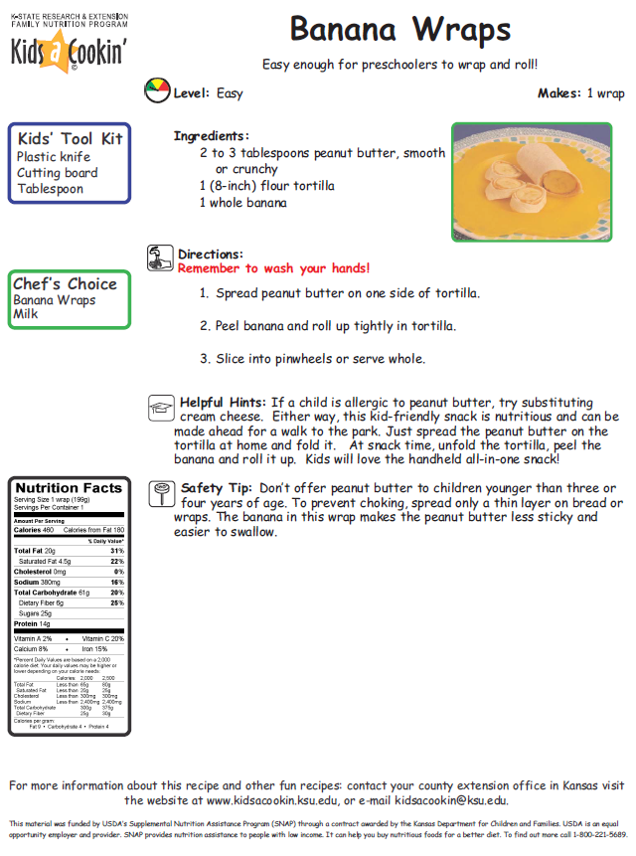
Snack Activity Recipe

Slide 12
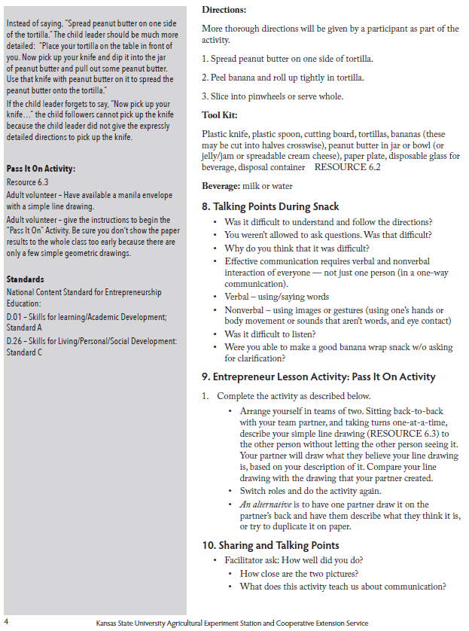
Side Bar

Slide 13
Beverage: milk or water
Talking Points During or After Snack
Was it difficult to understand and follow the directions?
You weren’t allowed to ask questions. Was that difficult? Why do you think that it was difficult?
Effective communication requires verbal and nonverbal interaction of everyone – not just one person (in a one-way communication.)
Verbal – using/saying words
Nonverbal- using images or gesture (using one’s hands or body movement or sounds that aren’t words, and eye contact)
Was it difficult to listen?
Were you able to make a good banana wrap snack w/o asking for clarification?
Talking Points

Slide 14
11. Review Characteristics of an Entrepreneur
An entrepreneur has good interpersonal and communication skills to know customers’ needs and wants.
An entrepreneur knows how to listen.
An entrepreneur has good verbal (speaking) skills.
An entrepreneur has good nonverbal (eye contact, hand gestures, body language) skills.
Characteristics of an
Entrepreneur

Slide 15
12. Close the Meeting
Tap the gavel twice. “The meeting of the Entrepreneur SPIN Club will now come to order.”
13. 4-H Flag Salute
“We will now have the 4-H Flag Salute lead by ________.”
(Choose someone to stand in front of the group to lead the pledge). At the end of the 4-H flag salute, everyone will shout the 4-H motto -- To Make The Best Better!” Tap the gavel three times to stand. When the pledge is completed, tap the gavel one time to adjourn the meeting.
“The meeting is adjourned!”
Closing and the Salute

Slide 16
E2: ENTREPRENEURSHIP EXPERIENCE
Create Your Own Future
Thank You!

