Slide 1
The 2015-2020 Dietary Guidelines for Americans
FCS February Update, 2016
Presented by
Mary Meck Higgins, Ph.D., R.D., L.D., FAND (Fellow of the Academy of Nutrition and Dietetics),
KSRE Human Nutrition Specialist

Slide 2
These slides will be on KSRE
Extension Food, Nutrition,
Dietetics and Health’s site,
www.ksre.k-state.edu/humannutrition
Click the ‘faculty/staff’ link.

Slide 3
An abbreviation used throughout this presentation is DGA, Dietary Guidelines for Americans

Slide 4
Outline of Today’s Session
Review the DGA Advisory Committee’s report
Overview of 2015-2020 DGA
Key elements of healthful eating patterns
Guidelines #1, #2, #3 + ‘Key Recommendations’
Shifts needed to align with healthful eating patterns, Guideline #4
Everyone has a role in supporting healthful eating patterns, Guideline #5

Slide 5
Today, as I review the new DGA, I will not repeat the information from my 8/2015 presentation about the DGA Advisory Committee’s Report. Please refer to those slides again, as desired, at Extension Food, Nutrition, Dietetics and Health’s site. Click the ‘faculty/staff’ link.

Slide 6
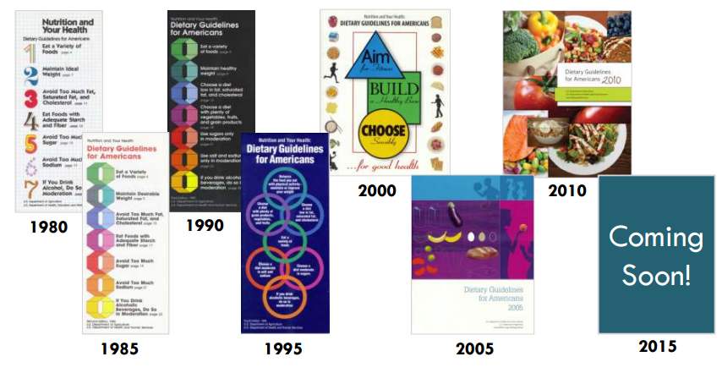
2015-2020 DGA are 8th edition
Adapted from: http://extension.usu.edu/mpr/files/uploads/PowerPoints/
ATagtow_MPRO_SNAP-ED_Presentation_Final_April_2015.pdf

Slide 7
The 2015-2020 DGA
Available online, at
www.health.gov/dietaryguidelines
PDF file is 213 pages
Published 1/7/2016 by
USDA’s Center for Nutrition Policy and Promotion, and
U.S. Health & Human Services’ (HHS) Office of Disease Prevention and Health Promotion

Slide 8
The 2015-2020 DGA
Will be the basis for KSRE’s nutrition education activities for the general public for the next 5 years
The DGA 2015-2020 are not expressly written for the public
Many ‘consumer resources’ describing the DGA messages will be published soon
www.choosemyplate.gov/dietary-guidelines

Slide 9
The DGA
Translate science into food-based guidance. Why?
Their main purpose is to inform Federal food, nutrition and health policies and programs (e.g., school lunch, older adult meal programs), including educational programs
The primary intended audiences are policymakers, and nutrition and health professionals / educators

Slide 10
The DGA
Translate science into food-based guidance. Why?
To promote health, healthy body weights, and prevention of chronic diseases
Even though the DGA aren’t primarily for the general public, they’re a good source of advice for individuals + families on healthful food/physical activity choices (for those ages 2+ yrs, including people at-risk for chronic diseases)

Slide 11
Improvement Is Needed
1/2 of U.S. adults have 1 or more preventable diet-related chronic dx
Heart disease, high blood pressure, stroke, type 2 diabetes, obesity, poor bone health/ osteoporosis, some cancers (breast/ colorectal/others)

Slide 12
Improvement Is Needed
The U.S. has:
A long history of high rates of diet-related preventable chronic dx
Low progress toward meeting 2010 Dietary Guidelines recommendations: average adherence is only 58% (There has been some progress: it was just 49% in 2000)
A great need to improve both dietary and physical activity education and behaviors across the entire U.S. population

Slide 13
Improvement Is Achievable
Eating a healthful diet that is…
Energy balanced, and
Provides sufficient intake of nutrients, and
Does not exceed intake of over-consumed nutrients
… can be achieved, and will result in positive health outcomes, but will require shifts from current typical U.S. dietary practices

Slide 14
The 2015-2020 DGA focus on eating patterns and their food and nutrient characteristics

Slide 15
Definition
“Eating Pattern” or “Dietary Pattern”
The foods + beverages that make up one’s complete dietary intake over time
A customary way of eating
The result of choices on many eating occasions over time, both at home and away from home
Consist of multiple + interacting food components
Are more predictive of overall health status and disease risk than are the individual foods or nutrients consumed

Slide 16
Definition
A “healthful eating pattern”
A combination of foods that’s linked to good health when eaten with regularity
Consuming one helps a person:
Achieve and maintain a healthy body weight
Obtain adequate nutrients
Reduce his or her risk of chronic disease
Can be tailored to meet an individual’s:
Personal, cultural and traditional preferences
Budget

Slide 17
The 2015-2020 DGA includes:
An introduction, 3 chapters and 14 appendices
5 general guidelines
Numerous specific key recommendations
3 sample healthful eating patterns

Slide 18
The 2015-2020 DGA includes:
14 appendices
#1, Physical Activity Guidelines
#3, Healthy U.S.-style eating pattern
#4, Mediterranean-style eating pattern
#5, Healthy vegetarian eating pattern (no red meats, poultry or seafood)
#14, food safety principles and guidance
Others: definitions, calorie needs, food sources of nutrients, more

Slide 19
3 chapters, 5 guidelines
Chapter 1, Key Elements of Healthful Eating Patterns; Guidelines #1, #2, #3 + the Key Recommendations
Chapter 2, Guideline #4: Shifts Needed To Align with Healthful Eating Patterns
Chapter 3, Guideline #5: Everyone Has a Role in Supporting Healthful Eating Patterns

Slide 20
Chapter 1, Key Elements of Healthful Eating Patterns

Slide 21
#1 of Five Guidelines
Eat a healthful eating pattern across the lifespan
All food and beverage choices matter
Choose a healthful eating pattern at an appropriate calorie level
The best way to determine whether an eating pattern is at an appropriate number of calories is to monitor body weight
Adjust calorie intake, and expenditures in physical activity, based on changes in weight over time

Slide 22
Key Recommendations
A healthful eating pattern includes:
A variety of vegetables from all of the subgroups—dark green, red and orange, legumes, starchy and other
Fruits, especially whole fruits
Grains, at least half of which are whole grains

Slide 23
Key Recommendations
A healthful eating pattern includes:
Fat-free or low-fat dairy, including milk, yogurt, cheese and/or fortified soy beverages
A variety of protein foods, including seafood, lean meats and poultry, eggs, legumes, and nuts, seeds and soy products
Liquid oils high in unsaturated fats
Note: Chapter 1 describes the best food choices and DGA amounts for each group, and nutrients they provide.

Slide 24
Key Recommendations
A healthful eating pattern limits:
Saturated fats and trans fats
Consume less than 10% of calories/day from saturated fats
Added sugars: less than 10% of calories/day
Sodium: less than 2,300 mg/day of sodium
Alcohol:
If consumed, up to 1 drink/day for women who are not pregnant, + up to 2 drinks/day for men
Use only by adults of legal drinking age

Slide 25
Key Recommendations
Nutritional needs should be met primarily from foods, especially nutrient-dense foods
All forms of foods can be included:
Fresh, canned, dried, frozen, juiced
Cooked, raw
Fortified foods /dietary supplements are useful in some cases
Such as for folic acid, iron, vitamin D

Slide 26
Key Recommendations
People of all ages should meet HHS’ Physical Activity Guidelines for Americans
To help promote health and reduce the risk of chronic disease
The relationship between diet and physical activity contributes to calorie balance and managing body weight

Slide 27
Sample Healthy Eating Pattern
“Healthy U.S.-style eating pattern” versus “typical U.S. diet”:
Both are based on the types + proportions of foods typically consumed in the U.S.
But, with the healthy eating pattern:
The foods are in nutrient-dense forms, and
The amounts recommended reflect those associated with positive health outcomes.
The same as the 2010 DGA USDA Food Pattern

Slide 28
Advice about Body Weight
All Americans should aim to achieve and maintain a healthy body weight
To lose weight, most people need to reduce the number of calories they get from foods/ beverages and increase physical activity
Overweight pregnant women should:
Gain weight within the gestational weight gain guidelines

Slide 29
Advice about Body Weight
All Americans should aim to achieve and maintain a healthy body weight
Overweight children + adolescents should:
Change their eating and physical activity behaviors to maintain or reduce their rate of weight gain while linear growth occurs
Overweight + obese adults should:
Change their eating and physical activity behaviors to prevent additional weight gain and/or promote weight loss

Slide 30
Advice about Body Weight
Overweight adults 65 years or older should:
Prevent additional weight gain. Obese older adults, particularly those with risk factors for heart disease, may find intentional weight loss to be beneficial and result in improved quality of life and reduced risk of chronic diseases and associated disabilities
More details are provided in the DGA

Slide 31
#2 of Five Guidelines
Focus on variety, nutrient density, and amount to meet nutrient needs within calorie limits
Choose a variety of nutrient-dense foods across and within all food groups in DGA amounts

Slide 32
Definition
“Variety”
A diverse assortment of foods + beverages across and within all food groups and subgroups selected to fulfill the recommended amounts without exceeding the limits for calories and other dietary components
Example in the vegetables food group:
Each week, choosing dark green, red and orange, legumes, starchy and other vegetables

Slide 33
Definition
“Nutrient dense” foods + beverages
Nutrient-dense foods and beverages are naturally lean or low in solid fats, and have little or no added solid fats, sugars, refined starches or sodium
Ideally, they also are in forms that retain naturally-occurring components, such as dietary fiber

Slide 34
Definition
“Nutrient dense” foods + beverages
Most food choices are not in nutrient-dense forms from most of the food groups, as they are typically consumed in the U.S.
Examples:
When prepared with little or no added solid fats, sugars, refined starches or sodium, all vegetables, fruits, whole grains, seafood, eggs, beans and peas, unsalted nuts and seeds, fat-free and low-fat dairy products, and lean meats and poultry

Slide 35
#3 of Five Guidelines
Limit calories from added sugars and saturated fats and reduce sodium intake
Consume an eating pattern low in added sugars, saturated fats and sodium
Cut back on foods and beverages higher in added sugars, saturated fats or sodium to amounts that fit within healthful eating patterns

Slide 36
#3 of Five Guidelines
Limit calories from added sugars and saturated fats and reduce sodium intake
Examples of foods high in added sugars:
Sugar-sweetened soda; Sugary snacks; Sweets
Examples of foods high in saturated fats:
Ice cream; Cheeseburger; Coconut oil
Examples of foods high in sodium:
Pizza; Deli meat / cold cuts sandwiches

Slide 37
Chapter 2, Shifts Needed To Align with Healthful Eating Patterns Note: This is a long chapter!

Slide 38
#4 of Five Guidelines
Shift to healthier foods, beverages
Choose nutrient-dense foods and beverages across and within all food groups, instead of eating less healthful foods
Consider cultural and personal preferences to make shifts in choices easier to accomplish and maintain
Make substitutions rather than increasing intake overall

Slide 39
Current U.S. Eating Pattern
75% have an eating pattern low in vegetables, fruits, dairy, oils
50% meet or exceed total grain + total protein DGA amounts, but eat too little of foods in the subgroups
Most have an eating pattern too high in added sugars, saturated fats, sodium, total calories

Slide 40
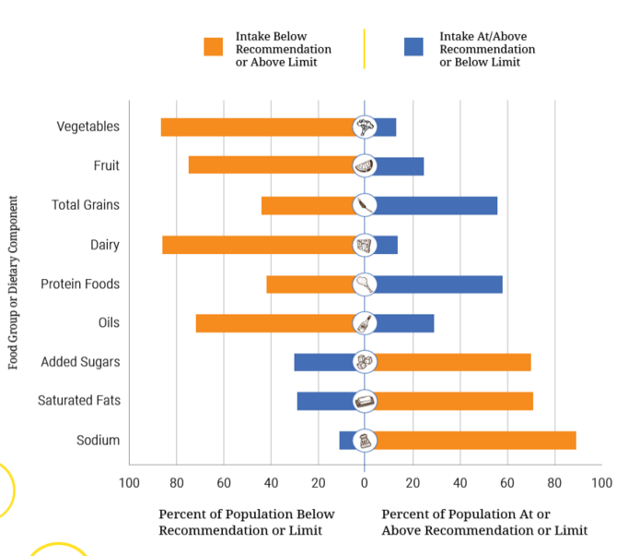
Current U.S. Eating Pattern compared to DGA 2015
Note: The center is the
DGA goal
or
limit
Note: To improve, shift orange bars to the center

Slide 41
Shifts Needed to Align
Shift to healthier foods, beverages
Foods in many food groups, as they are typically eaten in the U.S., are not in nutrient-dense forms
Contain added calories from added sugars, added refined starches and/or solid fats
Consuming added sugars, refined starches and solid fats makes it hard to meet nutrient needs while staying within calorie limits
Shifting is needed to align with the DGA

Slide 42
Shifts Needed to Align
Shift to healthier foods, beverages
17 examples of eating pattern shifts needed
This chapter methodically reviews
Each food group to encourage
Each type of food to limit
Offers details on why and how to shift intakes

Slide 43
Shifts Needed To Align
Example 1 - Shift to balance calories
How?
Shift to eating nutrient-dense foods instead of making typical food choices containing added sugars, added refined starches and/or solid fats, and
Shift to eating reduced portion sizes of foods and beverages that are not nutrient-dense

Slide 44
Shifts Needed To Align
Example 2 - Shift to eating more vegetables. How?
Include vegetables in most meals and snacks
Choose a green salad or a vegetable side dish
Shift to choosing vegetables instead of some meats, poultry, cheeses and snack foods
Increase the vegetables in mixed dishes and decrease the refined grains or meats in them
Eat a variety of vegetables: dark greens, red/orange, starchy, legumes, others

Slide 45
Shifts Needed To Align
Example 3 - Shift to eating more fruit. How?
Choose fruit as a snack
Add fruit to salads
Choose fruit as a side dish
Eat fruit for dessert instead of eating sugary foods (such as cakes, pies, cookies, donuts, ice cream or candies)

Slide 46
Shifts Needed To Align
Example 4 - Shift to make half of all grains consumed be whole grains. How?
Shift from refined to whole-grain breads, pasta and brown rice
Select foods that have whole grains listed as the first grain ingredient in the ingredients list
Cut back on eating cakes, cookies and pastries
Choose whole-grain and refined-grain foods in nutrient-dense forms

Slide 47
Shifts Needed To Align
Example 5 - Shift to eat more grain foods in a nutrient-dense form. How?
Choose plain popcorn instead of buttered
Choose bread instead of a croissant
Choose an English muffin instead of a biscuit
Choose nutrient-dense forms of both whole-grain and refined-grain foods

Slide 48
Shifts Needed To Align
Example 6 - Shift to consuming more dairy products. How?
Drink fat-free or low-fat milk or a fortified soy beverage with meals
Choose yogurt as a snack
Use yogurt as an ingredient in prepared dishes, such as salad dressings or spreads

Slide 49
Shifts Needed To Align
Example 7 - Shift to consuming dairy products in nutrient-dense forms. How?
Choose lower fat versions of milk, yogurt and cheeses, instead of whole milk products and regular cheeses
Choose fat-free or low-fat milk and yogurt
Choose fat-free or low-fat fortified soy beverages (soymilk)

Slide 50
Shifts Needed To Align
Example 8 - Shift to choosing more varied protein food choices. How?
Increase seafood intake by incorporating it as the protein foods choice in meals twice per week, instead of meat, poultry or eggs
Choose a salmon steak or a tuna sandwich
Use legumes, nuts or seeds in mixed dishes, instead of some meat or poultry
Choose a bean chili or add almonds to a main-dish salad

Slide 51
Shifts Needed To Align
Example 9 – Some need to shift to lesser amounts of some protein foods
Average weekly intakes of red meats, poultry and eggs are above recommended amounts for teen boys and adult men
ages 14-18: average 38, recommended 26-34 oz
ages 19-30: average 44, recommended 31-34 oz
ages 31-50: average 45, recommended 29-34 oz
ages 51-70: average 40, recommended 26-34 oz

Slide 52
Shifts Needed To Align
Example 9 - Some need to shift to lesser amounts of some protein foods
Why should we care?
Lower intakes of fresh red meats, processed red meats and processed poultry than the typical U.S. diet are associated with
Reduced risk of heart disease
Possibly of reduced risk of obesity, type 2 diabetes and some cancers

Slide 53
Shifts Needed To Align
Example 9 - Some need to shift to lesser amounts of some protein foods. How?
Shift towards choosing DGA amounts of meats, poultry and eggs
Instead, eat more seafood, legumes or choices from other under-consumed food groups

Slide 54
Shifts Needed To Align
Example 10 - Shift to eating protein foods that are more nutrient-dense. How?
Choose lean or lower-fat versions
Choose lower sodium options

Slide 55
Shifts Needed To Align
Example 10 - Shift to eating protein foods that are more nutrient-dense
Include “processed” red meats/poultry, if desired, only if the eating pattern also stays within limits for sodium, saturated fats, calories + added sugars
Common “processed” red meats/poultry are:
Bacon
Hot dogs
Sausages
Ham
Pastrami
Luncheon/deli meats

Slide 56
Shifts Needed To Align
Example 11 - Shift to consuming oils instead of solid fats. How?
When cooking, use vegetable oil instead of solid fats (e.g., butter, stick margarine, shortening, lard, coconut oil)
Increase intake of seafood and nuts, in place of some meat and poultry
Choose salad dressings and spreads made with oils instead of solid fats

Slide 57
Shifts Needed To Align
Example 12 - Shift to reduce added sugars to less than 10% of calories/d
Why should we care?
This shift is associated with
Reduced risk of cardiovascular disease in adults
May also reduce risk of obesity, type 2 diabetes, and some types of cancer in adults

Slide 58
Shifts Needed To Align
Example 12 - Shift to reduce added sugars to less than 10% of calories/d. How?
If you drink sugar-sweetened beverages (Regular soft drinks; Fruit drinks; Sweetened coffee and tea; Sport drinks; Energy drinks; Beverages containing alcohol; Flavored waters):
Drink them less often
Reduce portion sizes

Slide 59
Shifts Needed To Align
Example 12 - Shift to reduce added sugars to less than 10% of calories/d. How?
Instead of sugar-sweetened beverages, drink
Water and other beverages with no added sugars
Low-fat or fat-free milk
100% fruit or vegetable juice within recommended amounts
Beverages low in added sugars

Slide 60
Shifts Needed To Align
Example 12 - Shift to reduce added sugars to less than 10% of calories/d
Limit how often you eat desserts and sweet snacks, or decrease portion sizes of them:
Grain-based types: cakes, pies, cookies, brownies, donuts, sweet rolls, pastries
Dairy-based types: ice cream, other frozen desserts, puddings
Sweets: candies, sugars, jams, syrups, sweetened toppings

Slide 61
Shifts Needed To Align
Example 12 - Shift to reduce added sugars to less than 10% of calories/d. How?
Choose yogurt and other dairy foods that have no added sugars
Choose unsweetened or no-sugar-added versions of canned fruit and fruit sauces (e.g., applesauce)

Slide 62
Shifts Needed To Align
Example 13 - Shift to reduce intake of saturated and solid fats to less than 10% of calories/day
Why should we care?
This shift is associated with reduced risk of heart attacks and death from heart disease
This shift will substantially reduce excess calories in the typical U.S. diet

Slide 63
Shifts Needed To Align
Example 13 - Shift to reduce intake of saturated and solid fats to less than 10% of calories/d
“Solid fats” are added to many foods + are
Fats that are solid at room temperature
The major source of saturated fats in the U.S.
Foods high in saturated fats include:
Coconut oil, palm oil, palm kernel oil, hydrogenated vegetable oils, meats that are not labeled as lean, poultry fats, butter, cream, cheeses, whole milk

Slide 64
Shifts Needed To Align
Example 13 - Shift to reduce intake of saturated and solid fats
Dietary solid/saturated fats are mainly in:
Mixed dishes containing cheese, meat or both, such as burgers, sandwiches, tacos, pizza;
Snacks + sweets; Protein foods; Dairy products

Slide 65
Shifts Needed To Align
Example 13 - Shift to reduce intake of saturated and solid fats to less than 10% of calories/d. How?
Replace saturated fats with unsaturated fats, especially polyunsaturated fats, while also keeping total dietary fats within DGA levels
Note: Replacing total dietary fat or saturated fats with carbohydrates is NOT associated with reduced risk of heart disease

Slide 66
Shifts Needed To Align
Example 13 - Shift to reduce intake of saturated and solid fats. How?
Change ingredients in mixed dishes to increase the amounts of vegetables, whole grains, lean meat, and low-fat or fat-free cheese, instead of putting some of the fatty meat and/or regular cheese in the dish
Prepare foods using oils high in polyunsaturated or monounsaturated fats, instead of using foods high in saturated fats

Slide 67
Shifts Needed To Align
Example 13 - Shift to reduce intake of saturated and solid fats. How?
Read food labels to choose foods (esp. snack foods, sweets + dairy products) lower in saturated fats, and higher in polyunsaturated or monounsaturated fats
Eat smaller portions of foods high in saturated fats, and/or eat them less often
Use oil-based dressings + spreads on foods, not those made from solid fats (e.g., butter, stick margarine, cream cheese)

Slide 68
Shifts Needed To Align
Example 13 - Shift to reduce intake of saturated and solid fats. How?
Choose lower-fat versions of foods + beverages that contain saturated fats
Lean cuts of meat, not fatty cuts
Skinless poultry; discard the skin
Fat-free or low-fat milk, not 2% or whole milk
Low-fat or fat-free cheeses, not regular cheeses
Fat-free creams and yogurt, not regular types

Slide 69
Shifts Needed To Align
Example 14 - Shift food choices to reduce sodium intake to less than 2,300 mg/day
Why should we care?
This shift is associated with reduced blood pressure
Most people typically consume too much sodium/day:
For adult men, the average intake is 4,240 mg
For adult women, the average is 2,980 mg

Slide 70
Shifts Needed To Align
Example 14 - Shift food choices to reduce sodium intake. How?
Read the Nutrition Facts label (esp. for pizza, pasta dishes, sauces, soups, other mixed dishes, protein foods + grain foods)
Choose foods with less sodium per serving
Choose low-sodium, reduced-sodium and no-salt-added forms of high sodium foods
If eating foods high in sodium, reduce portion sizes and/or eat them less often

Slide 71
Shifts Needed To Align
Example 14 - Shift food choices to reduce sodium intake. How?
Choose fresh poultry, seafood, pork and red meats, not processed meat and poultry
Eat at home more often
Limit cooking with sauces, mixes and “instant” products, including flavored rice, instant noodles, and ready-made pasta
Flavor foods with herbs and spices, not salt
Use minimal amounts of salt at the table

Slide 72
Shifts Needed To Align
Example 15 - Shift to moderate alcohol and caffeine consumption, if any. How?
37% of U.S. adults don’t limit alcohol intake to moderate amounts 1x or more/month
5 to 10% of U.S. adults don’t limit caffeine intake to moderate amounts, or 400 mg/day
Coffee and tea provide 70 to 90% of caffeine intake for adults

Slide 73
Shifts Needed To Align
Example 16 - Shift to eating more vegetables, fruits, whole grains and dairy, as noted previously
Why should we care?
This shift will increase intake of the under-consumed nutrients of public health concern
Dietary fiber
Potassium
Calcium
Vitamin D

Slide 74
Shifts Needed To Align
Example 17 – For some, shift to eating more dietary iron
Who? Young children; Adolescent girls and women capable of becoming pregnant; Women who are pregnant
How?
Eat foods with heme iron, such as lean meats, poultry and seafood
Eat legumes, dark-green vegetables, foods enriched or fortified with iron; and eat vitamin C-rich foods when eating these foods

Slide 75
Current U.S. Physical Activity
20% of adults meet guidelines for aerobic and muscle-strengthening activity; 80% do not meet them
30% of adults report engaging in NO leisure time physical activity
Physical activity related to work, home and transportation has declined in recent decades

Slide 76
Shifts Needed To Align
Shifts are needed to increase physical activity instead of being sedentary so often
To meet recommendations of Physical Activity Guidelines, the U.S. public should:
Increase time spent doing aerobic physical activities
Do muscle strengthening activities 2 days/week
Limit screen time and sedentary time

Slide 77
Shifts Needed To Align
Summary of Shifts Needed
Every food choice is a chance to move toward a more healthful eating pattern
We have many opportunities each day to make shifts to improve our eating patterns
Some needed shifts will require effort to accomplish, others will be minor
Small shifts in food choices at a certain meal/snack time, or on a certain day, or in a certain place, can make big differences if sustained over time

Slide 78
Chapter 3, Everyone Has a Role in Supporting Healthful Eating Patterns

Slide 79
#5 of Five Guidelines
Everyone has a role in supporting healthful eating patterns for all
Help support individuals/families to choose healthful eating patterns in multiple settings:
Where we live, learn, work, play and shop
Homes; Schools; Work sites; Stores; Restaurants; Communities
Help make healthful lifestyle choices be:
Easy, accessible, affordable, and the normal or usual choices made

Slide 80
#5 of Five Guidelines
Everyone has a role in supporting healthful eating patterns for all
The chapter describes:
Factors that influence eating + physical activity behaviors, using the social-ecological model
Ways to implement strategies to help individuals align their eating patterns with the DGA
Need multiple efforts by:
Educators, health professionals, communities, businesses and industries, organizations, governments, and other segments of society

Slide 81
#5 of Five Guidelines
Everyone has a role in supporting healthful eating patterns for all
Help improve everyone’s access to healthy, safe and affordable food choices
Help improve household food security
Help improve acculturation by encouraging immigrants to:
Retain healthful aspects of their eating and physical activity patterns, and
Avoid adopting behaviors that are less healthful

Slide 82
#5 of Five Guidelines
Everyone has a role in supporting healthful eating patterns for all
Help improve social/cultural norms and values
To embrace, support and maintain
Healthful eating patterns
Physical activity behaviors

Slide 83
Support healthful eating patterns
At home
Individuals and families can try out small changes to find what works for them, such as
Drink water more often, instead of sweetened beverages
Add more veggies to favorite dishes
Plan and cook more meals at home
Be physically active when spending time with family and friends
Limit screen time and time spent sitting down

Slide 84
Support healthful eating patterns
At child care centers and schools
Staff can
Improve the selection of healthful food choices in cafeterias and vending machines
Offer menu labeling for food choices
Provide nutrition education programs and school gardens
Increase school-based physical activity
Encourage parents and caregivers to promote active play and healthful eating at home

Slide 85
Support healthful eating patterns
At work
Worksite personnel can:
Encourage physical activity breaks, walking meetings, standing desks
Offer healthful food options in the cafeteria, vending machines, and at staff meetings or sponsored functions
Provide health and wellness programs and nutrition counseling
Offer flexible schedules that allow for physical activity

Slide 86
Support healthful eating patterns
In shopping sites
Managers of grocery stores, concession stands, other food retail outlets, food service establishments, other businesses selling foods can:
Provide healthful food choices
Display healthful food choices more prominently than less-healthful choices
Inform consumers about making healthful changes

Slide 87
Support healthful eating patterns
In communities
Community leaders can:
Offer classes that teach skills to support healthy eating patterns, including
Gardening, food preparation/cooking, meal planning, food label reading
Increase access to affordable healthful food choices through community gardens, farmers markets, food banks, homeless shelters
Create walkable communities by maintaining safe public spaces

Slide 88
Summary of 2015-2020 DGA
3 “building blocks” of healthy lifestyles =
Eating vegetables, fruits, whole grains, low-fat dairy, protein foods.
------
Eating limited amounts of saturated fats, added sugars, sodium, alcohol.
------
Being physically active.

Slide 89
DGA Resources from Extension Food, Nutrition, Dietetics and Health

Slide 90
DGA Resources
On Extension Food, Nutrition, Dietetics and Health’s website, in “Nutrition Topics” section
Getting started with MyPlate
Older Adults site
On right sidebar: Weekly menu planning tool
Outlines how to eat the Healthy U.S.-style eating pattern for a week
Healthy sustainable diets

Slide 91
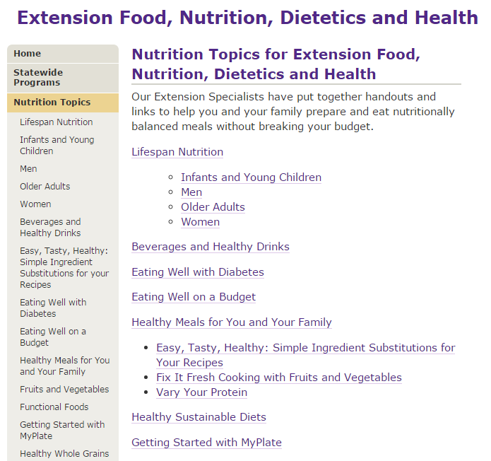
DGA Resources

Slide 92
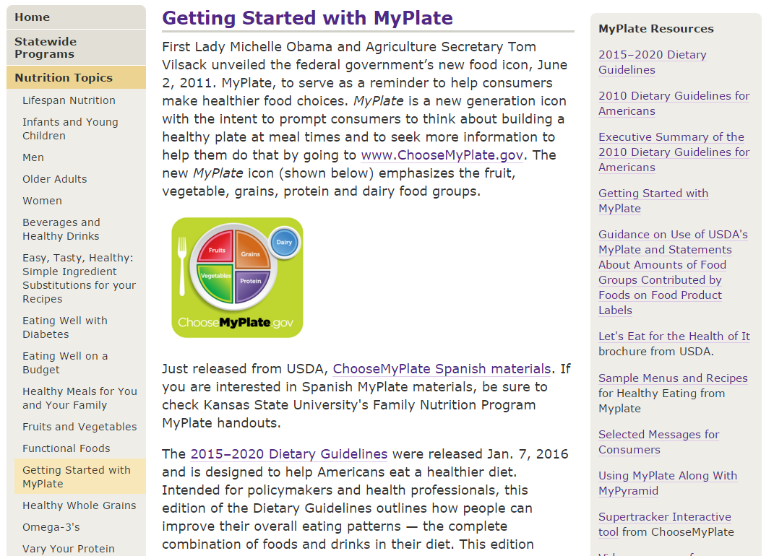
DGA Resources

Slide 93
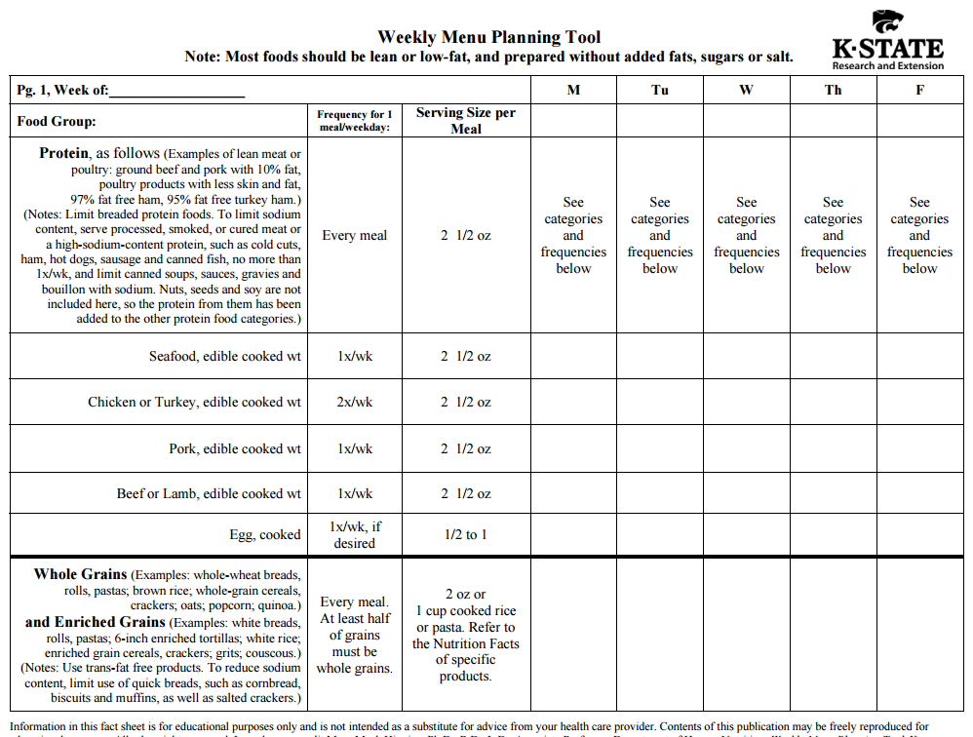
Healthy U.S.-style Eating Pattern

Slide 94
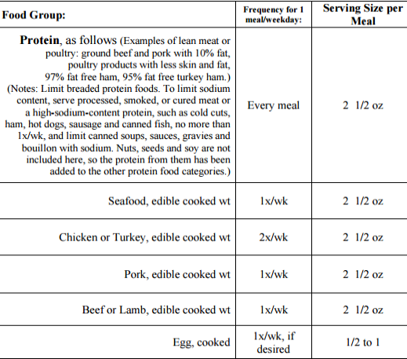

Slide 96
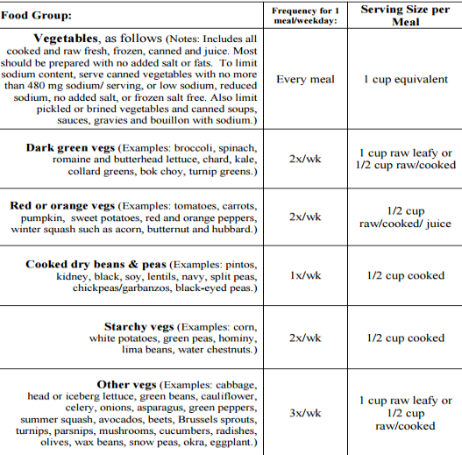

Slide 97
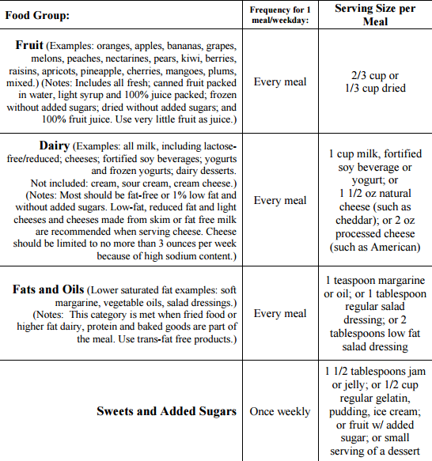

Slide 98
Sustainability Issues
2015-2020 DGA don’t include as a factor the goal of sustainability
Evaluating the natural resources required + environmental impacts of a food source
Sustainability issues were in the DGA Advisory Committee’s scientific report
USDA/HHS said sustainability is
“Outside the scope of the DGA, as mandated by the 1990 National Nutrition Monitoring and Related Research Act”
“An important policy conversation, but the DGA are not the appropriate vehicle for this”

Slide 99
DGA Resources
KSU Pub MF3060, still current

Slide 100
The 2015-2020 Dietary Guidelines for Americans
FCS February Update, 2016
Presented by
Mary Meck Higgins, Ph.D., R.D., L.D., FAND (Fellow of the Academy of Nutrition and Dietetics),
KSRE Human Nutrition Specialist

