Slide 1


Community Conversations about Health
August 2018 FCS Update

Slide 2

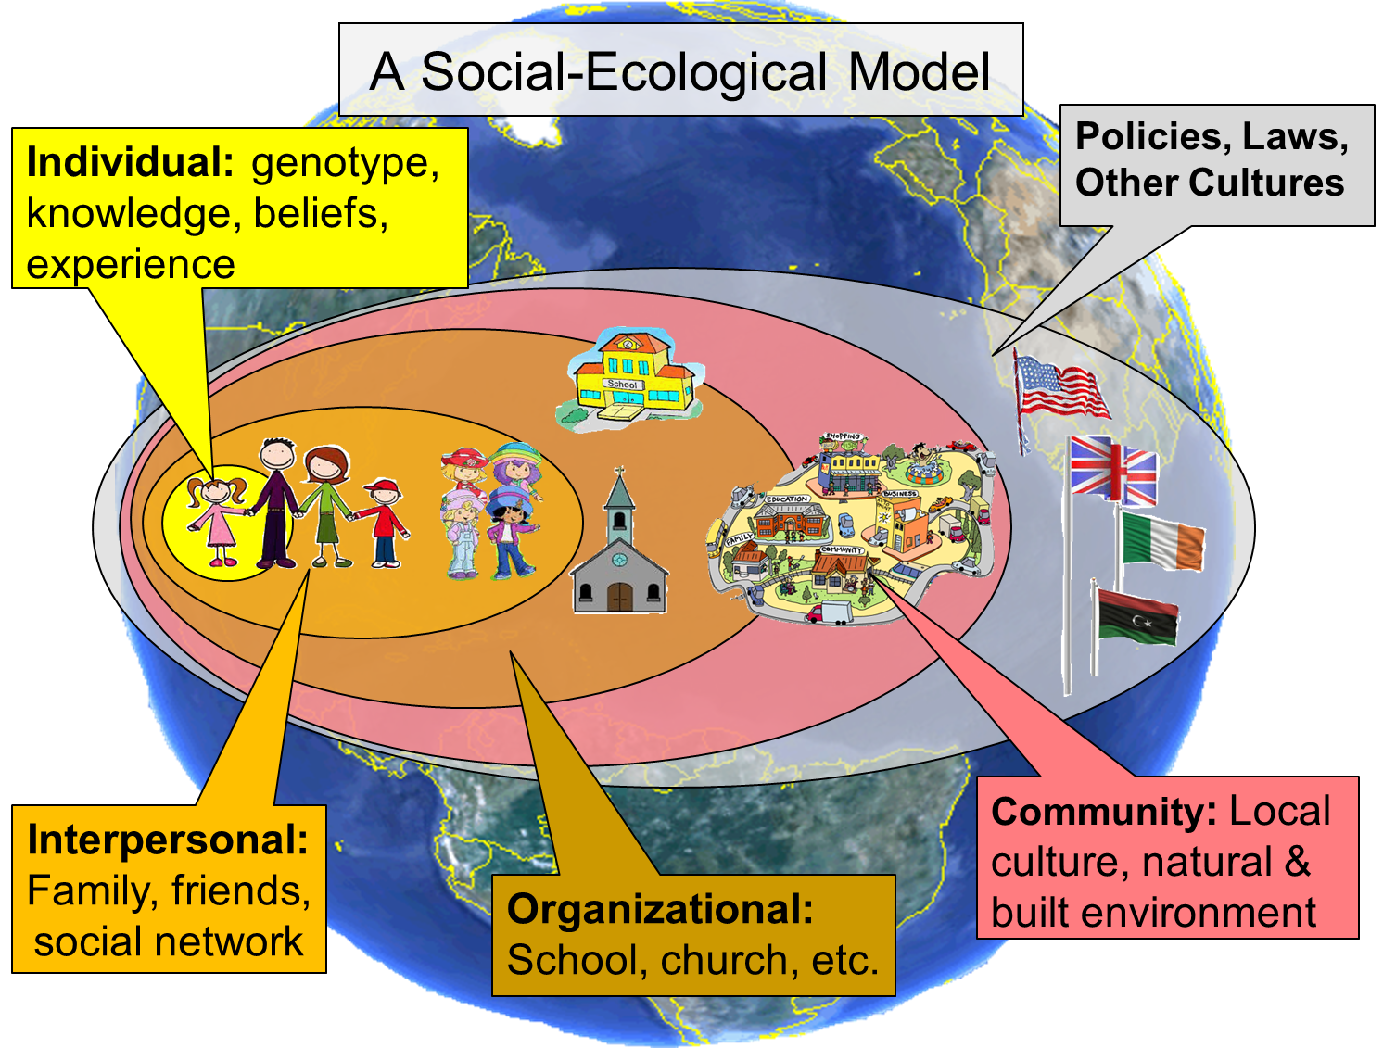
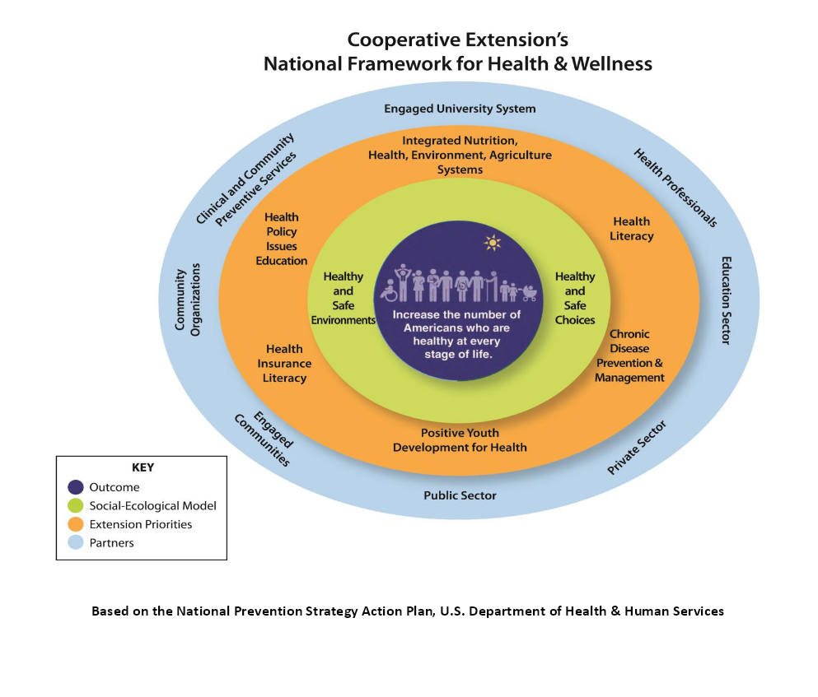



Recap of Recent Past
Focus Groups
Update Feb 2017
PSE
May 2017
Culture of Health Workshops
Value of Family and
Consumer Sciences Extension

Slide 3

Why Health?
Health is a
Grand Challenge…
Why?

Slide 4
Why focus on Health?
We live in a time when we no longer expect that American children will live a longer life than their parents.
Center for Disease Control
Notes:
According to the Centers for Disease Control and Prevention, genes, biology, and health behaviors together account for about 25% of population health. The remaining 75% can be attributed to the social environment, physical environment, and health services/medical care. (education, housing, work, environment, lifestyles, etc) Many of these population health disparities are due to poverty, inequities among minority racial and ethnic groups, and lack of access to health care. The impact of these factors are especially hard-felt by Kansans living in rural and frontier regions that are challenged by geographic, social isolation, and lack of access to consistent health care services and professionals.
Lack of access to health care services and professionals is complicated by distance to health care services, high rates of poverty, and unique health conditions associated with working in agriculture. Rural communities also confront out-migration of young people leaving for education and employment, while elderly citizens age in-place, families living in poverty remain, and new immigrants migrate to the area in pursuit of jobs and social mobility. (Environmental determinants of health (e.g. access to parks and green areas, air pollution, road safety, urban solid waste treatment))

Slide 5
Health is Complex
25% related to genes and health behaviors
75% related to other things…
      Poverty, inequities among races and ethnicities, access to health care… etc.
      “Social and Environmental Determinants” of health
Center for Disease Control
Notes:
According to the Centers for Disease Control and Prevention, genes, biology, and health behaviors together account for about 25% of population health. The remaining 75% can be attributed to the social environment, physical environment, and health services/medical care. (education, housing, work, environment, lifestyles, etc) Many of these population health disparities are due to poverty, inequities among minority racial and ethnic groups, and lack of access to health care. The impact of these factors are especially hard-felt by Kansans living in rural and frontier regions that are challenged by geographic, social isolation, and lack of access to consistent health care services and professionals.
Lack of access to health care services and professionals is complicated by distance to health care services, high rates of poverty, and unique health conditions associated with working in agriculture. Rural communities also confront out-migration of young people leaving for education and employment, while elderly citizens age in-place, families living in poverty remain, and new immigrants migrate to the area in pursuit of jobs and social mobility. (Environmental determinants of health (e.g. access to parks and green areas, air pollution, road safety, urban solid waste treatment))

Slide 6
Complex Issues Need Complex Solutions
We can’t solve the issues alone
Need community connections and collaboration
Improvements needed in policies, systems and environments
Not every community is in the same situation… many are already addressing issues and Extension may be involved

Slide 7

Extension Health Framework

Slide 8
National Health Framework…
(The Cooperative Extension) model arose at a time when American agriculture was largely inefficient and only marginally productive. The consequences of the agricultural practices of the time were endangering our Nation’s economic, environmental, and personal health. A century later, American agriculture is without equal in its contributing food to a growing world population.
We, and others, believe that this same system of Extension can do for the nation’s health what it did for American agriculture.
Cooperative Extension’s National Framework for Health and Wellness, 2014

Slide 9
Healthy Communities
Partnerships
Facilitating conversations
Helping create a “Culture of Health”
Our work will change… Expect more collaborative work, less direct education

Slide 10
March Community Conversations
KSRE agents and key local community partners
  March 26, 2018
    Salina, Olathe, Garden City
  March 27, 2018
    Manhattan, Colby, Wichita, Girard
Frame the issue local (spring/summer)
  Data, identify collaborators, etc.
Local community conversations (spring/summer/fall)
Prepare community plan (by November)

Slide 11
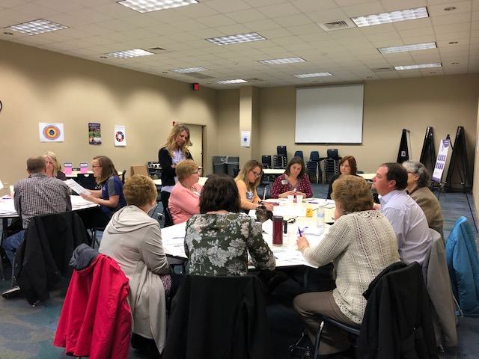
Results of March
Community Conversations About Health
About 250 people in attendance
Including:
  Extension (FCS, CV, ANR, and 4-HYD)
  Health Departments
  Local Health Coalition Members
  Extension Board and PDC Members
  Wide variety of other stakeholders

Slide 12
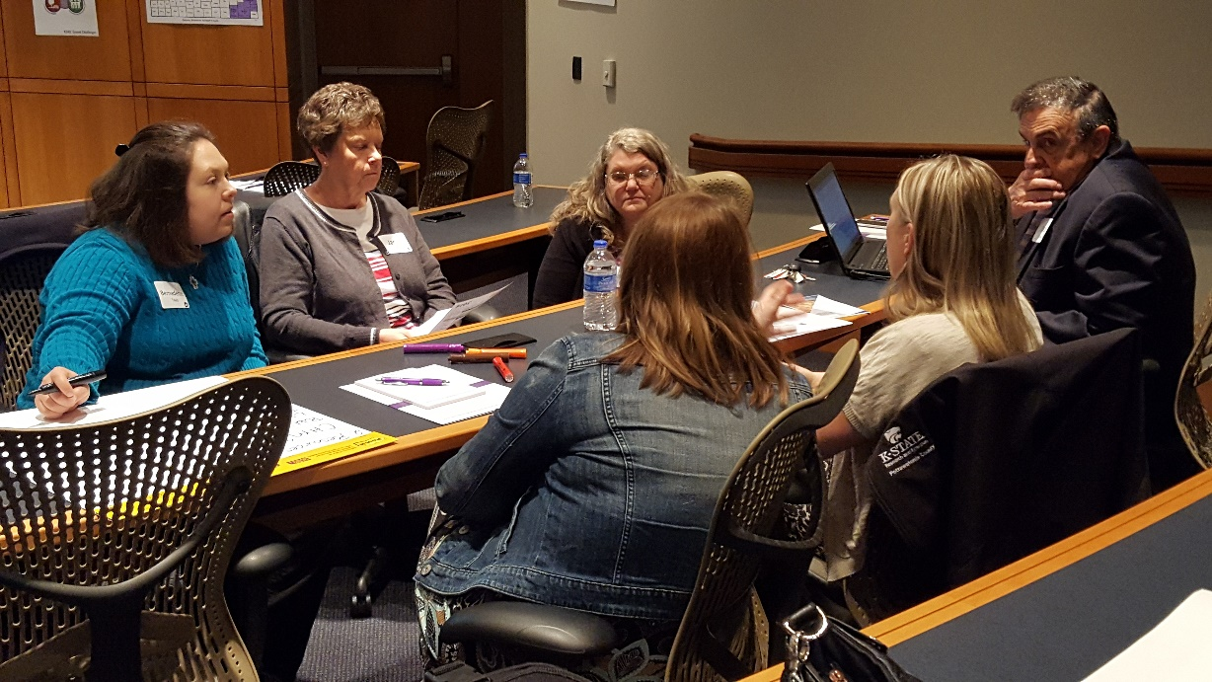
Community Conversations About Health
Discussion Topics
  Local health concerns
  Current resources
  Greatest local needs
  Partners
  Goals

Slide 13
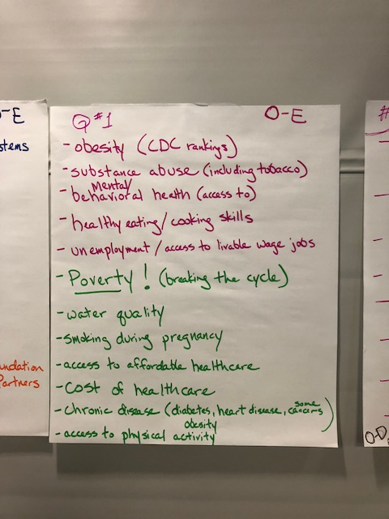
Community Conversation Results… Concerns
Physical Health
    Obesity
    Diabetes
    Cancer
    Heart disease
    Dental
Mental Health
    Farm stress
    Suicides
    Addictions
Access
    Health care
    Nutritious foods
    Healthy environments
Finances
    Poverty
    Health insurance and care
Cultural and language differences

Slide 14
Community Conversation Results… Resources
Food banks and pantries
Shelters
Pathways grants
Council on Aging
County Health Department
County mental health resources
Churches
Recreation programs
Health coalition
Hospitals and clinics
Media
Early childhood groups
Schools
Law enforcement
Non-profits
Resource directories
Data
Nursing care facilities
Volunteers
Circles and Thrive programs
Community Foundations
Community gardens and farmer’s markets
Summer meal programs
Senior centers and meal sites
Extension programs
  SHICK, EFNEP/SNAP-Ed, Walk Kansas, Dining with Diabetes, Stay Strong, Stay Healthy
Parks and walking trails
Businesses
KansasWorks
KDHE, DCF, other agencies
Thrift stores
FCE
KS Ag Mediation
KS Health Foundation
Corporate partners
BCBS
Local policy makers
Live Well
YMCA
Guidance centers
Youth
KU Med, Children’s Mercy
Public libraries
Food councils
Meals on Wheels
Salvation Army and Goodwill
Disability support services
Housing programs
WIC

Slide 15
Community Conversation Results…
Greatest Local Needs
Resources
    Time, people, coalitions
    Funding
    Facilitators
    Partners (including DCF, chambers, )
    Volunteers
    Leadership
    Advocacy with Ext. Bds and local officials
    Community health assessments and data
    Involve youth and low income
    Community health workers
    Public buy-in
    No food tax
    Medicaid expansion
    Transportation
    Mind shifts
Topics
    Mental health
    Access to food (gardens, grocery stores, farmer’s markets, etc.)
    Housing
    Technology
    Physical activity, including walking paths
    Elder care
    Essential living skills (esp. cooking)
    School and worksite wellness
    Job preparation skills
    Addiction prevention
    Diabetes prevention and education
Training
    Cultural awareness
    Relationship training
    Grant writing
    Poverty training
    PSE Training (Extension and community)
    Mentor training

Slide 16

KSRE Culture Of Health Toolkit
www.ksre.k-state.edu/fcs/cultureofhealth.html

Slide 17
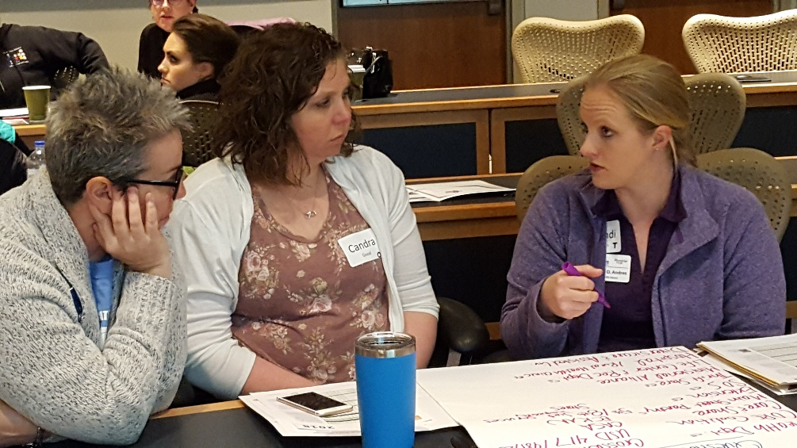
KSRE Culture Of Health Toolkit
Purpose and objectives for conversations
Planning for local community conversations
  Identifying/convening the leadership team
  Understanding roles
  Determining goals and agenda for the conversation
  Determining the questions
  Building a timeline
  Picking a venue
  Inviting the audience
  Creating an inviting, comfortable space
  Facilitating
  Evaluating
  Determining next steps and follow-up

Slide 18
KSRE Culture Of Health Community Grants
Culture of Health
Health flourishes for all
Health is a social value
Healthy environ-ments
Health care doesn’t burden the economy
We make proactive healthy choices
Health care is available to all
RFA is out
  Funding to local Extension offices
    Up to $5000 for counties
    Up to $10,000 for districts
  Purpose is to advance the
  Culture of Health

Slide 19
KSRE Culture Of Health Community Grants
Culture of Health
Health flourishes for all
Health is a social value
Healthy environ-ments
Health care doesn’t burden the economy
We make proactive healthy choices
Health care is available to all
Timeline:
  Proposals due Nov. 1
  Awards announced by Dec. 5
  Funding available in January
  Projects begin in February
  Can be up to 24 months

Slide 20

KSRE Culture Of Health Community Grants
Criteria:
  Contributes to KSRE Grand Challenge of Health
Culture of Health
Health flourishes for all
Health is a social value
Healthy environ-ments
Health care doesn’t burden the economy
We make proactive healthy choices
Health care is available to all

Slide 21
KSRE Culture Of Health Community Grants
Criteria (continued.):
  Addresses a *community need
  *Promotes PSE supporting health
  Clear objectives/intended outcomes
  Direct-ed is research/evidence based
  Multidisciplinary team/coalition
  Reasonable time line
  Letters of commitment/support
  Reasonable and specific budget
  Signatures of supervisor/regional director/board chair
Culture of Health
Health flourishes for all
Health is a social value
Healthy environ-ments
Health care doesn’t burden the economy
We make proactive healthy choices
Health care is available to all

Slide 22
KSRE Culture Of Health Community Grants
Allowable use of funding:
  Recruitment of coalition members
  Promotion and marketing
  Office supplies and materials (no equipment)
  Event costs, including space and transportation
  Curriculum purchases (only evidence-based)
  Training relevant to project
  Travel to obtain training relevant to project
  Food and non-alcoholic beverages for meetings or education
  Match for other funding
  Other, with approval
Culture of Health
Health flourishes for all
Health is a social value
Healthy environ-ments
Health care doesn’t burden the economy
We make proactive healthy choices
Health care is available to all

Slide 23
KSRE Culture Of Health Community Grants
Preference will be given to those who attended the March conversations and/or have completed a local conversation about health since then.
There is still time to do one, if you haven’t!
Culture of Health
Health flourishes for all
Health is a social value
Healthy environ-ments
Health care doesn’t burden the economy
We make proactive healthy choices
Health care is available to all

Slide 24
Culture of Health
Questions?
Culture of Health
Health flourishes for all
Health is a social value
Healthy environ-ments
Health care doesn’t burden the economy
We make proactive healthy choices
Health care is available to all

