Slide 1
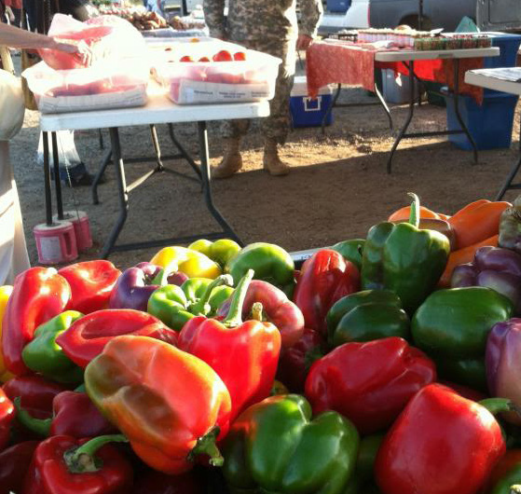
Simple Seasonal Meals
Donna Krug
Barton County Family and Consumer Sciences Agent
2016 FCS Series – K-State Research & Extension

Slide 3
Why eat seasonally?
By Choosing fruits and vegetables in season you get all of the benefits- food that tastes good, is good for you, and is reasonably priced.

Slide 4
How far does produce travel from farm to table?
A. 500 miles
B. 800 miles
C. 1,500 miles
D. 2,000 miles

Slide 5
This is cause for concern
In most cases, the farther your produce travels the less nutritious and tasty it is by the time you eat it.
Even though the grocery store appears to have a wide variety of produce options available, their focus is on varieties that travel well and have a longer shelf life.
Needlessly transporting produce all around the globe wastes natural resources and harms the environment

Slide 6
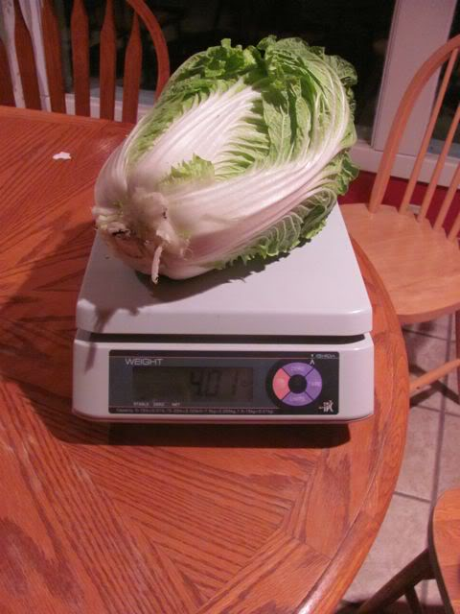
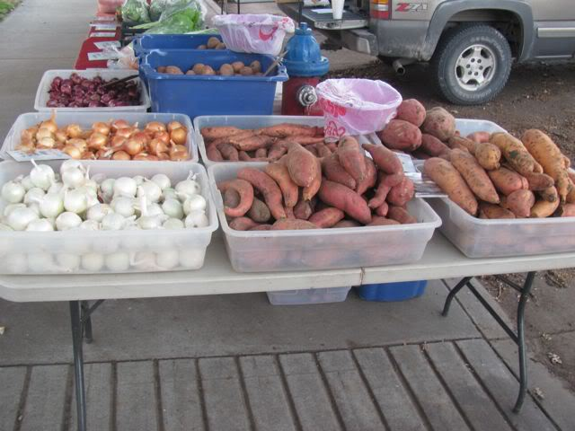
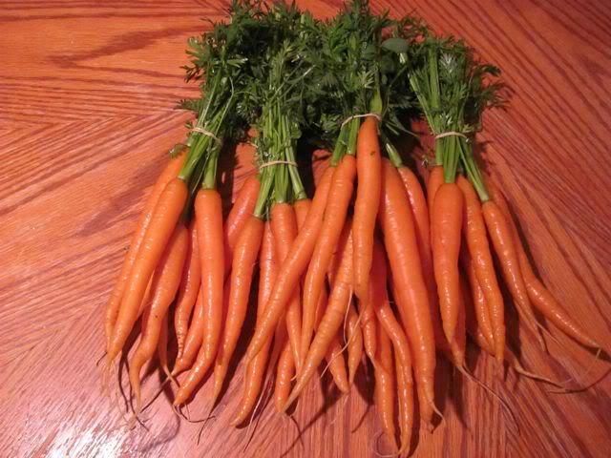
“Buying locally grown and in season produce has many benefits. Nutritionally, you get more ‘Bang for your Buck.’ Choosing to buy from your local farmers market allows you to purchase food that was picked in the last few days, if not hours, and is at its peak quality. Eating seasonally and locally gives you a broader variety of foods in your diet.
Who knew watermelon radishes were so good or carrots could taste like candy in the wintertime? Finally, it is just fun to try new foods that you may not have tried before”.
(Jay Sleichter, Jay’s Jellies, Produce and More, north central Kansas)

Slide 7
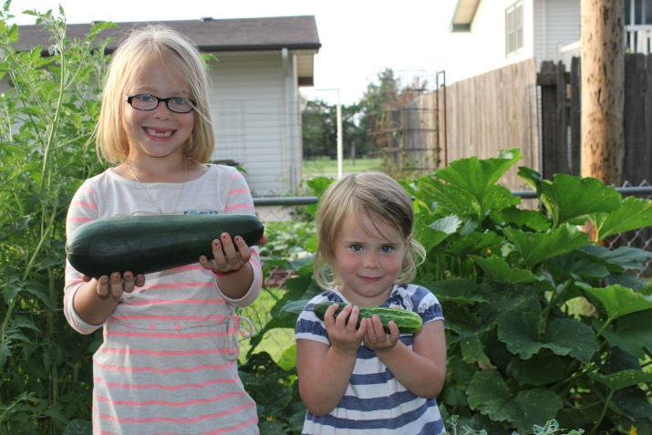
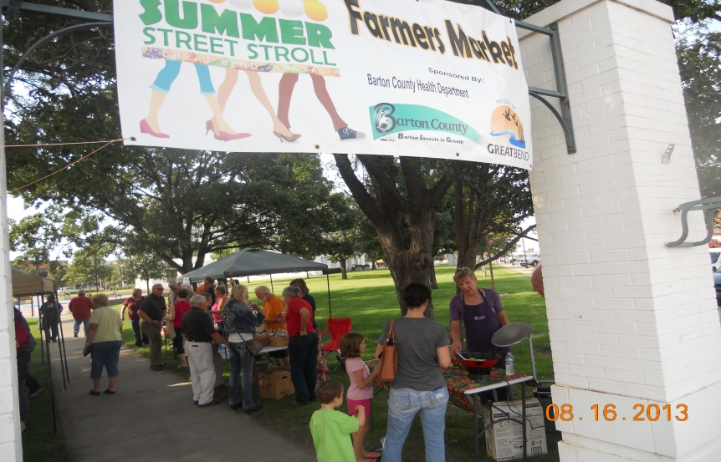
Options for eating local
Grow your own garden
Participate in a community garden
Join a CSA (Community Supported Agriculture)
Visit the farmers market

Slide 8
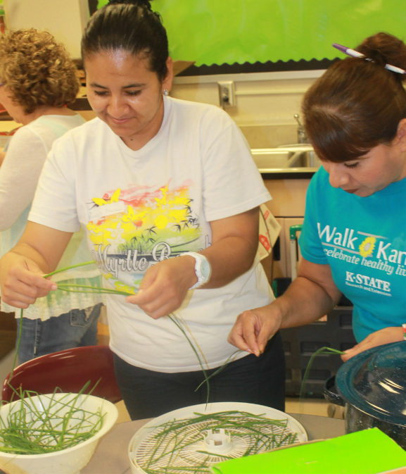
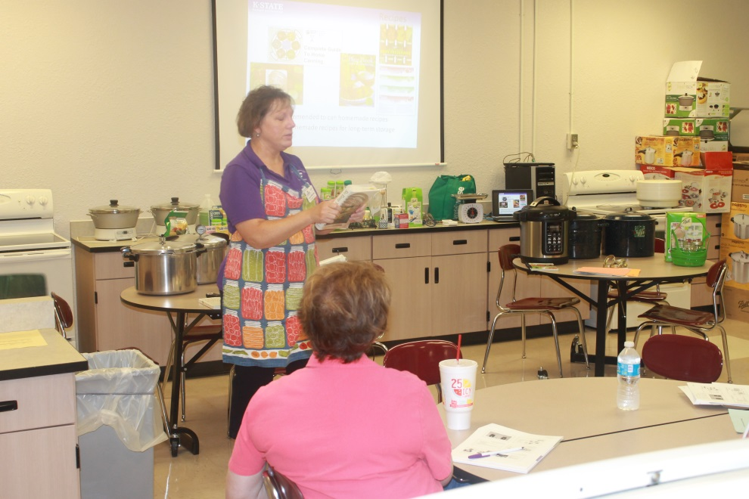
Preserve the Harvest
Adding home grown products adds flavor to Winter dishes
Preserving items in season saves money

Slide 9
Seasonal Recipes
“Working with fresh produce – chopping, mincing, slicing – can be renewing and nourishing, for those who partake of the results, as well as for those who prepare the recipes.”
Nancy O’Connor
Rolling Prairie Cookbook

Slide 10
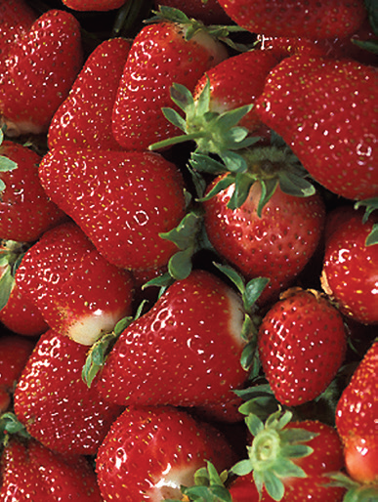
Spring Has Sprung!
Asparagus and a variety of salad greens are the first produce available in Kansas. Enjoy these Spring recipes:
Marinated Pasta and Asparagus Salad
Spring Strawberry Spinach Salad

Slide 11
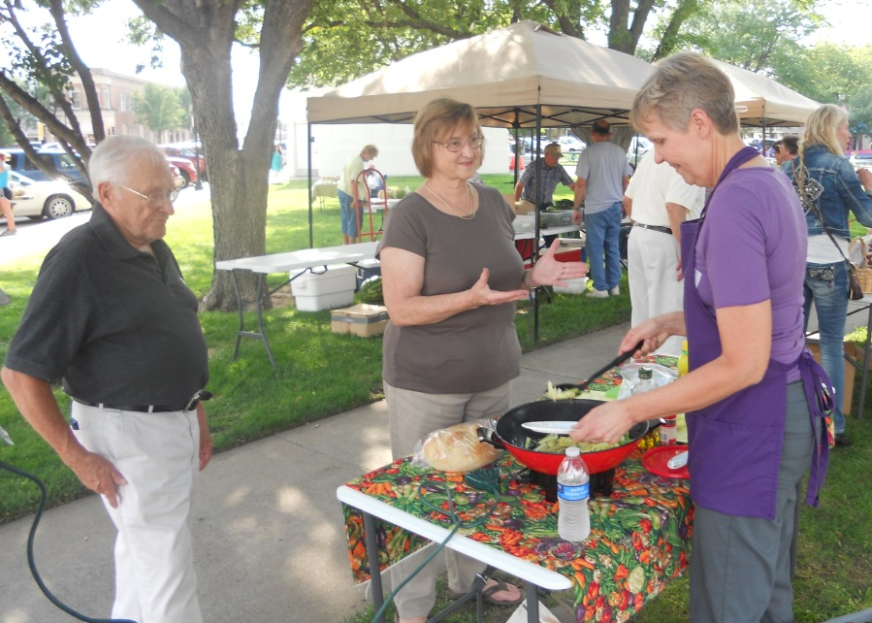
Summer Sensations
Summer menus highlight locally grown produce as much as possible. Try one of these recipes for a cool treat:
Sweet Melon Salsa
Frosty Cantaloupe Smoothie
Pasta with Spicy Summer
Vegetables

Slide 12
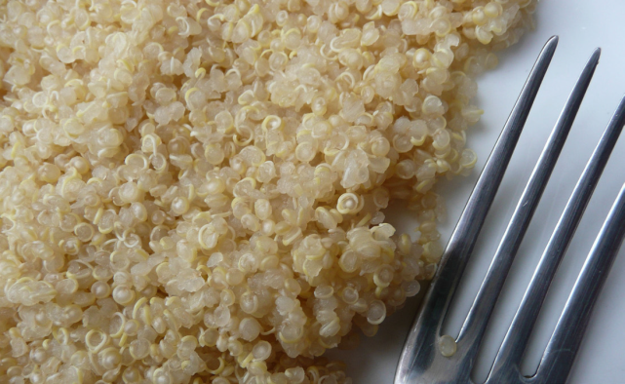
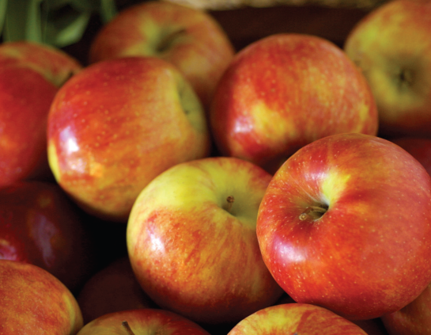
Fall Splendor
The fall menu is full of colorful root vegetables, making for some tasty dishes. Add these recipes to your fall menu:
Aztec Grain Salad
Quick Grated Beets
Simple Preparation of Greens
Gingered Apple Crisp
Vegetarian Groundnut Stew

Slide 13
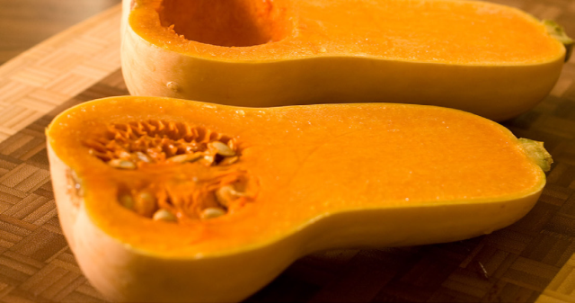
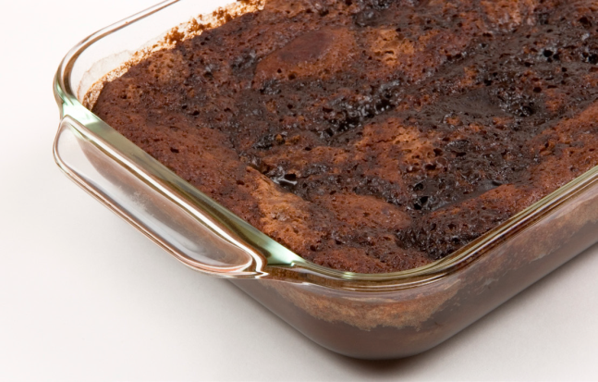
Winter Comforts
You can still take advantage of seasonal vegetables and incorporate nutritious ingredients into winter favorites.
Short Grain Brown Rice with Squash
Harvest Delight
Secret Chocolate Cake

Slide 14
Recipes that span the Seasons
An excellent Harvest Calendar for Kansans is available at: http://growinglawrence.org/harvestcalendar.html

Slide 16
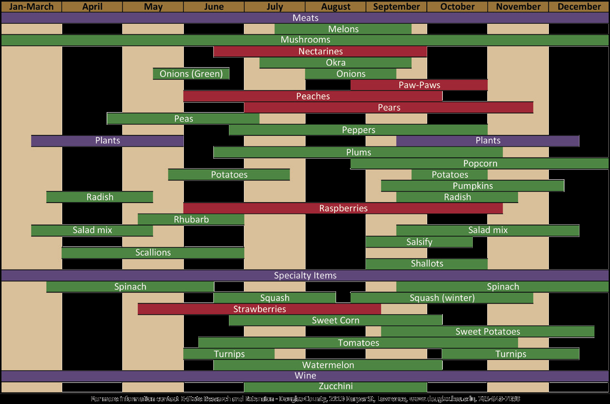

Slide 17
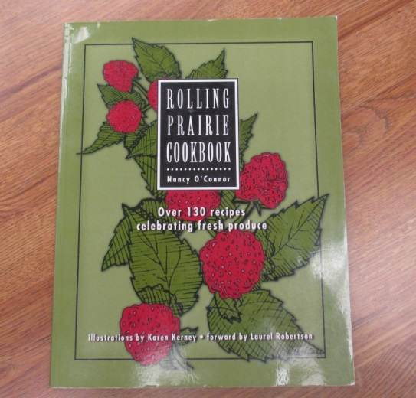
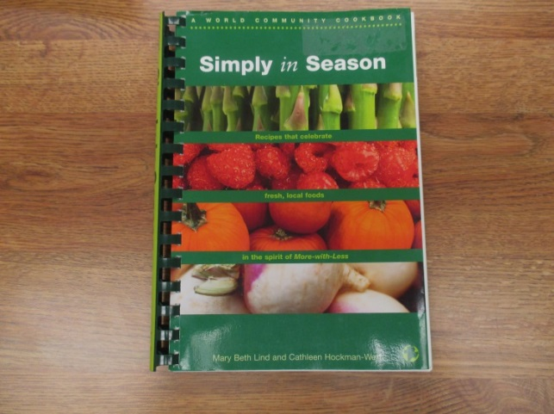
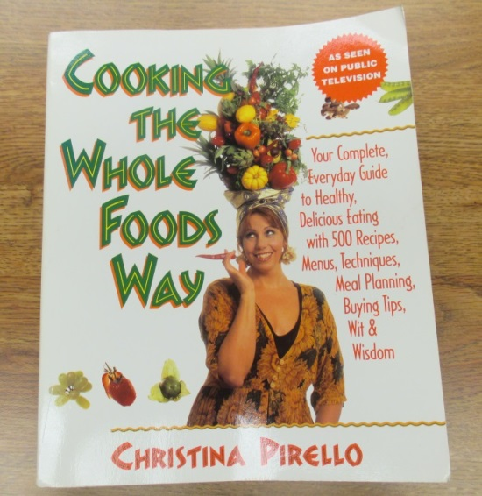
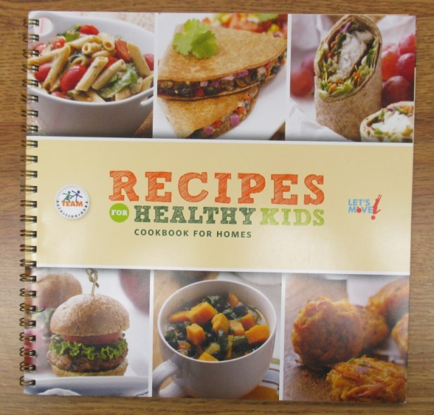
Recipe Sources

Slide 18
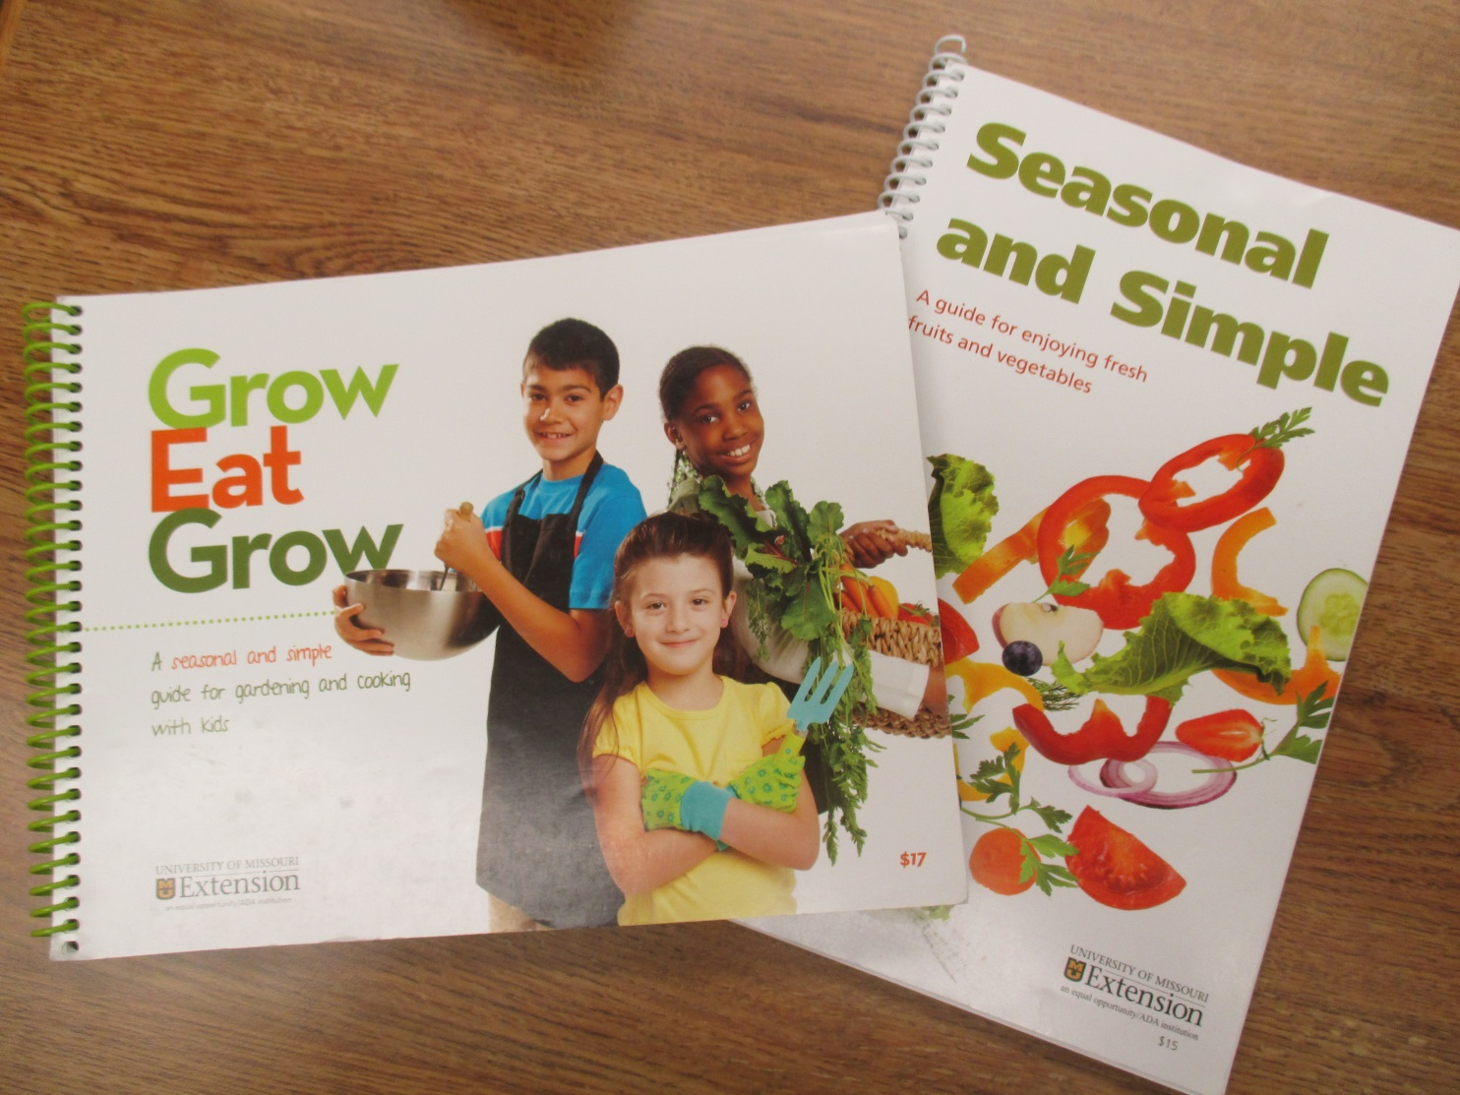
Additional Resources

Slide 19
Material adapted from Simple Seasonal Meals, fact sheet and leader’s guide:
Publications from Kansas State University are available at: www.ksre.ksu.edu
Publications are reviewed or revised annually by appropriate faculty to reflect current research and practice. Date shown is that of publication or last revision. Contents of this publication may be freely reproduced for educational purposes. All other rights reserved. In each case, credit Donna Krug, Simple Seasonal Meals, Fact Sheet and Leader’s Guide, Kansas State University, July 2014.
Kansas State University Agricultural Experiment Station and Cooperative Extension Service
K-State Research and Extension is an equal opportunity provider and employer. Issued in furtherance of Cooperative Extension Work, Acts of May 8 and June 30, 1914, as amended. Kansas State University, County Extension Councils, Extension Districts, and United States Department of Agriculture Cooperating, John D.Floros, Director.
MF3217 and MF3218 August 2015

