Slide 1
Know Yourself, Understand Others, Improve Relationships FCS Update August 24, 2015
Debra Bolton, PhD
Family and Consumer Sciences
Kansas State University Research Extension

Slide 2
Purpose
Explore patterns of traditions
Cultural patterns and their affect on communication
Self-Identification of biases that interfere with communication
Help to improve comfort in building relationships

Slide 3
What’s In Your Name
Pick your first, middle, or last name
Does it have a story?
How does it relate to your identity?
Tell us about it.

Slide 4
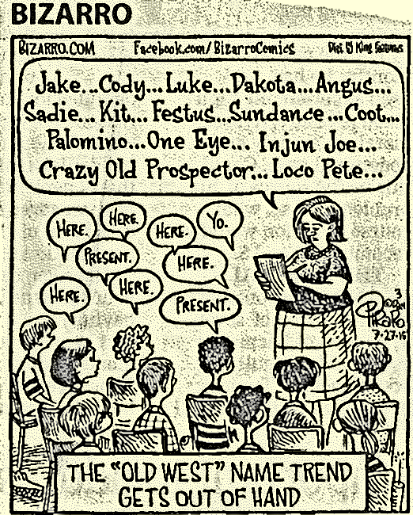

Slide 5
What is Diversity?
Difference
Human
Physical
Belief Systems
Geography
Intellectual
Language

Slide 6
What is culture?
The lens through which we view the world
Lets us know how to act within that realm
Human identity
All humans belong to a culture

Slide 7
Where do we get our cultures?
Our Families – Historical Allegiances
Our work
Our associations
Our hobbies
Our faith communities & other belief systems
Anything we do that gathers us with other people
Name a cultural practice from ancestor

Slide 8
What are the levels of influence?
Broad ideas, laws, social class, other cultures
Mass media, work environment, community
Immediate influences: Family, Friends, Social networks
YOU!
Genotype
Knowledge
Beliefs
Experiences

Slide 9
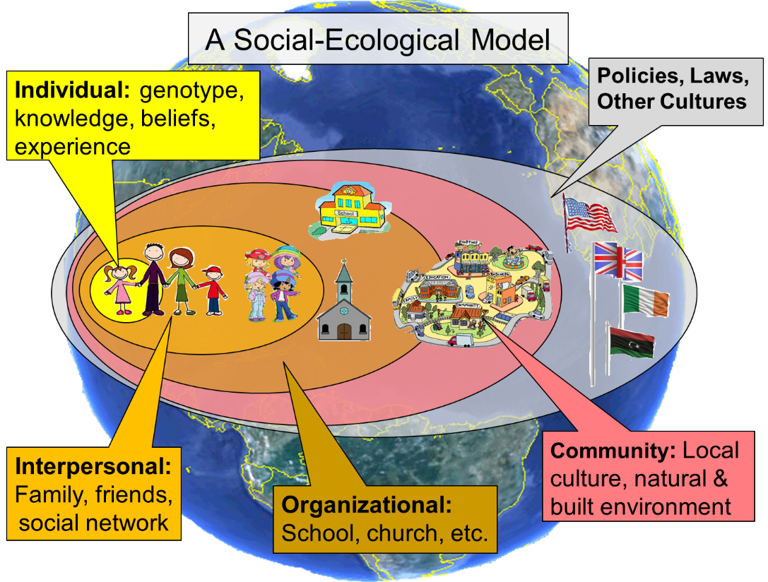

Slide 10
The Questions of Cultural Patterns
Human nature?
Humankind to nature?
Time orientation?
Value placed on activity?
Relationship of people to each other?

Slide 11
Across Cultures – Human Nature
Basically Evil
Intrinsically Evil
Puritan Ancestry
Extreme: humans can’t be trusted…
Mixture of Good/Evil
Cannot eliminate: natural part of world
Dual approach
Basically Good
Extreme: Buddhism/Confucianism
People are good: culture makes evil
Fate vs. intellect

Slide 12
Across Cultures: Humans & Nature
Subjugated
Powerful forces outside of control
Stoically accept
“not that it matters”
Harmony
Part of life
American Indn
“mother earth”
“All things connect
Master of Nature
Conquer/direct to our advantage
“Tame it”
Clear separation from nature?
Dominance of space
Structuring of Markets
Buyer influence

Slide 13
Across Cultures: Time Orientation
Past:
History
Traditions
Religion
Ancestors
Guide future
Present:
Future is vague
“We don’t know the future/not that interested in the past”
Real exists here and now
Future:
U.S. Dominant
What is going to happen
Control future?

Slide 14
Across Cultures: Activity Orientation
Being:
People/events/ideas flow spontaneously
Work for the moment
Simple act of conversation
Being-in-Becoming:
Development & growth
Spiritual life
Emotional vitality
Doing:
Accomplishments measured
Activity & Action
Dominant in U.S.
Not as much patience to “sit & talk”
Life in constant motion

Slide 15
Across Cultures: Social
Authoritarian:
“Born to lead”
Others must follow
Widespread perception that it is the “norm”
Collective:
Group most important
Often passive
“Don’t draw attention to oneself”
Individual:
U.S. Constitution
“equal rights”
Control over one’s destiny
All else “violates will of God”

Slide 16
What else does this mean?
Semantics
Geographical Regions
Culture (ethnic, socio-economic, religion, etc.)
Gender
Mother tongue
Discipline (job)
Family

Slide 17
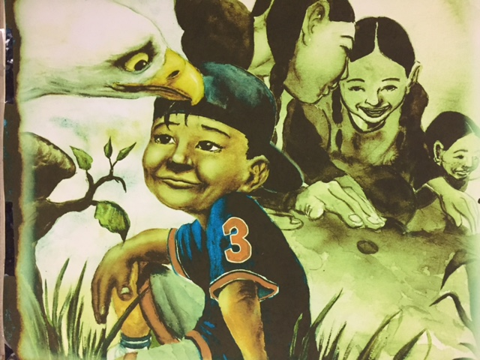

Slide 18
Personal Biases
We like what we know
We judge the world around us based on what we know
We may look at difference as “wrong”
We can to take it “personally.”
“It’s hard to look at others objectively.”

Slide 19
Tolerance Scale
Appreciation
Acceptance
Tolerance
Avoidance
Repulsion
(Marofsky, 2008)

Slide 20
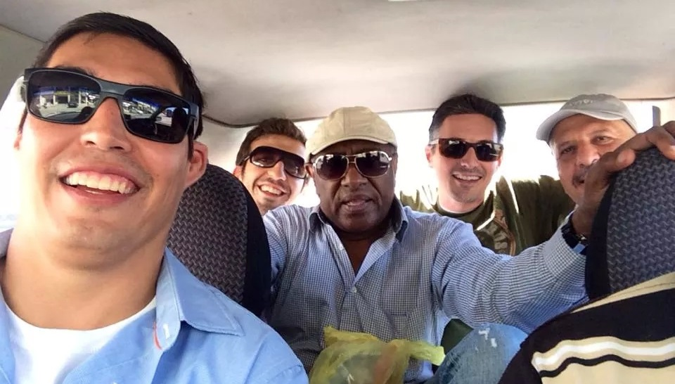
American Indian, Syrian, Sudanese, Turk, & Iraqi
…Riding around somewhere in the Middle East
Notes:
American Indian, Syrian, Sudanese, Turk, and Iraqi. (“Good for the soul to be sharing with an educated and diverse group”.)

Slide 21
Judgment Language
“They are not like us.”
“They don’t have our values.”
“We invited them, but they’re not interested, so they don’t come.”
“They just don’t care about doing better.”
“We need to show them how it’s done.”
“Those people on food stamps eat nothing but junk food.”

Slide 23
“The single biggest problem in communication is the illusion that it has taken place.”
-- George Bernard Shaw,
Irish Playwright and Likable Curmudgeon

Slide 25
Communication
“Did you say what I think you said?”
Generational
“How do you ‘hear’ me?”
What factors might impede communication?
Let’s discuss…

Slide 26
Generation Timeline
1922-1945 Veterans, Silent, Traditionalists | 1946-1964 Baby Boomers | 1965-1980 Generation X GenX, Xers | 1981-2000 Gen Y, Millennial, Echo Boomers
Respect for Authority | Optimism Involvement | Skepticism Fun Informality | Realism Confidence Extreme fun Social
Traditional Nuclear | Disintegrating | Latch-key kids | Merged Families
A Dream | A Birthright | A way to get there | An incredible expense
Rotary Phones One-on-One Write a memo | Touch-tone phones Call me anytime | Cell phones Call me only at work | Internet Picture phones E-mail
Put it away Pay Cash | Buy now, pay later | Cautious Conservative Save, save, save | Earn to spend

Slide 27
New words in Lexicon

Slide 28
What are the challenges?
Do you understand yourself?
Do you try to make others’ ideas fit with yours?
How does that work?
What can we do to make it better?
Are you willing to look at difference as asset?
Let’s discuss some ideas…

Slide 29
Advantages
Cultural pluralism
Integration
Cohesive communities
Improved well-being for all

Slide 31
Build Relationships
Volunteer your time
Be deliberate about learning from others
Put a human face on those you don’t understand or fear
Be an empiricist
Remember that difference is just difference
Observe mindful value comparisons

Slide 32
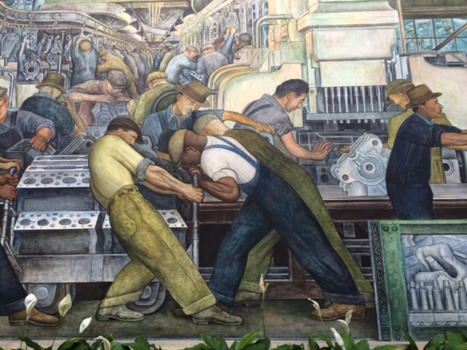
It’s the mindful value comparisons…

Slide 33
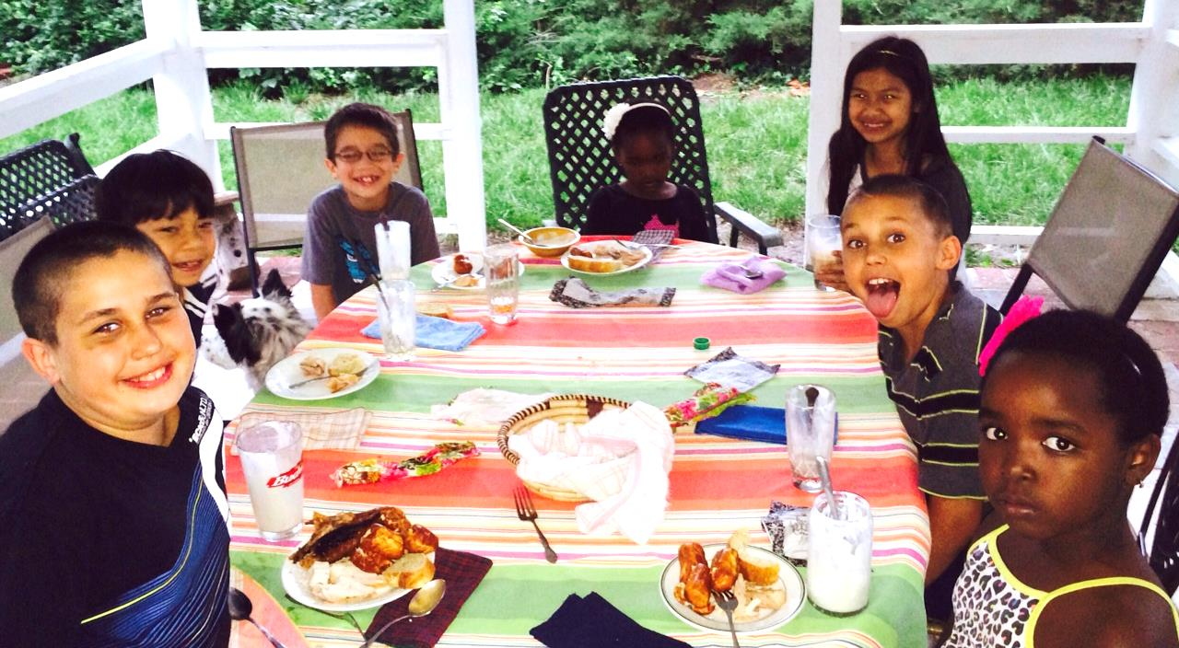
Questions?
Kiddie UN!

Slide 34
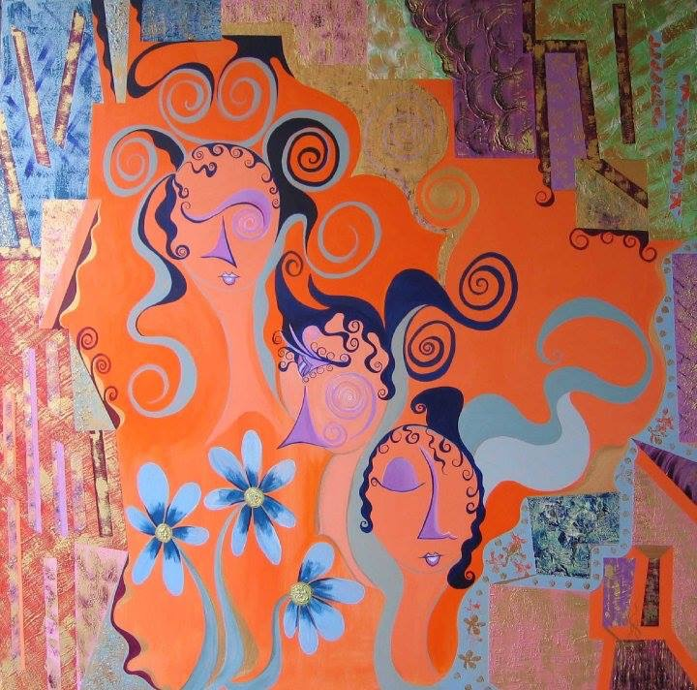
Did this lesson challenge
your way of Knowing/Thinking?

Slide 35
References
Bronfenbrenner, U. (1979). The ecology of human development. Cambridge MA: Harvard University Press.
Deen, M. Y. Extension Youth and Family Specialist, Wenatchee, Washington mdeen@wsu.edu
Karp, Hank; Fuller, Connie; Sirias, Danilo. Bridging the Boomer Xer Gap: Creating Authentic Teams for High Performance at Work. Palo Alto, Calif.: Davies-Black Publishing, 2002.
Samovar, L.A.; R.E. Porter; E. R. McDaniel. (2004). Communication between cultures, 5th ed. Belmont, CA: Wadsworth.
Ting-Toomey, S. (2005). Understanding intercultural communication. Los Angeles: Roxbury.
Walston, Sandra Ford. Distinguishing Communication Approaches Across Generations, 1999 (online publication), http://www.walstoncourage.com/pages/articles/generation.htm.

