Slide 1
Get Financially Prepared:
Take Steps Ahead of Disaster
Family Resource Management PFT members:
Diane Burnett, Miami County
Valeria Edwards, Johnson County
Rhonda Gordon, Lyon County
Jamie Rathbun, Ellsworth County
Cindy Williams, Meadowlark District
Deb Wood, Geary County

Slide 2
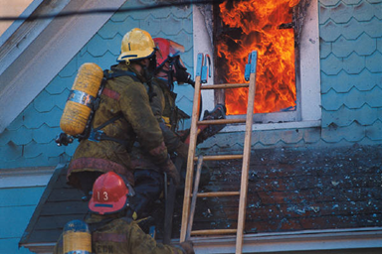
Would you be prepared to take action if you were in a disaster situation and needed to immediately take shelter or evacuate your home?
Fire
Tornado
Flood
Hurricane

Slide 3
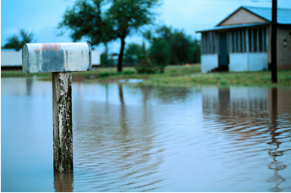
Read over the List for a Basic Emergency Supply Kit.
Would you add anything else?
Share your thoughts with someone else in the room.

Slide 4
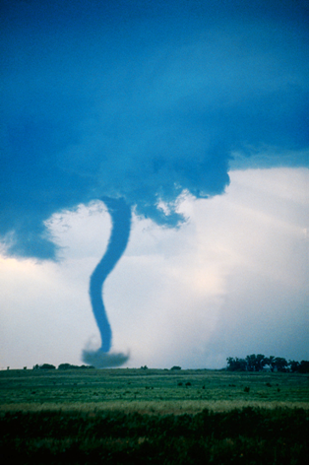
To be prepared, you should also
Have a household inventory
Check your insurance coverage
Prepare a grab-and-go box for
important documents
The second side of your paper includes a list for Financial Emergency Preparedness and what to put in your grab-and-go box.

Slide 5
Prepare a Household Inventory
What is a household inventory?
An itemized list of your belongings in:
Home
Basement
Attic
Garage
Storage facilities (on- & off-site)

Slide 6
Prepare a Household Inventory
Do I need a household inventory?
YES!!!
A household inventory is critical before and after a disaster. It is just as vital to your home as smoke detectors, fire extinguishers, dead bolt locks and extra pantry goods.

Slide 7

Prepare a Household Inventory
When will I need a Household Inventory?
Burglary
Vandalism
Fire
Natural Disaster
The inventory helps ensure that you will be able to repair or replace your damaged belongings.

Slide 8
Prepare a Household Inventory
What is the purpose of a household inventory?
Provides proof of items you owned
Helps establish the value of items
Fulfills requirements for insurance claim
Reduces stress during chaos

Slide 9
Prepare a Household Inventory
How do I start?
Photograph/video tape every wall in each room of your home and storage areas
Open closets, cabinets, cupboards, and drawers to document their contents
Take close-ups of unique and expensive items to show their existence and condition
Date the photographs
Narrate the video

Slide 10
Prepare a Household Inventory
Be sure to include:
Original receipts showing price, date, and place of purchase
Current value
Serial and model numbers from product manuals
Alterations or repairs done to the item(s) and their expense, especially if it increases the value
Not necessary to list finance or shipping costs

Slide 11
Prepare a Household Inventory
Special considerations for special items
For antiques, original works of art, jewelry:
Expert’s appraisal
Insurance “floater” or “rider” to fully insure each item

Slide 12
Prepare a Household Inventory
Be sure to include:
China, crystal, silver
Linens
Clothing
Collections
Tools
Electronics and electrical appliances
Office equipment
Recreation and equipment
Items normally stored in the garage basement or out-buildings
Personal items stored off-site (i.e. school/gym lockers, etc)

Slide 13

Prepare a Household Inventory
Where do I keep it?
Keep a working copy (paper or electronic) in your home file
Keep one copy away from the insured dwelling
  In a safe deposit box
  With a trusted person
  Stored on-line, so that it can be accessed from computer

Slide 14
Prepare a Household Inventory
Update! Update! Update!
Remember to keep all copies up-to-date and compare them on a semi-annual basis
Update the inventory when items are acquired or discarded

Slide 15
Review Your Insurance Coverage
Check your insurance at least annually to verify you have adequate coverage
Set aside emergency funds to cover the policy deductibles
Keep the name/policy number(s) in your grab-and-go box

Slide 16
Review Your Insurance Coverage
Homeowner’s Insurance
Protects your home and contents
Need even if home is not mortgaged, to protect investment
Home and furnishings should be insured for at least 80% of replacement cost
Contents should be covered for replacement cost instead of actual cash value
Know what type of disasters your policy covers
May also cover temporary living expenses

Slide 17
Review Your Insurance Coverage
Auto Insurance
Comprehensive pays for damage to your auto resulting from acts of nature (windstorm, fire, hail)
Do you have funds to cover
the deductible?

Slide 18
Review Your Insurance Coverage
Disability Insurance
During a disaster you may be injured and can no longer work
Your income stops but expenses continue
Short-term disability policy may cover for a defined period or until you return to work
Long-term disability policy could replace 60-70% of monthly income until retirement
Know how your policy defines a “disability”

Slide 19
Review Your Insurance Coverage
Life Insurance
Needed if someone dies as a result of a disaster, to be able to pay bills
75% of current household income needed to replace the wage earner
Review policy as family needs change
Life insurance calculator to help determine coverage needs, www.choosetosave.org/calculators

Slide 20
Create a Grab-and-Go Box
Step 1-
Place papers in sealed, waterproof plastic bags
Store in a durable, sealed box (a portable, fireproof and waterproof box or waterproof backpack is recommended)
Step 2-
Store box at home in a secure, easily accessible location
Notes:
Are you prepared to evacuate quickly with important documents if disaster strikes? Natural disasters can strike suddenly. Taking time now to assemble important papers in a box that is safe and ready to go at a moment’s notice can save a lot of time and frustration in the event of a fire, storm, or flood. Prepare now by creating a portable file you can grab and go.
Be sure to store this in a place in your home that you can grab quickly, but not so visible that a thief could easily take it.

Slide 21
Create a Grab-and-Go Box
Step 3-
If you must evacuate:
  Grab box and take with you
  Keep the box with you at all times
  Do not leave box unattended in your car

Slide 22
Create a Grab-and-Go Box
Items to include
Cash for several days living expenses
Rolls of quarters
Emergency phone numbers
Back-up copies or computerized financial records
Keys to safe deposit box
Combination to safe
Negatives/electronic backups for irreplaceable personal photos
Computer user names and passwords
Notes:
Items to keep in your box or backpack include…
Emergency phone numbers would include numbers for
doctor and pharmacy
Financial institutions
Insurance companies
Credit card companies
Minister
Repair contractors
Family / Friends
Workplace
Schools
Computer access – passwords to get on your computer and access any online banking or credit card accounts to pay your bills

Slide 23
Create a Grab-and-Go Box
Include copies of:
Deeds
Titles
Wills and/or trust documents
Home inventory
Employee-benefit documents
Passports and other identity documents
Military service records
Durable power of attorney
Healthcare directives
First two pages of previous year’s federal and state income tax returns
Stock and bond certificates
Recent investment statements
Birth, death, adoption and marriage certificates
Notes:
Note that originals of most of these documents should be stored in a safe deposit box, along with other valuables.
Home inventory – paper and electronic copy is recommended

Slide 24
Create a Grab-and-Go Box
List of numbers
Social security
Bank account(s)
Loan
Credit card
Driver’s license
Investment account

Slide 25
Create a Grab-and-Go Box
Also include:
Copies of important papers
Copies of immunization records
Copies of health, dental and/or prescription insurance cards or numbers
Copies of homeowner’s or renter’s, auto, disability, life, flood insurance policies (at least policy number)
Insurance company telephone numbers, including local agent and company headquarters
List of debt obligations, due dates and contact

Slide 26
After a Disaster
Family and friends can help you with:
Witnessing the damage
Photograph-/videotaping the damage
Providing access to telephone, office, other facilities
Errands: faxing, copying
Storing valuables, important papers
Providing moral support and humor
Providing temporary food, clothing, lodging

Slide 27
After a Disaster
Know that several groups will be collecting information directly after a disaster
United Way
Red Cross
Salvation Army
Insurance
Those working with Emergency Management

Slide 28

After a Disaster
Document the Disaster
What happened?
When did it happen?
What damage was sustained?
What are the cost of repairs?
Carry a notebook. Document who you talk to and what you agree upon.

Slide 29
After the Disaster
Receipts: Keep Them!
From emergency service providers and purchases related to the disaster (food, clothing, lodging).
Keep check stubs from vouchers you may receive from disaster assistance agencies.
All are necessary for tax and insurance purposes.

Slide 30
Get Financially Prepared:
Take Steps Ahead of Disaster
Thank you for participating in an educational program sponsored by your local K-State Research and Extension office. Help us report the impact of this program by completing this feedback form.
Please provide your contact information, if you are willing to provide 30-60 day follow-up information about the actions you have taken as a result of this program.

Slide 31
Brand names appearing in this publication are for product identification purposes only. No endorsement is intended, nor is criticism implied of similar products not mentioned.
Contents of this publication may be freely reproduced for educational purposes. All other rights reserved. In each case, credit Family Resource Management Program Focus Team, Get Financially Prepared: Take Steps Ahead of Disaster, Kansas State University, August 2012.
Kansas State University
Agricultural Experiment Station
and Cooperative Extension Service
K-State Research and Extension is an equal opportunity provider and employer. Issued in furtherance of Cooperative Extension Work, Acts of May 8 and June 30, 1914, as amended. Kansas State University, County Extension Councils, Extension Districts, and United States Department of Agriculture Cooperating, John D. Floros, Director.

